Slide 1
Study Startup The Treasure Map
Nicole Kressin, MSN, RN

Slide 2
Study Startup Steps
Phase 1
Confidentiality Agreement (CDA)
Phase 3
Submit to committees
Phase 4
Regulatory documents
Financial disclosures
FDA 1572
Clinicaltrials.gov
Phase 2
Feasibility
Contract to DSP via UIRIS
Create internal and external budget
Consent/Record of Consent

Slide 3
Study Startup Steps
Final Step: Submit to IRB!

Slide 4
Phase 1

Slide 5
Meet Dr. Redbeard
Your PI, Dr. Redbeard receives an email from Parrot Pharmaceuticals asking if our site is interested in participating in a new study titled “A Multicenter Phase III Study to Evaluate the of the Efficacy of Parrotripsen for Improving Health Outcomes and Lifespan in Pirates.”
The sponsor has included a feasibility form to be completed by the coordinator and returned to them in 3 business days.
Dr. Redbeard replies to the sponsor that he is interested and tells you to take it from there. What do you do next?

Slide 6
What do you do?
Fill out the feasibility form, have your PI sign on the PI signature line, and send it back to the sponsor within 3 business days.
Ignore the form because today is food truck day, and the form looks like a lot of work.
Determine how detailed the form is- if it requires specifics or looks very time consuming, you may need a CDA first.
D. All of the above.
E. Only A and C.

Slide 7
First: Get Organized!
Study startup is a long, labor-intensive process that can take months.
You will be filling out many, many different forms and working with many different people.
Before you start, create the following:
A checklist of forms to be completed
A list of contact info for everyone involved with the study
Electronic and hard copy folders for study documents
Notes:
You can email me for an example of the study startup checklist. I always saved my contact info on the shared drive, as you never know what will happen and someone will have to take over your study suddenly. That info should be easily accessible to anyone who may need it. If lost, your PI will be held responsible.

Slide 8
First: Get Organized!
Make sure to save electronic copies of EVERYTHING in a secure location.
Shared drive folders
Organize your folders so you and others can find things easily!
You will also need paper copies of many of these forms for your reg binder. Some coordinators prefer to keep copies of all forms.
Notes:
Email me for an example folder structure to help you organize your electronic files. You do not want to waste time hunting for important documents that could be easily found if you take the time to organize yourself up front. I also always kept a separate “financial” binder for internal forms that do not go in the reg binder. This is for your team’s information only and will not be reviewed during monitor visits. Nice to have in case access to electronic copies is ever lost. This happened to me and I had nothing for an old study! Other tips: do not password protect your documents! You can use permissions in shared folders instead.

Slide 9
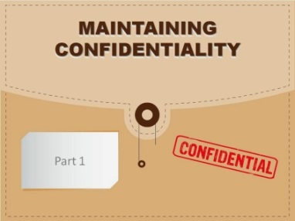
Phase 1: CDA
Confidentiality Agreement (CDA): This is a legal agreement between the University of Iowa and the study sponsor that outlines what information the parties wish to share with one another, but wish to restrict from wider use.
A CDA protects you, your PI and the university from future litigation, thus it is imperative that it be routed through the proper channels for review.

Slide 10
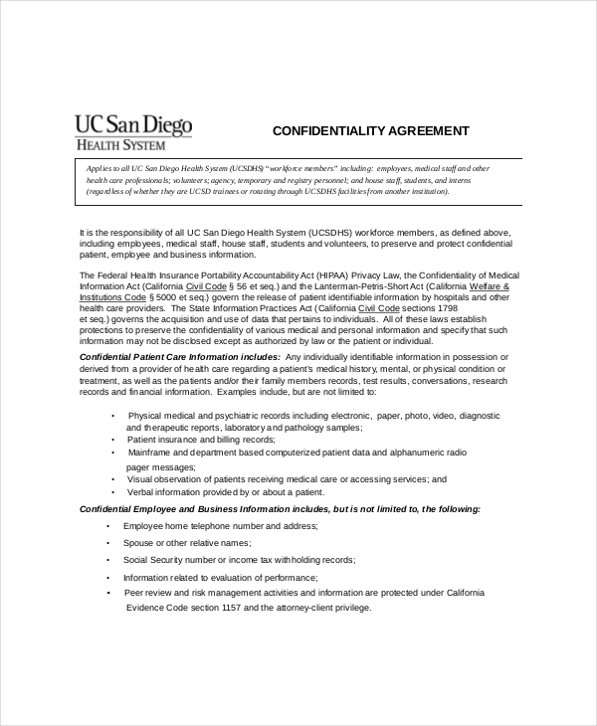
Phase 1: CDA (continued)
A CDA MUST be completed before any study start up activities occur.
NIH studies typically will not have this.
Also sometimes referred to as a Non-Disclosure Agreement (NDA)
Notes:
There is no negotiating with the NIH or most other government sponsors. CDAs are required for any industry-sponsored study or collaborations with PI’s at other institutions.

Slide 11
Phase 1: CDA
CDAs are routed to the Division of Sponsored Programs (DSP) through the UIRIS system on a Non-Monetary routing form.
To create and route a form, go to: https://uiris.uiowa.edu and log in with your HawkID and password.
The form will be routed to the PI and Division of Sponsored Programs (DSP) at minimum. Allow at least 5 business days for this process to be completed.
Notes:
Often the CDAs look like any other form with a space for the PI to sign at the bottom. It is not acceptable to just have the PI sign the CDA! The DSP routing policy page discusses the 5 day deadline if you need to give that to an impatient sponsor.

Slide 12
What is the Division of Sponsored Programs (DSP)?
The Division of Sponsored Programs offers a range of services for faculty, staff, and students seeking external funding for research, training, service, and other scholarly and creative endeavors that enrich The University and its broad and far-reaching communities. DSP assists with the search for external funding sources; reviews and approves grant applications; negotiates award stipulations; facilitates post-award project management; and monitors and advises on issues of regulatory compliance.
Learn more about DSP here: http://dsp.research.uiowa.edu/
UI Routing Policy: https://dsp.research.uiowa.edu/ui-routing-policy-procedure
Notes:
I will refer to a lot of different policies during this presentation. Just to be clear, a policy is something that must always be followed. Not following a written policy at the UI can result in disciplinary action. Be sure to familiarize yourself with these policies and any others that pertain to your job.

Slide 13
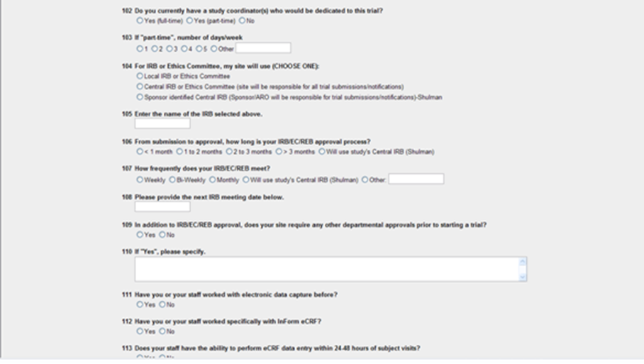
Phase 1: Feasibility
The sponsor will now assess the feasibility of conducting the study at our site. This is often done concurrently with the CDA.
Sponsors often ask us to complete a feasibility questionnaire on first contact, while the CDA is being completed. This gives them an idea whether we have access to a population that will yield the enrollment they desire, and whether we have adequate facilities, equipment and personnel to complete the study.
Notes:
If the form asks for numbers, estimates are usually fine. If they want exact numbers taken from Epic, etc., I would get the CDA first.

Slide 14
Phase 1: Feasibility
Your team must carefully study the protocol and other materials provided by the sponsor at this point to determine whether you are capable of meeting the study’s requirements. There should be clear, honest communication between the PI and study team members about what they are able to do.

Slide 15
Phase 1: Feasibility
Feasibility visit: Frequently, studies will visit our site to meet the study team and view our facilities and equipment.
This is our opportunity to make a positive impression, as the sponsor is still determining whether they want to fund the research at this site.
If the sponsor knows our site and/or the PI/study team well, a feasibility visit may not be required.

Slide 16
How did you help Dr. Redbeard?
What form did you submit through UIRIS?
Confidentiality agreement (CDA)
How long does that form take to complete?
Minimum 5 days
Will you need to communicate to your sponsor that this will take longer than they are probably used to?
YES!

Slide 17
Phase 2

Slide 18
Congratulations! Your site has been selected!
Parrot Pharmaceuticals has officially selected Dr. Redbeard and your team as a study site. Now what?

Slide 19
What do you do?
Start enrolling patients right away!
Submit the study to IRB.
Finalize the contract and budget.
Nothing, wait for someone to tell you what to do.

Slide 20
Phase 2: Contract
The sponsor will send you a study contract or Clinical Trial Agreement (CTA).
A Clinical Trial Agreement (CTA) is a legally binding agreement that manages the relationship between the sponsor that may be providing the study drug or device, the financial support and /or proprietary information and the institution that may be providing data and/or results, publication, input into further intellectual property.
It is important to have a CTA for allocation of risk, responsibility, funds, obligations, and the protection of academic, legal, intellectual property and integrity.
Notes:
NIH and other government sponsors typically do not send a contract, as the terms for those grants are not negotiable.

Slide 21
Phase 2: Contract
CLINICAL STUDY AGREEMENT
THIS CLINICAL STUDY AGREEMENT is made and entered into as the date signed by both parties below (the “Effective Date” (“Sponsor”) and University of Iowa 200 Hawkins Drive Iowa City, IA 52242, (“Institution”) and PI., a physician licensed to practice medicine in the state of Iowa (“Investigator”), have agreed to the following terms and conditions (“Agreement”) with respect to the conduct of the clinical research study identified below.
WHEREAS, Institution employs or provides study staff and facilities or other services to conduct clinical research studies; and
WHEREAS, Sponsor is engaged in the research and development, manufacture and marketing of medical devices, software, firmware and other intellectual property defined herein; and is developing the ("Study Device") to provide a general direction for further standard of care evaluation and testing of patients with or without symptoms
WHEREAS, Principal Investigator is qualified by training and experience to conduct clinical studies;
WHEREAS, Institution, Principal Investigator and Sponsor desire to enter into this Agreement to provide the terms and conditions upon which Sponsor may engage Institution and Principal Investigator to conduct research pursuant to this Clinical Study Agreement and Protocol (as defined below) specifying the details of the research services described herein and the related terms and conditions; and
WHEREAS, the Clinical Study (as defined below) contemplated by this Agreement is of mutual interest and benefit to Institution and Sponsor, and will further Institution's instructional, basic science, clinical science and fundamental research objectives and missions.
Notes:
Goes on for several pages, outlining terms of the agreement, use of data, patient injury language, payments for services, etc. At the bottom is a line for the PI to sign. DO NOT have the PI sign- they are not lawyers! Just route through UIRIS system.

Slide 22
Phase 2: Contract
The contract must be routed to DSP through UIRIS.
The contract negotiation process can be lengthy, taking weeks or even months. It is very important to route the contract as soon as you receive it to minimize delays.
Use a Monetary Routing Form
To create and route a form, go to: https://uiris.uiowa.edu and log in with your HawkID and password.

Slide 23
Phase 2: Budget
The sponsor will send you a proposed budget, usually at the same time as the contract.
Review the budget VERY carefully as it is in the sponsor’s best interest to offer us as little as possible, and their offer may not cover our costs.
Use UIHC standard research pricing to help you determine how much you should ask the sponsor to pay for services.

Slide 24
Phase 2: Budget
UIHC Standard Research Pricing
General:
Research pricing for radiology and laboratory procedures can be found here: Compliance- research billing

Slide 25
What do you do?
What form should be routed through UIRIS as soon as possible to avoid delays?
Contract or CTA
What resources are available to help you with the study budget?
Compliance research pricing page, standard research pricing menu

Slide 26
Phase 3
Submit to IRB
JOC
P&T/IDS
Nursing Research Committee
MPRC
Pathology
CRU

Slide 27
What do you do?
This is the point at which your study starts to feel like a lot of paperwork. How do you handle it?
Try to argue with anyone who will listen that you shouldn’t have to do all of this just for a simple study.
Go to Java House, get a cookie and hope the work will just do itself.
Take a deep breath and remind yourself this is just part of the job, and everyone has to do it.

Slide 28
Phase 3: IRB
Determine which IRB is best for your study at the following link: https://hso.research.uiowa.edu/external-and-central-irb-reliance-models
HawkIRB is usually used for in-house and NIH studies. Website: www.hawkirb.research.uiowa.edu
WIRB is usually used for industry-sponsored studies. Website: www.wirb.com
For other external IRBs and specific grants/sponsors, please refer to the HSO website link above.

Slide 29
Phase 3: IRB
Central IRB
Local IRB
Some large, industry sponsored studies with many sites will have all sites use the same IRB to expedite the review process.
If your study is using a central IRB that is not WIRB, contact HSO directly at uirb-external@uiowa.edu
“Local” refers to our organization’s IRB that is used only for investigators in our organization- HawkIRB.
NIH, PI-initiated and some industry sponsored studies will use HawkIRB.

Slide 30
Phase 3: IRB
Begin your HawkIRB application.
You must submit the study first to HawkIRB even if you are using WIRB or another external IRB.
The HawkIRB application will automatically determine which committee approvals are required for your study.
Notes:
Please remember that sponsors often work with much smaller organizations than ours that do not have as much, or possibly any, of this internal paperwork and they may not realize how much time and effort is required internally on top of the regulatory forms and IRB application. You may need to patiently communicate this with a sponsor if they are not understanding what is taking so long. Most monitors I’ve worked with were shocked when they came to UIHC and saw what a large hospital it is.

Slide 31
Phase 3: Committee Applications
Some of the committee applications required for study start up are incorporated in the HawkIRB application.
CRU requires a separate I-Cart application
Pathology requires a separate application.
Notes:
Committee applications are part of the full HawkIRB application and also the external IRB HawkIRB application. If you need assistance completing a committee application, there is contact information on all of the forms.

Slide 32
Phase 3: Joint Office for Compliance Research Billing (JOC)
JOC reviews all new studies (HawkIRB and WIRB) to determine whether the study involves tests, procedures, office visits or hospitalizations at UIHC.
If so, JOC will create a billing plan to make sure the subject’s care is billed to the study when appropriate.
JOC will send you a copy of the billing plan to approve. You must obtain the PI’s signature and return to JOC before your plan is considered final.
CRU services are not billed through JOC
More info on JOC here: https://hso.research.uiowa.edu/joint-office-compliance-research-billing

Slide 33
Pharmacy and Therapeutics (P&T)
The P&T Subcommittee must review a research protocol if it involves:
the administration of investigational new drugs or drugs that are given "off-label";
FDA approved drugs that are given as a component of a research protocol;
any other substance that is ingested (with the exception of enteral feedings such as baby formulas, unless they contain a non-Generally Regarded As Safe [GRAS] ingredient); or
any other substance that is injected, inhaled, or applied to the body.

Slide 34
Pharmacy and Therapeutics (P&T)
G
-
12 NEW DRUG DATA
DATE
HOSP. #
IRB # _____________________________
NAME
Upon approval from P & T Subcommittee, and after the patient has
BIRTH DATE
consented to participate,
the investigator must assure that
ADDRESS
completed form
this
is
filed/scanned in to the patient’s medical rec
l
ord.
IF NOT IMPRINTED, PRINT DATE, HOSP. #, NAME AND LOCATION
Generic Name:
File most recent sheet of this number ON BOTTOM
l
Trade Name:
Other Names: (e.g., Chemical Name, Investigational Name/Number, IND# if appl
icable)
Drug Class:
Use:
Site and Mechanism of Action:
Onset of Action:
Duration of Action:
Metabolism & Excretion:
Dosage:
Duration of Study Drug Treatment:
Interacting Drugs:
Adverse Effects:
Toxicity Management:
Investigator Names
Home Phone #
Hospital extension
/
1.
pager
#
2.
3.
References:
Double Blind Test?
Yes
No
q
q
Revised
12
-
18
-
07
UNIVERSITY OF IOWA HOSPITALS AND CLINICS
200 Hawkins Drive, Iowa City, IA 52242
Notes:
This form must be in the chart of any subject enrolled in a study so that any care provider in the hospital will have some basic information about the study drug.

Slide 35
Investigational Drug Services (IDS)
IDS is required to dispense study medications and must approve studies prior to UI IRB approval being granted.
IDS pharmacy is located at elevator M, lower level.
Email your protocol and pharmacy manual directly to IDS to receive approval.
More information: https://www.uihealthcare.org/2column.aspx?id=231324

Slide 36
Investigational Drug Service (IDS)
Department of Pharmaceutical Care
University of Iowa Hospitals and Clinics
Investigational Drug Study Standard Charge Worksheet
for FY 20
1
5
-
20
1
6
Submit completed worksheet
electronicall
y
to t
he Investigational Drug Service
with
the IRB application
. Pleas
e note
worksheet contains 2 pages.
NOTE:
The fees below
are
effective
July
1,
201
5
. It is anticipated that fees will be adjusted again
on July 1, 20
16
. If the
protocol will extend for more than
one year, please
include at least
a
5
% increase in your bud
get for administrative and
dispensing fees, and
at least
10% for drugs or supplies not provided by sponsors. For questions or clarifications, please
contact the Investigational Drug
Service
at (319) 356
-
2577
,
Theresa
-
Hobbs@uiowa.edu
;
Kristine
-
Angela
Johnson@uiowa.edu
; or
-
Merriss@uiowa.edu
.
Thank you.
Type of Dispenses
(see section II
I
B
elow):
Principal Investigator:
Study Title:
Estimated # of Dispenses/
P
atient/
Y
ear:
IRB Number (if available):
Estimated # of
P
atients/
Y
ear:
Contact Person:
Estimated Duration of Study:
Date:
Email:
Grant Account Number (MFK):
Phone/Pager #:
ACTIVITY
RATE
SUBTOTAL
Studies which require significantly more record keeping, compounding, dispensing
I
time, and/or patient monitoring will be charged for additional time and labor.
Study Set
-
Up and Close
-
§
Out Acti
vities, includes:
$
12
00
/ Protocol / Initial year
$
§
Review of study design, identification of pharmacy
issues
§
Initiate receipt and inventory of investigational agent(s)
Preparation of Drug Accountability Record/Notebooks
§
Studies requirin
g electronic drug accountability and
/or electronic case report
$100
/
Initial
year
§
form
completion
will be charged an additional fee of $100/year.
$
§
Development and distribution of dispensing guidelines
§
Randomization and double blinding if requested
§
Training of staff
§
Epic Build
§
Set up supplies, storage
§
(Drug Destruction, Temperature Monitoring etc)
§
Staff in
-
§
services
§
Site initiation meetings with investigators and study monitors
§
Reconciliation of drug accountability records
at end of study
§
Photocopying, return of drug, maintenance of discontinued study file
§
Temperature Logs
Study close
-
out
st
II
Study Maintenance
[not assessed for the 1
year]
$
60
0
/ Subsequen
t year
$
§
Inventory Control/Accountability (monthly)
§
Studies requiring electronic drug accountability and
/or electronic case report
$100
/
Subsequent
year
§
form
completion
will be charged an additional fee of $100/year
$
§
Ordering and maintaining
appropriate stock of drug
§
Drug Receipt
§
Checking for expired drugs; date extension and relabeling of drugs prn
§
Monitor visits
Internal QA audits
•
Temperature Reports
•
Copying drug accountability logs and shipment reports
•
Makin
g scripts, printing copies
Estimated
Set Up/
Maintenance
Complete preparation/d
ispensing costs and estimated total charge on page 2.
Cost
(Sub Total)
$

Slide 37
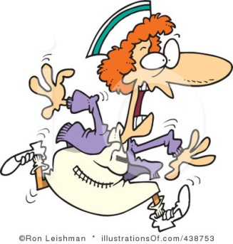
Nursing Research Committee (NRC)
Per UIHC policy N-A-12.001, NRC must approve any research that will involve:
Participation of nursing staff, patients or supplies
Procedures not standard of care in the nursing unit or clinic
Development of instruments or procedures
More information: https://hso.research.uiowa.edu/nursing-research-committee

Slide 38
Nursing Research Committee (NRC)
The
University of Iowa Hospitals and Clinics
If investigational drugs are to be administered by Department of Nursing
Services and patient care
personnel, please see
policy
N
-
Department of Nursing Services and Patient Care
08.140
Investig
ational Drugs
for additional instructions.
Modification
Descri
:
FORM I
be
modifications being
submitted
for review that involves nursing, nursing resources or
evaluates nursing practices; and any attachments (i.e., consent documents, letters of
Request for Approval of Research
Description
support, etc.).
:
New Study
Modifications to a previously approved study which changes
Approval Process:
Review by
appropriate
UIHC physicians
/medical directors
,
IRB ID#:
nursing involvement, nursing resources or evaluates nursing
Managers who have management responsibilities for
Directors for Clinical Services,
and Nurse
practices. Indicate below which venue previously approved thi
participants
or areas involved. Signa
tures are
WIRB ID#:
study.
s
required to document their reviews and give permission to conduct the research in their respective
area(s). Research proposals will not be reviewed until all required signatures have been obtained
IRB ID#:
received.
and
Nursing Research and Evidence
-
(NREC)
Based Practice Committee
I understand that this protocol t
itled “
” will be conducted on
(clinical area
WIRB ID#:
(Principal Investigator). The project purpose is to
.
(N)
participants
with
[s]
) by
will be
enrolled.
UIHC Depa
rtment of Nursing Services and Patient Care
staff will participate in this study
Date:
indicated above.
as
Title of Project:
Funding
Principal Investigator (PI):
I
:
understand
that this study provides funding to the Department of Nursing Services and Patient
Co
Care for
. The funding is provided by
.
-
Investigators:
I understand that
no
funding is being provided
PI
Address:
Reimbursement funding for training of unit nursing staff.
PI
Telephone:
PI Email Address:
Required Signatures
Advisor Name:
:
Advisor Email Address:
Director for Clinical Services
for Specified
Nurse Manager for Specified Nursing
Research Study Coordinator Name:
Nursing Unit/Division
Unit/Division
Research Study Coordinator Email Address:
Director for Clinical Services
for Specified
Nurse Manager for Specified Nursing
Clinical Services Areas to
•
be
Used (
list
specific units/clinics):
Nursing Unit/Division
Unit/Division
•
•
•
•
•
•
•
Other (please specify):
•
•
Dir
ector for Clinical Services
for Specified
Nurse Manager for Specified Nursing
Nursing Unit/Division
Unit/Division
Data Collection Period:
Start Dat
e:
End Date:
Physician
Other:
The Department of Nursing Services and Patient Care’s Nursing Research and Evidence
-
Practice Committee
(NREC) supports research and nurses involvement in research
Based
.
Therefore, th
NREC
revi
ews
all
e
Physician
Other
research.
studies that involve the participation of nursing staff on protocols or procedures for
Even if participation is part of regular patient care or nursing activities of the unit, clinic or
Nurse Manager Resource (specific to this
Research
Study
Resource (specific to this
setting (e.g., medication administration, blood dra
ws or monitoring),
the study still requires review.
study)
study)
Notes:
This is not the whole form, as it is several pages long. This is to give you an idea what it will entail. Note that there are many signatures needed, especially if you will be conducting your study in multiple clinical areas. In my experience, this was the form that took the longest to complete because of all the signatures.

Slide 39
Medical Radiation Protection Committee (MPRC)
MPRC must review studies that involve radiation exposure for subjects and/or study personnel
Any study that involves X-Rays, CT scans, PET scans or radioactive drugs such as MRI contrast, must be reviewed.
MRI scans without contrast do not emit radiation and do not need to be reviewed.
More information here: https://ehs.research.uiowa.edu/human-use-mrpc-faqs

Slide 40
Medical Radiation Protection Committee (MPRC)
Note that there is a long form and a short form.
Short form may be used for the majority of studies.
The long form must be used if the study involves procedures with an effective dose equivalent greater than 100 mrem, or radiation exposure to minors or pregnant women; radiation procedures performed outside UIHC, UI College of Dentistry, or VAMC facilities
Find both forms here: https://uiowa.edu/eforms/environmental-health-safety
Notes:
Dose equivalents for common procedures are listed in a table on the forms. If your specific procedure is not listed, contact the radiation safety officer at 5-8517. They are a very helpful group!

Slide 41
Pathology
Any study that uses pathology services must be reviewed
Labs that are processed by specimen control or another UIHC lab (except CRU) must be reviewed
Pathology application is not built in to the HawkIRB application
You do not need to have pathology approval prior to submitting to IRB, but submit to pathology as soon as possible.

Slide 42
Pathology
More info, instructions and application forms here: https://www.medicine.uiowa.edu/pathology/research/pathology-clinical-trials-support-core
To find pricing for research pathology tests, use the research pricing link we discussed in the budgeting section.

Slide 43
Clinical Research Unit (CRU)
Any protocol that utilizes CRU services must be reviewed by CRU.
You do not have to have CRU approval to submit to IRB, but submit to CRU as soon as possible.
It can take several weeks from submitting your application to finalizing a CRU cost analysis, orders and nurses notes.
New study team members must also attend a 45-minute CRU orientation prior to using CRU in any capacity.
You will want to get a CRU cost analysis before your study budget is finalized, so you can ask the sponsor for the appropriate amount to cover CRU fees.

Slide 44
Clinical Research Unit (CRU)
Apply for CRU services through I-Cart: http://icts.uiowa.edu/pages/i-cart-view-and-order-services
I-Cart can be daunting. Please contact the CRU directly for assistance with completing an I-Cart application.
More information on the CRU: http://www.icts.uiowa.edu/pages/clinical-research-unit

Slide 45
Parrot Pharma sent you the study startup documents. Now what?
Protocol calls for 3 visits with labs (mail out and local), EKG, and dispensing of study drug.
Visits can be in pirate care clinic or CRU.
What approvals do we need and why?

Slide 46
What did we do with the Parrot Pharma Study?
Submitted to WIRB
Obtained approval from JOC, P&T, IDS, NRC, Pathology and CRU.
Did not need MPRC approval.

Slide 47
Phase 4

Slide 48
What do you do?
Parrot Pharma sends you a template consent form. They’ve already filled in your PI’s name and everything. Can you go ahead and submit this form to IRB as is?
No! You need to include required UI language.

Slide 49
Phase 4: Informed Consent Form (ICF)/Record of Consent (ROC)
Some sponsors will send you a template consent form.
If not, you can create a template in the HawkIRB application.
UI has required language that must be included, unaltered, in any consent form.
The various committees also have required language to include.
Be sure to submit your consents to your sponsor for review and approval prior to submitting to IRB.

Slide 50
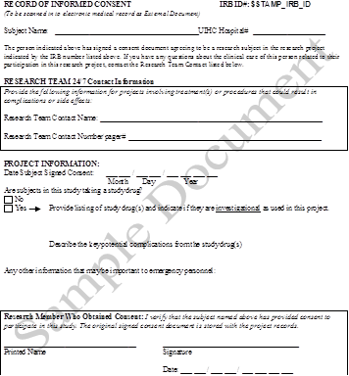
Phase 4: Consent/Record of Consent
The HawkIRB application will let you create a record of consent form.

Slide 51
Phase 4: Financial Disclosure Forms (FDF)
The Food and Drug Administration (FDA) is issuing regulations requiring the sponsor of any drug, including a biological product, or device marketing application (applicant), to submit certain information concerning the compensation to, and financial interests of, any clinical investigator conducting certain clinical studies. This requirement will apply to any covered clinical study of a drug or device submitted in a marketing application that the applicant or FDA relies on to establish that the product is effective, including studies that show equivalence to an effective product, or that make a significant contribution to the demonstration of safety. This final rule requires applicants to certify to the absence of certain financial interests of clinical investigators and/or disclose those financial interests, as required, when covered clinical studies are submitted to FDA in support of product marketing.
Source: https://www.fda.gov/ScienceResearch/SpecialTopics/RunningClinicalTrials/ucm119145.htm

Slide 52
Phase 4: Financial Disclosures

Slide 53
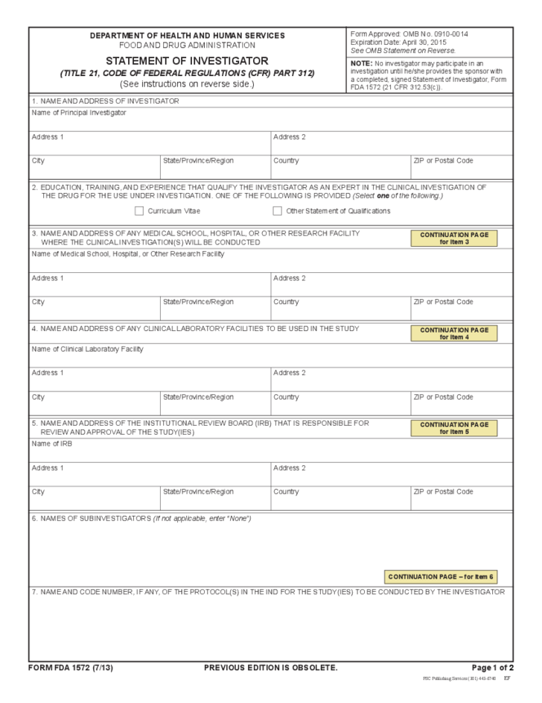
Phase 4: 1572
A form that must be filed by an investigator running a clinical trial to study a new drug or agent. The investigator agrees to follow the U.S. Food and Drug Administration (FDA) Code of Federal Regulations for the clinical trial. The investigator verifies that he or she has the experience and background needed to conduct the trial and that it will be done in a way that is ethical and scientifically sound. Also called 1572 form.
Notes:
The sponsor will dictate who is listed on the 1572. Usually the PI and all sub-I’s are, sometimes the coordinator, pharmacist, etc. and/or other members of the study team are also listed.

Slide 54
Phase 4: Clinical Trials.gov
“The final rule”
This final rule details the requirements for submitting registration and summary results information, including adverse event information, for specified clinical trials of drug products (including biological products) and device products and for pediatric postmarket surveillances of a device product to ClinicalTrials.gov, the clinical trial registry and results data bank operated by the National Library of Medicine (NLM) of the National Institutes of Health (NIH).

Slide 55
Phase 4: Clinical Trials.gov
Most industry-sponsored trials will be registered by the sponsor.
You may need to register a PI-initiated or a study from a startup/smaller sponsor yourself.
Instructions for registering: https://clinicaltrials.gov/ct2/manage-recs/how-register
Notes:
Also make sure that you are following the requirements for updating your trial as time goes on. It is common for a study to be registered and then not updated when complete, etc.

Slide 56
Startup of NIH Studies
NIH and other public grant-funded studies usually come with pre-determined, non-negotiable budgets and contracts.
Usually there is no CDA.
Most of the time, you can start with phase 3- IRB and committees.

Slide 57
Final Step: Submit to IRB!
How long will it take?
Once submitted to HawkIRB, allow at least 8 weeks to receive approval from all committees, a finalized contract, and IRB approval.
Can be longer or shorter, but this is a good estimate to give to your sponsor when they ask.
If several weeks go by and you haven’t received any approvals, do not hesitate to follow up directly with the committees!

Slide 58
What happens after IRB approval?
Sponsor will schedule a site initiation visit (SIV) with you.
Your sponsor will tell you when you are ready to begin enrolling- usually only after SIV occurs.
Notes:
In my experience, the SIV is often a 1-day visit aimed at providing more in-depth training for your team.

Slide 59
Congratulations! You did it!

