Slide 1
Study Documentation Presented by: Kelly Henderson, MS ICTS Program Manager 27Sept2018

Slide 2
Objectives:
Background
Understanding Essential Documents
Regulatory Binder Management
Documentation & Record Keeping
Electronic Documentation
Resources
Disclaimer Disclosure: No conflict of interest

Slide 3
Background
Elements of a “Quality” Clinical Study
Scientifically valid and ethically sound experimental design
Qualified and trained personnel
Adequate monitoring
Document management
Current, complete, and accurate data collection
Adequate protection of subjects – rights, safety, and well-being

Slide 4
Regulatory Oversight and
Guidance
CFR
Federal Code of Regulation
OHRP
Office for Human Research Protection
https://www.hhs.gov/ohrp/regulations-and-policy/regulations
IRB
Institution Review Board
HHS
U.S. Department of Health & Human Services
https://hawkirb.research.uiowa.edu
https://www.hhs.gov/ohrp
https://www.hhs.gov
ICH
International Council
of Harmonization
FDA
Food & Drug Administration
GCP
Good Clinical Practice
https://www.fda.gov
https://www.ich.org
https://www.fda.gov/scienceresearch/specialtopics/runningclinicaltrials/ucm155713.htm#FDARegulations
Notes:
CLINICAL RESEARCH GUIDELINES
Links:
- https://hawkirb.research.uiowa.edu
- https://www.ich.org
- https://www.hhs.gov/ohrp
- https://www.hhs.gov
- https://www.hhs.gov/ohrp/regulations-and-policy/regulations
- https://www.hhs.gov/ohrp/regulations-and-policy/regulations/fda
- https://www.fda.gov/ScienceResearch/SpecialTopics/RunningClinicalTrials
- https://www.fda.gov/scienceresearch/specialtopics/runningclinicaltrials/ucm155713.htm#FDARegulations
There are laws, regulations, guidance, and guidelines in the conduct of clinical research. The list foregoes the order of authority.
In terms of a higher standard, there may be overlap in the standards expressed in each. At the same time, each may also cover certain unique standards.
For Example: Human Subject Protection regulations do not discuss quality management while ICH GCP's guidelines do.
As a practice, you are required to comply with laws and regulations, should take into account agency guidance, and may be required to follow GCP Guidelines depending on the trial, trial sponsor, trial location, and/or the government in which data from the trial is going to be submitted
The International Conference on Harmonization (ICH) of Technical Requirements for the Registration of Pharmaceuticals for Human Use, commonly referred to as the International Conference on Harmonization (ICH) is an attempt to streamline the process for developing and marketing new drugs internationally. The ICH is comprised of representatives from the pharmaceutical industry and the regulatory bodies of the United States, Japan and the European Union. In addition, observers include Canada, the European Free Trade Area, and the World Health Organization. The ICH has established several international standards of Good Clinical Practice (GCP) for the development of pharmaceutical products. The guideline that primarily affects investigators in the daily practice of clinical research is E6, "ICH Harmonized Tripartite
Guideline: Guideline for Good Clinical Practice." The E6 guideline has 8 parts: 1) glossary; 2) principles; 3) IRBs; 4) investigator; 5) sponsor; 6) protocol and amendments; 7) Investigator's Brochure; and 8) essential documents. The initial basis for drafting the E6 guidelines was the U.S. FDA regulations for the protection of human subjects (21 CFR 50 and 56).

Slide 5
Background
REGULATORY OVERSIGHT
Code of Federal Regulations (CFR)
21 CFR: 11, 50, 54, 56, 312, 314 and 45 CFR 46
International Council of Harmonization (ICH) Guidelines
E6 GCP
Provide Standards and Guidance in Conduct of Clinical Research
Rights, safety, and well-being of subjects
Roles and Responsibilities of Investigators and Research Staff
Study conduct and protocol management
Safety reporting
Documentation and Record Keeping
Notes:
Regulatory Oversight
The Code of Federal Regulations (CFR) is the codification of the general and permanent rules and regulations (sometimes called administrative law) published in the Federal Register by the executive departments and agencies of the federal government of the United States.
There are a number of policies governing privacy and confidentiality in research. Whereas these are not exhaustive, they are the major regulations to which investigators must adhere.
Common Rule 38 CFR 16.111 - When appropriate, there are adequate provisions to protect the privacy of subjects and to maintain the confidentiality of data.
FDA Regulations 21 CFR 50.27 - The ICF includes a statement describing the extent, if any, to which confidentiality of records identifying the subject will be maintained and that notes the possibility that the FDA may inspect the records.
HIPAA Privacy Rule 45 CFR Part 160 and Subparts A and E of part 164 - Research is not a covered function in itself. However, VA research (and clinical trials in and of themselves are covered) because it involves health care by a covered entity (VHA), and medical record or biologic samples labeled with health information are maintained by the covered entity (VHA) in the trial.
VHA Privacy Policy VHA Handbook 1605.1 and VHA Handbook 1605.2- Incorporate the HIPAA regulations into VHA-specific policy. It applies to all patient health information at VHA facilities, including that used for medical research or produced in the course of that research.

Slide 6
Essential Documents
Section 8 ICH E6 GCP
Documents that “individually and collectively permit evaluation of the conduct of the trial and the quality of the data produced”
“Serve to demonstrate the compliance of the investigator, sponsor, and monitor with the standards of GCP and the applicable regulatory requirements”
Minimum list of essential documents can be found in ICH GCP E6(R2) Section 8.
Notes:
The documentation should “stand on its own” in telling the “story” of the study.
The PI is responsible for all protocol activities including the maintenance and storage of the study documentation, but must rely on the research coordinator and research team to comply with the guidance.

Slide 7
Source Documentation
Section 1.52 ICH E6 GCP
Source Documents: original documents, data, and records
Examples:
Original paper clinical visit note by a clinical licensed professional
Electronic Medical Record (EMR) notes or reports scanned into the EMR from outside medical offices
Test results printed from an institutional EMR
Pathology reports and/or procedure(s) results
Specific form created by the Clinical Research Unit for the study to record a mandatory process required by the protocol (i.e. PK sample statement log, patient drug diary, procedure orders)
**TIP: All Source Documents - original or electronic - must have a signature and date, by the person creating the source. When applicable the PI.

Slide 8
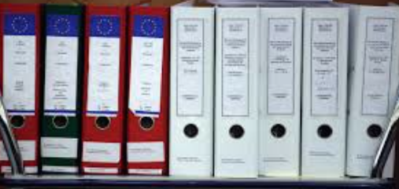
Regulatory Binder
Lots of names!
Investigator Binder | Regulatory Binder |
Study Binder | Investigational Site File (ISF) |
Trial Master File (TMF)

Slide 9
Regulatory Binder
Purpose
Organize the filing of study Essential Documents
Manage all aspects of the trial conducted at the site
Evaluate trial conduct and quality of data produced
Document the compliance of the investigator and sponsor to the standards / requirements of: FDA, IRB, NIH, Good Clinical Practice (GCP)
Document qualifications, credentials, and training
Section 8.1, 8.2, 8.3, 8.4 ICH GCP E6

Slide 10
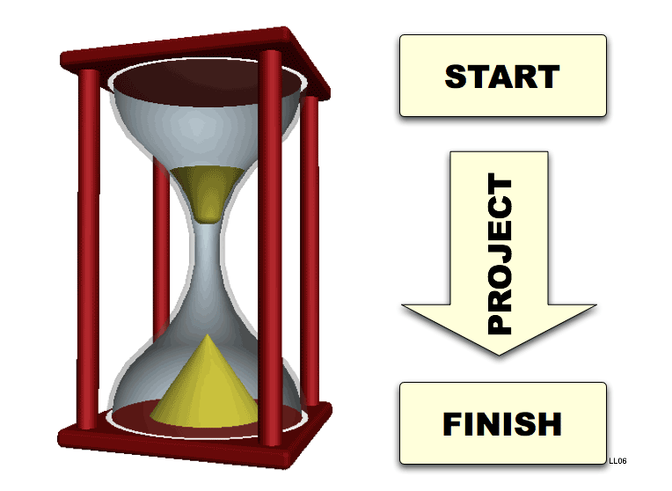
Essential Documents Timeline: 1. BEFORE the study starts 2. DURING the conduct of the study 3. AFTER completion or termination of the study *Keep the binder current and up-to-date at all times*
Regulatory Binder
Notes:
The investigator/institution should have control of all essential documents and records generated by the investigator/institution before, during, and after the trial.
**Required for observational and interventional clinical research studies – regardless of funding Type

Slide 11
Regulatory Binder
Inspection and Monitoring Expectations
Data integrity - efficacy and safety data
Evidence that the rights, safety, and welfare of subjects have been protected
Study conduct is compliant with applicable regulations and requirements
Available for inspection and copying (e.g. FDA, Sponsor, CRO)
Retained for appropriate length of time
Preserved independently at clinical site and meets regulatory requirements

Slide 12
PoLL question:
Who can conduct an inspection/or monitor your research study?
Institutional Review Board (IRB)
Joint Office for Research Billing (JOC)
Sponsor/Clinical Research Organization (CRO)
Department of Health and Human Services (OHRP)
Food and Drug Administration (FDA)
Cooperative Group/NIH
Grant Accounting/Billing
VA Research Compliance Officer (RCO)
All of the above
Only 1, 3, and 5

Slide 13
PoLL question:
Who can conduct an inspection/or monitor your research study?
Institutional Review Board (IRB)
Joint Office for Research Billing (JOC)
Sponsor/Clinical Research Organization (CRO)
Department of Health and Human Services (OHRP)
Food and Drug Administration (FDA)
Cooperative Group/NIH
Grant Accounting/Billing
VA Research Compliance Officer (RCO)
All of the above
Only 1, 3, and 5
ANSWER: #9

Slide 14
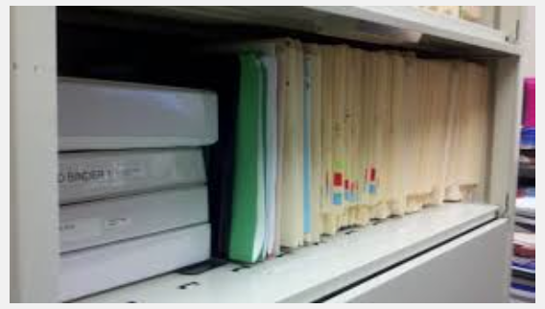
Regulatory Binder
Investigator maintains at clinical site
Store binder in a safe, secure location ONLY accessible to research study team
Subject-specific documentation and information (e.g., signed consent forms, test results, and completed case report forms, should be maintained separately in a subject binder/file.
Document locations of other information, if located separate from regulatory binder (note-to-file or log)
NEVER discard old versions of documents!
Notes:
First items reviewed during and audit or inspection.

Slide 15
Regulatory Binder
Best Practice Recommendations
Organize and order the sections to facilitate easy
use and reference
Store study documents in Reverse Chronological Order
Place newest items within a section at the front
Multi-site Studies: The Lead Site may choose to customize a Checklist for the study and provide to all participating sites.

Slide 16
Table of Contents
Regulatory Binder
Protocol & Amendments
Protocol Training Logs
Informed Consent Documents/Patient Information
IRB Documentation Approvals/Correspondence
Curriculum Vitae (CVs)
Investigator Qualification Documentation
Clinical Investigator Brochure (IB)
FDA Documents
Financial Disclosure Forms (FDF)
Study Communications/Correspondence Site-Sponsor-Governing
Delegation of Authority Log/Roles and Responsibilities / Signatures
Clinical Research Training/Certifications
Screening/Enrollment Logs
Signed Consent Documents
Investigational Product/Device Accountability Logs
Specimen Tracking Log
Serious Adverse Event (SAE)/Safety Reports/ Unanticipated Event
Data Safety Monitoring Documents
Study Protocol Deviation Forms
Clinical Site Monitoring Visits
Notes-To-File (NTFs)
Case Report Forms (blank master copies)
Subject Logs
Notes:
*Checklist Of Essential Documents

Slide 17
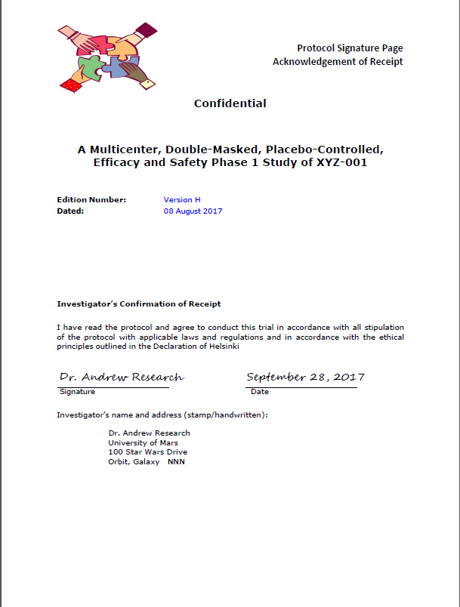
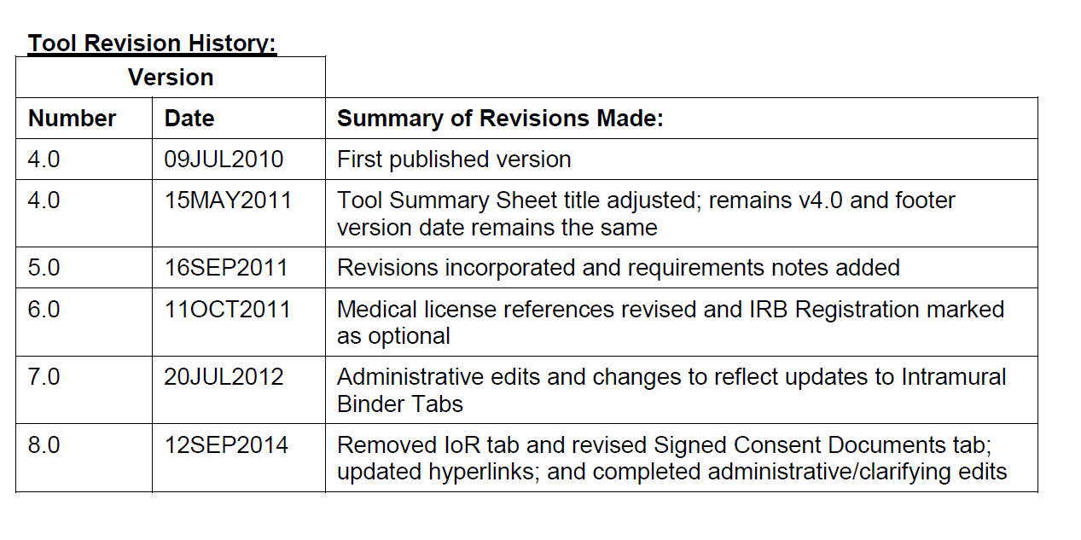
Protocol & Amendments
IRB-approved protocol
IRB-approved protocol amendments
Signed principal investigator (PI) signature pages
for all protocol versions
Log of protocol changes

Slide 18
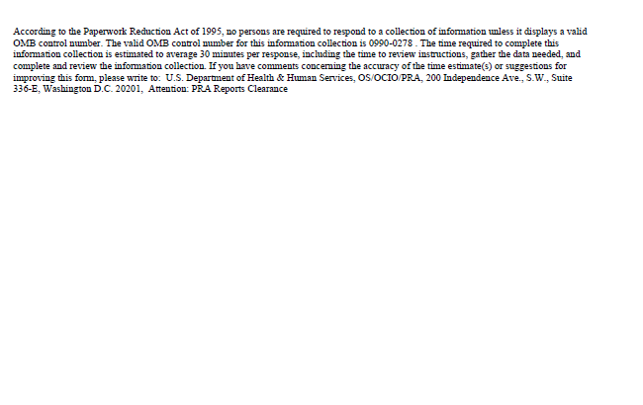
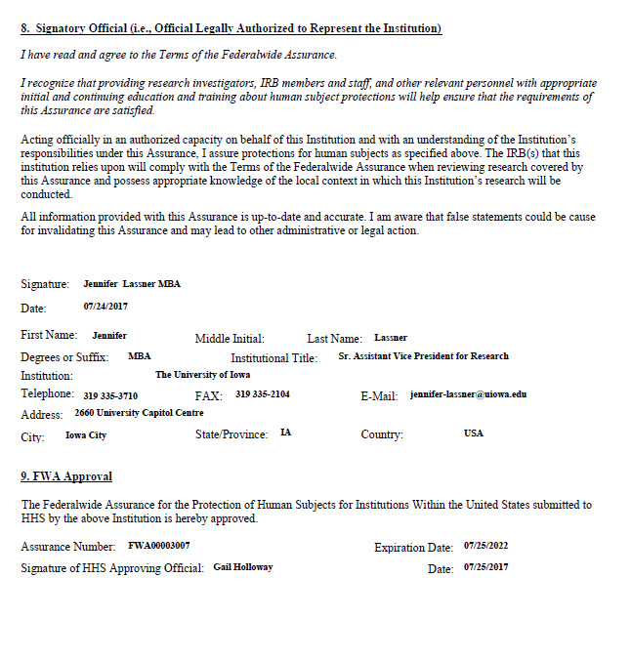
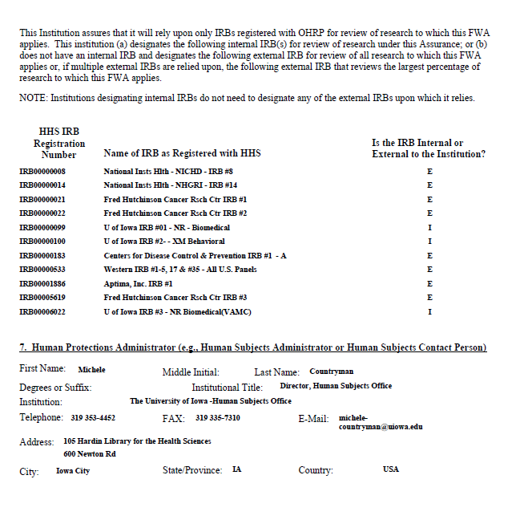
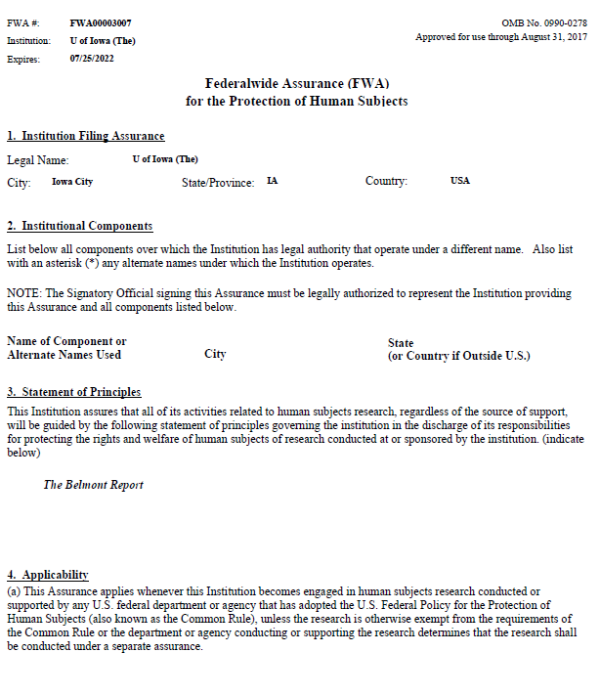
IRB Documentation
IRB Federal Wide Assurance Number
Updated IRB Roster (optional)
IRB Registration (optional)
Link to OHRP Database - FWA & IRB Registration:
https://ohrp.cit.nih.gov/search/IrbDtl.aspx
https://hso.research.uiowa.edu/sites/hso.research.uiowa.edu/files/FWA_Expires7.25.22.pdf

Slide 19
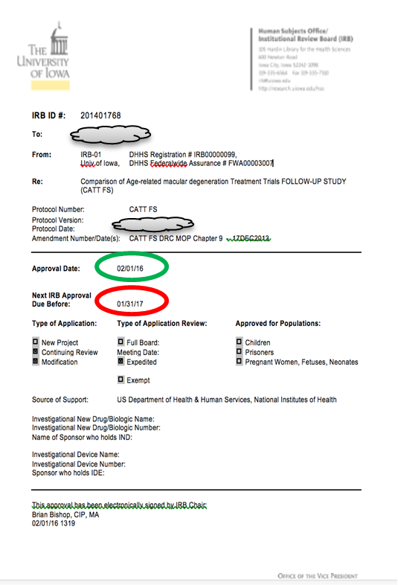
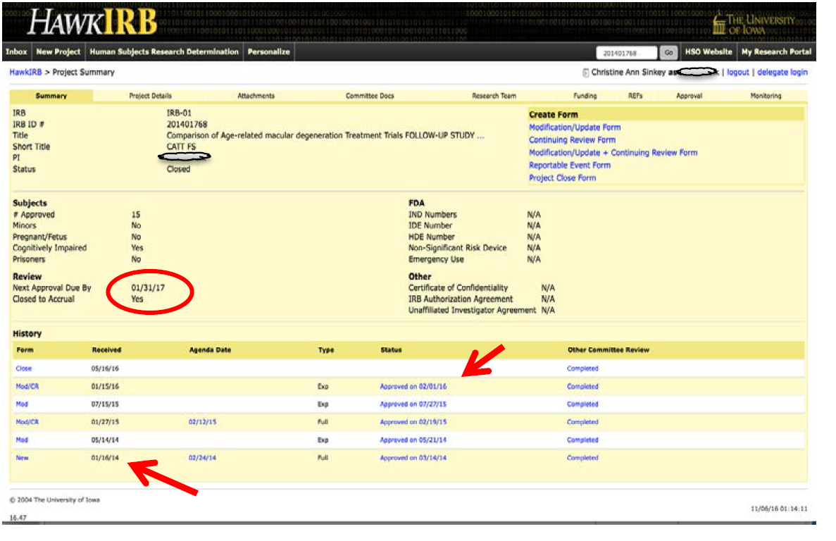
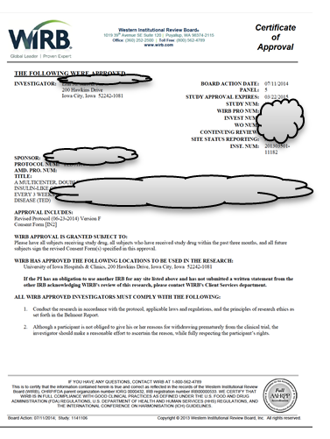
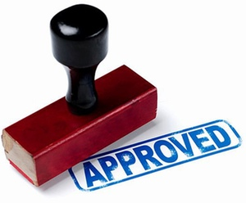
IRB Approvals & Correspondence
Original IRB New Project application /
submission
IRB approval letters
IRB Annual Continuing Reviews
Project closure notification
IRB-approved advertisements, brochures
IRB-approved Participant Information Sheets
IRB-approved blank Case Report Forms (CRFs)

Slide 20
Informed Consent Documents
IRB-approved/stamped (clean copy):
Consent documents
Consent summaries
Assent documents
Short form consents for non-English speakers/readers
**Note: Keeping a log of Informed Consent Form versions can be helpful

Slide 21
Informed Consent Documents
Retain all original, signed consent documents:
Current IRB approved/stamped version
Consent modification (e.g., protocol amendments requiring new version)
**Even if the subject withdraws consent or screen fails!**
Store in one location - subject folder or separate binder
If stored separately, document the location in a Note-To-File

Slide 22
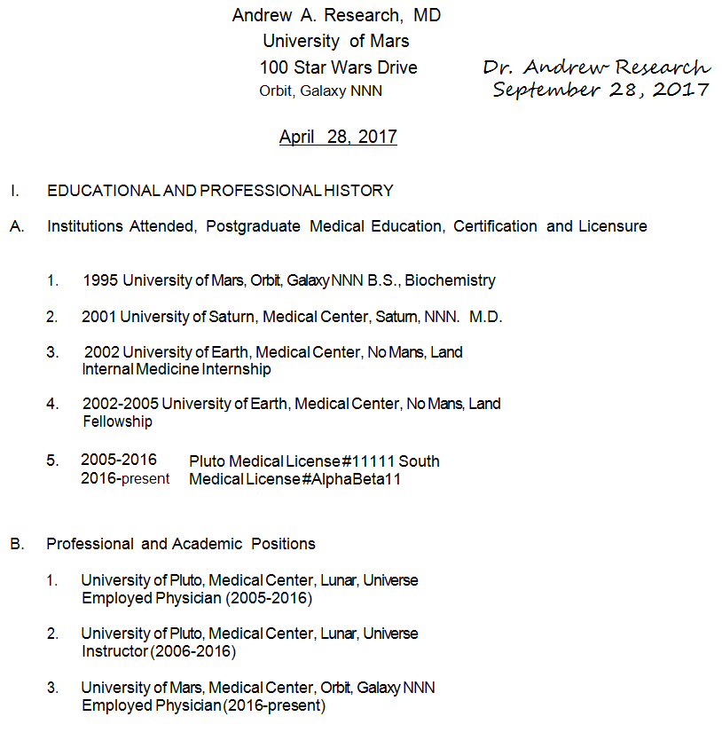
Investigator Qualification Documentation
Up-to-date Curriculum Vitae (CV) for principal investigator (PI) and subinvestigator(s)
Include institution address, name, and date in header; with original signature and date in upper right hand corner
Institution address, name, and licensure need to mirror the information on the FDA 1572
Current clinical professional licensure (dental, medical, nursing, pharmacy, etc.) for PI and co-investigators, if licensed
Update CV and documents as the licensures expire or qualifications change
.

Slide 23
Investigator’s Brochure (IB)
The Investigator’s Brochure (IB) is a compilation of the clinical and nonclinical data on the investigational product(s) that are relevant to the study
e.g., mechanism of action, potential risks and adverse reactions, the ‘expected’ adverse reactions associated with previous use of the investigational product
All IB amendments need to be saved during the trial

Slide 24
POLL QUESTION
Who signs the Form FDA 1572?
Clinical Investigator (a.k.a. Principal Investigator)
Sponsor
Coordinator
FDA
Laboratory
All of the above
Only 1

Slide 25
POLL QUESTION
Who signs the Form FDA 1572?
Clinical Investigator (a.k.a. Principal Investigator)
Sponsor
Coordinator
FDA
Laboratory
All of the above
Only 1
ANSWER: #7
The investigator’s signature on this form constitutes the investigator’s affirmation that he or she is qualified to conduct the clinical investigation and constitutes the investigator’s written commitment to abide by FDA regulations in the conduct of the clinical investigations.

Slide 26
FDA Documents
FDA Form 1572: Statement of Investigator for IND studies (21 CFR Part 312)
FDA Guidance https://www.fda.gov/downloads/RegulatoryInformation/Guidances/UCM214282.pdf
Investigator Agreement for device studies (21 CFR Part 812)
FDA approval or authorization letters
FDA Form 1571: Investigational New Drug Application (IND)
FDA Correspondence Log (if applicable)
***Watch expiration dates on bottom of electronic forms!***
Go to FDA website for most current versions of FDA Forms to download:
https://www.fda.gov/AboutFDA/ReportsManualsForms/Forms/default.htm

Slide 27
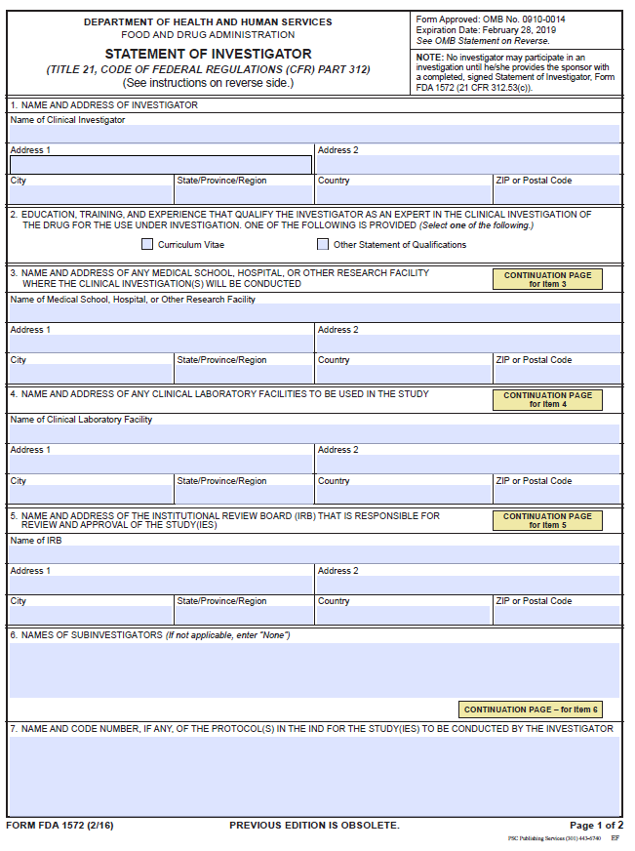
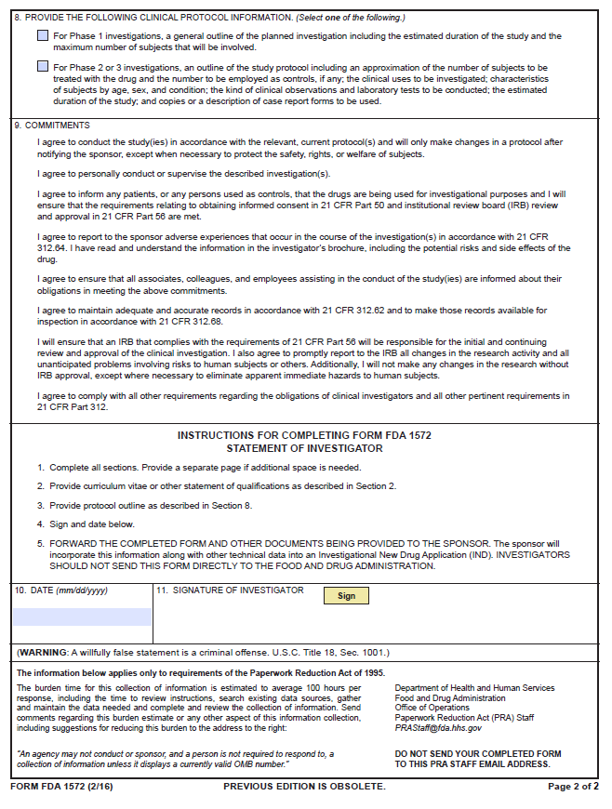
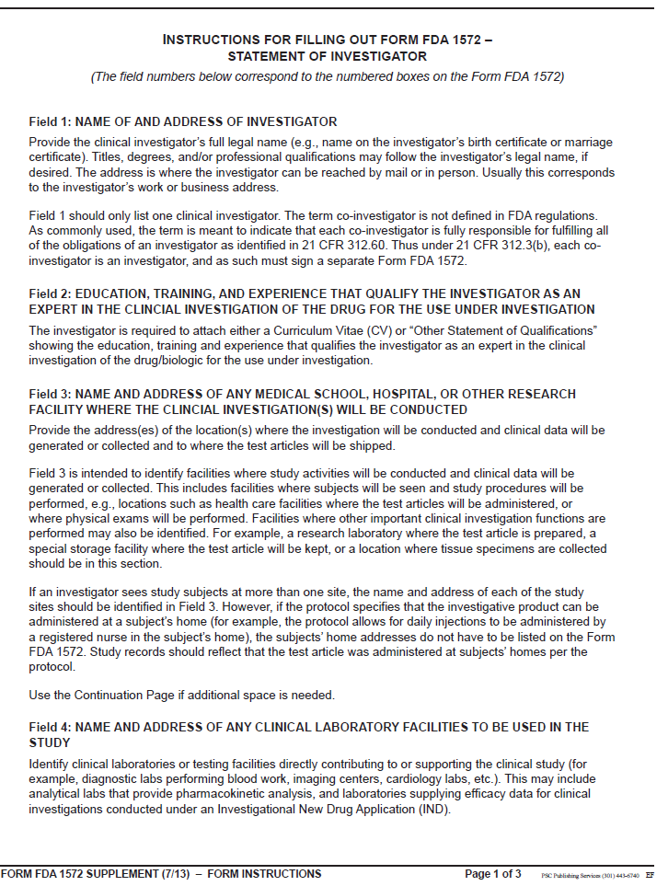
Example Form FDA 1572: Statement of Investigator
ALWAYS CHECK
Expiration date
FDA WEBSITE
LATEST VERSION
1572 FORM
www.fda.gov/downloads/aboutfda/reportsmanualsforms/forms/ucm074728.pdf
Notes:
The FDA Form 1572 is the Statement of Investigator - an agreement signed by the investigator to provide certain information to the sponsor and assure that he/she will comply with FDA regulations related to the conduct of a clinical investigation of an investigational drug or biologic.

Slide 28
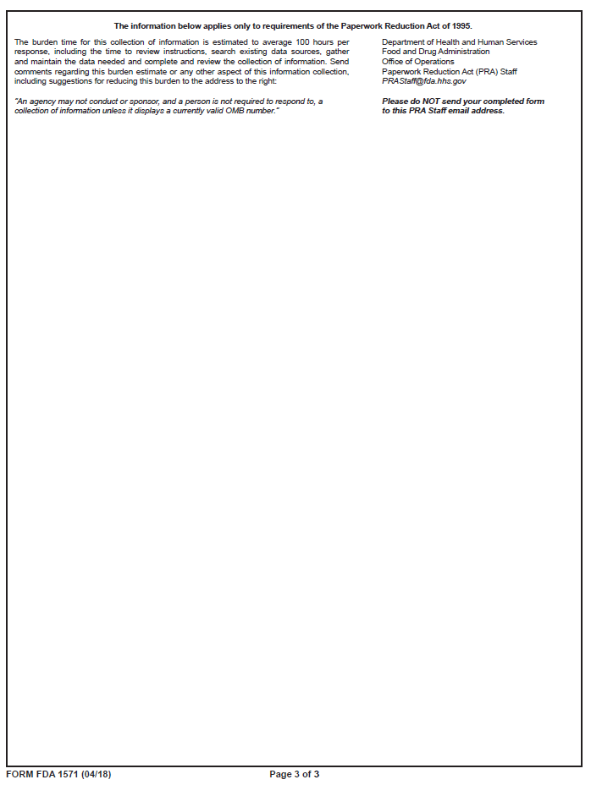
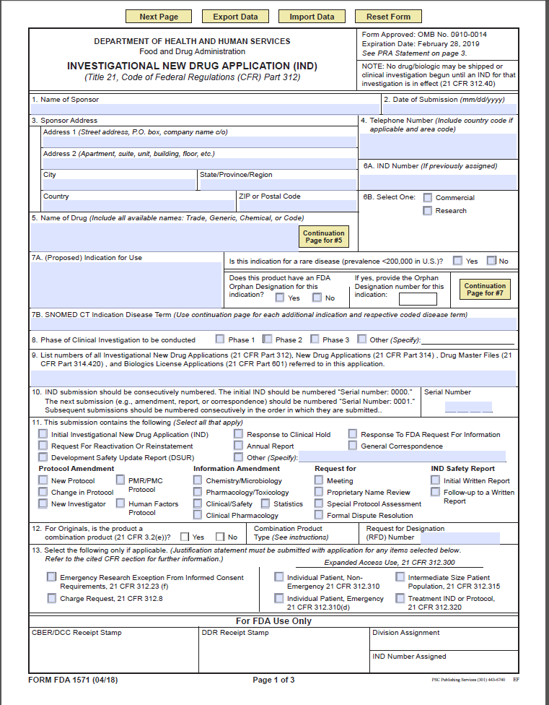
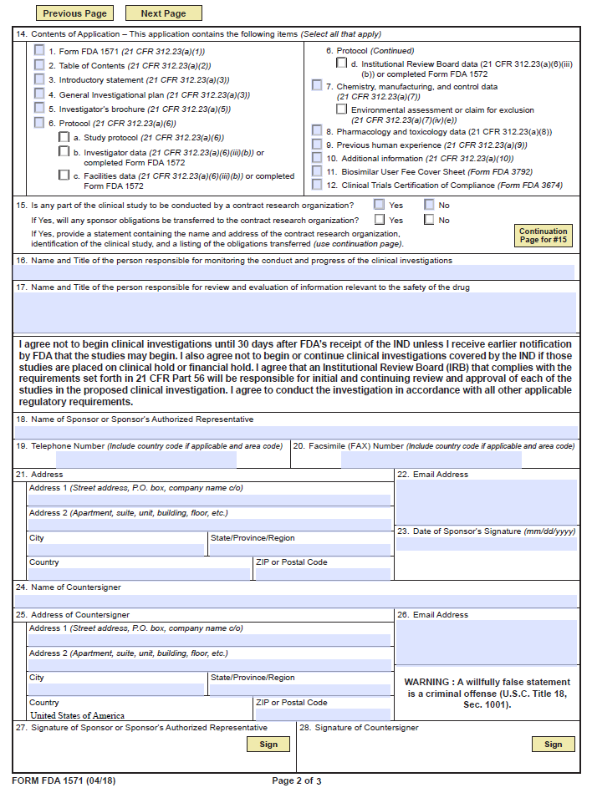
Example Form FDA 1571:
FDA IND Application Number: Must accompany any amendments, annual reports,
IND safety reports or general correspondence the sponsor submits to the FDA about the IND.
Form Fields have changed!!
ALWAYS CHECK
FDA WEBSITE
for
LATEST VERSION
1571 FORM
https://www.fda.gov/downloads/AboutFDA/ReportsManualsForms/Forms/UCM083533.pdf
Notes:
The FDA Form 1571 or ‘1571’ is the Investigational New Drug (IND) application cover page and it must accompany the initial IND submission and any amendments, IND safety reports, annual reports or general correspondence the sponsor submits to the FDA about the IND. The 1571 is a contractual agreement between the sponsor and the FDA. By signing the 1571, the SI agrees to the following:
S/he will not begin the clinical investigations until 30 days after the FDA’s receipt of the IND, unless the sponsor receives earlier notification from the FDA
S/he will not begin or continue the investigations covered by the IND if the FDA has placed the investigations on clinical hold
S/he will conduct the investigation in accordance with all other applicable regulatory requirements
An IRB that complies with 21 CFR 56 will be responsible for initial and continuing review and approval

Slide 29
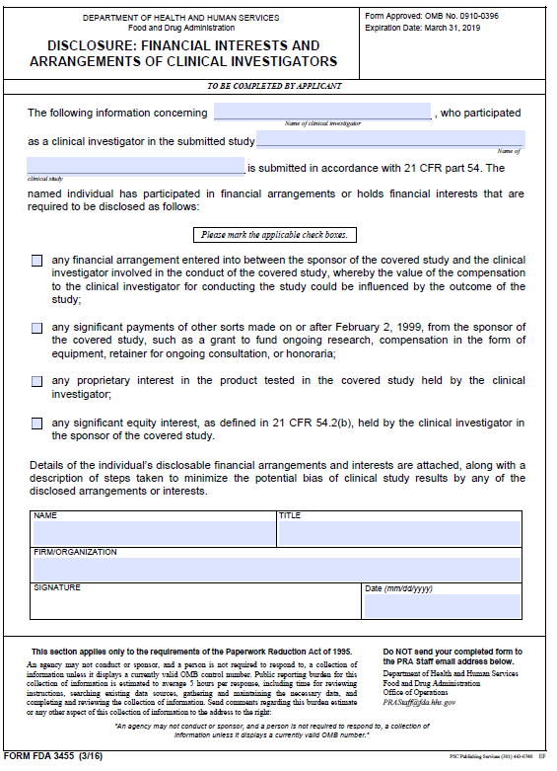
Financial Disclosure Forms (FDF)
Financial Disclosure Forms (FDFs) certify the absence of certain financial interests and arrangements of clinical investigators that could affect the reliability of data submitted to FDA, or to disclose those financial interests and arrangements to the agency and identify steps taken to minimize the potential for bias (21 CFR 54)
Signed by the PI, sub-investigators, and each applicable research team
member listed on the FDA 1572
Protocol title and number should match the title and number listed
on FDA Form 1572
If any of the five financial interest questions are checked “Yes” a
statement addressing the nature, amount of interest, arrangement or
payment must be attached to the FDF
Ancillary Disclosures:
FDA Form 3410: Confidential Financial Disclosure Report
FDA Form 3453: Certification: Financial Interests and Arrangements of the Investigators
FDA Form 3455: Disclosure: Financial Interests and Arrangements of the Investigators
Link for additional information: http://www.fda.gov/downloads/regulatoryinformation/guidances/ucm341008.pdf

Slide 30
Delegation Of Authority Log (DoA)
Log of Assigned Study Responsibilities and descriptions signed/dated by the Principal Investigator (PI)
Documents PI delegation of trial related duties to other qualified and appropriately trained research study team members
The investigator is responsible for supervising any individual or party to whom the investigator delegates trial-related duties and functions conducted at the trial site.
Be sure to include ALL research team members on IRB application:
Start and Stop Dates of delegated duties
PRINTED name, initials, & original signatures
Descriptions of study responsibilities

Slide 31
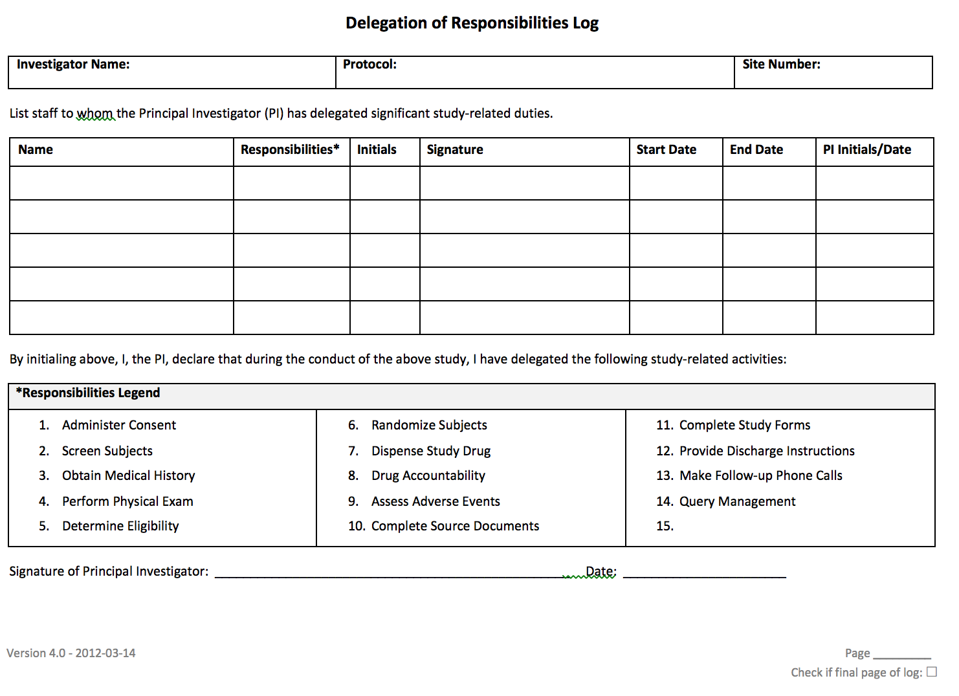
Delegation of Authority Log Example:

Slide 32
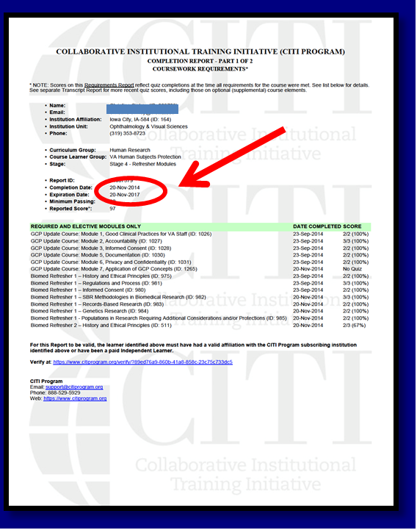
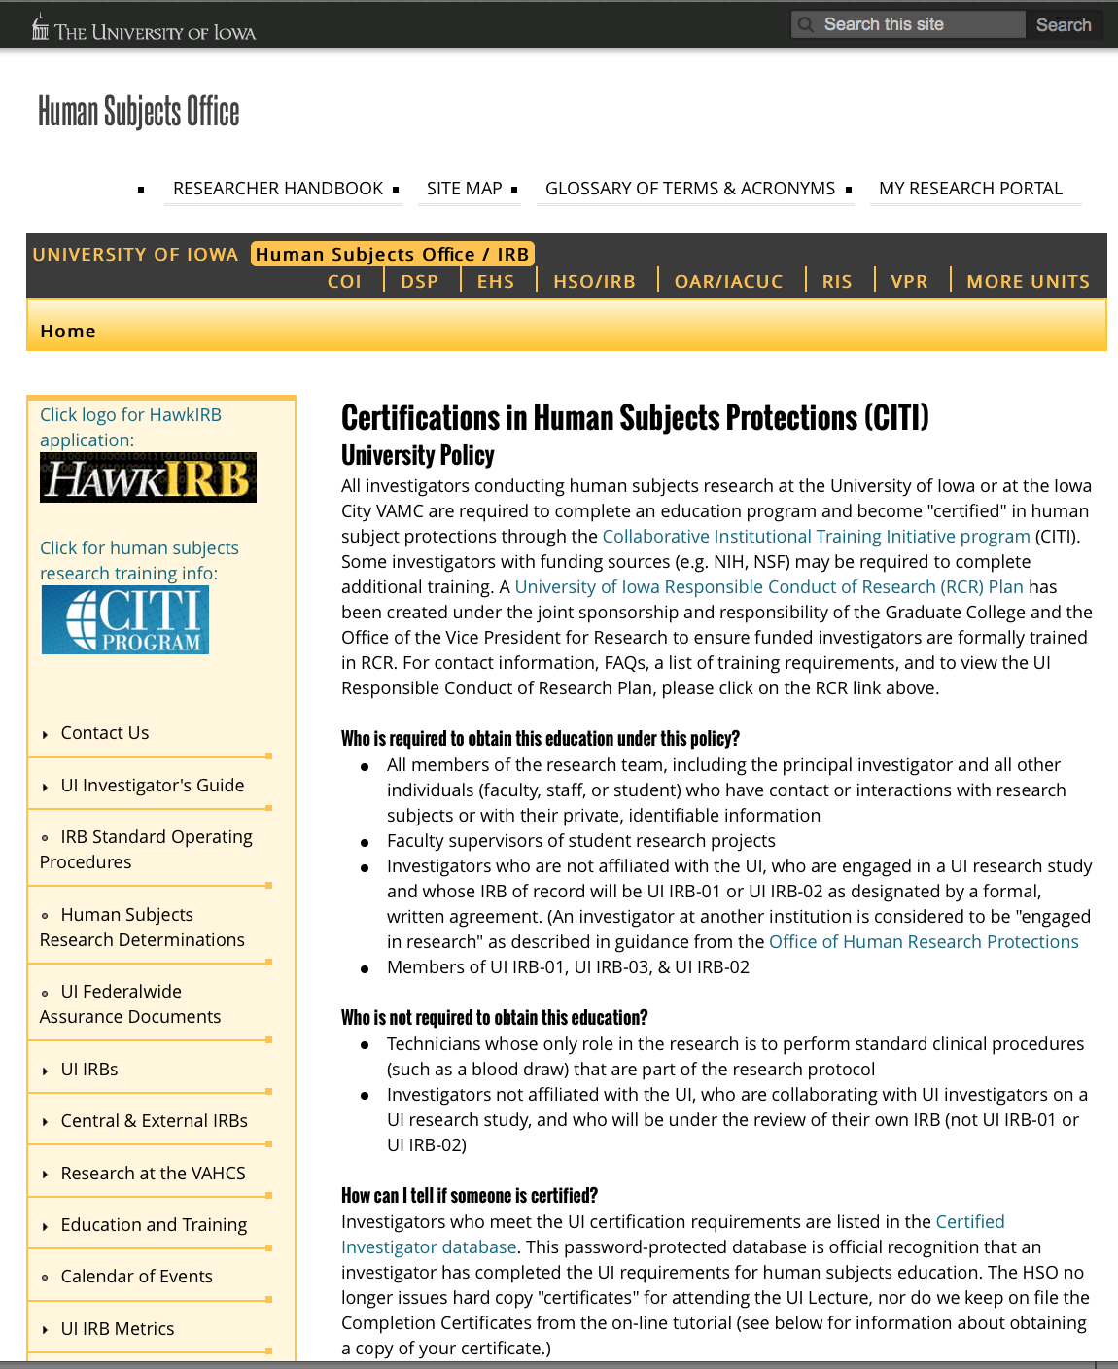
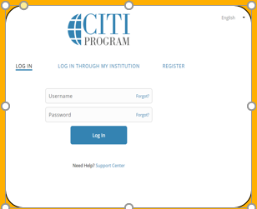
Research Educational Training
Current training certificates for all study team members
Human Subject Protections (HSP)
Good Clinical Practice (GCP)
https://hso.research.uiowa.edu
https://www.citiprogram.org

Slide 33
Training Documentation
Documentation of study-related training, specific
study procedure certifications, and protocol training
Dangerous Goods Training
Training for shipping biologics (IATA)
DOCUMENT THE TRAINING!!!
**Note: Be sure to have a process in place to check qualifications / credentials

Slide 34
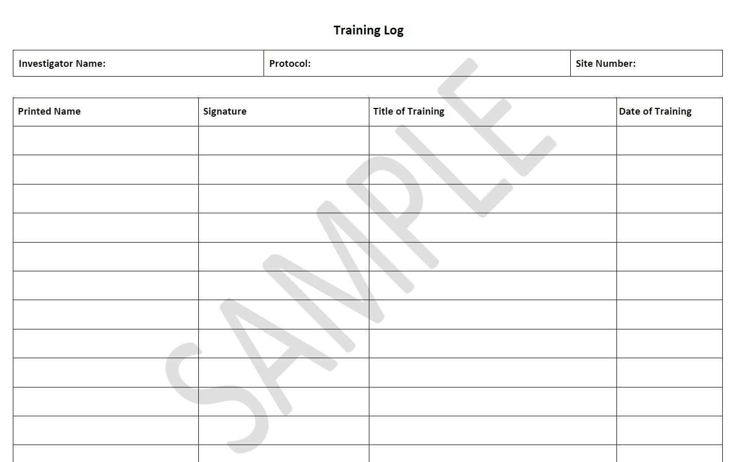
Example Training Log:

Slide 35
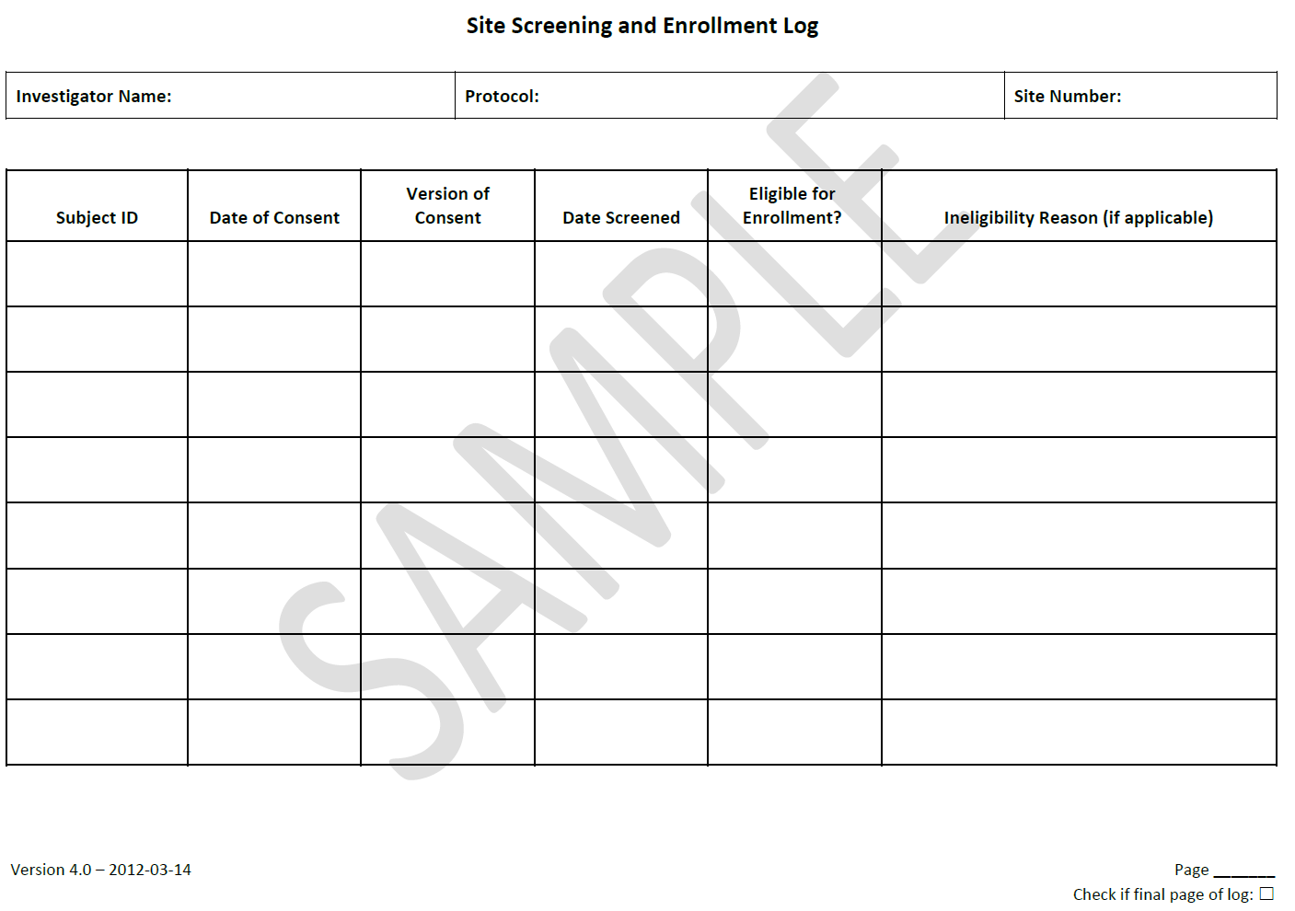
Screening/Enrollment Log
Used to document the consent and screening of all subjects and the outcome of each screening
Contains subject’s assigned study code, date screened, eligibility for enrollment and/or reason for screen failure
NO subject identifiers
Tracked separately using a Code List
Follow site Screening and Enrollment Plan for enrolled subjects (as per IRB application)
May be paper or electronic

Slide 36
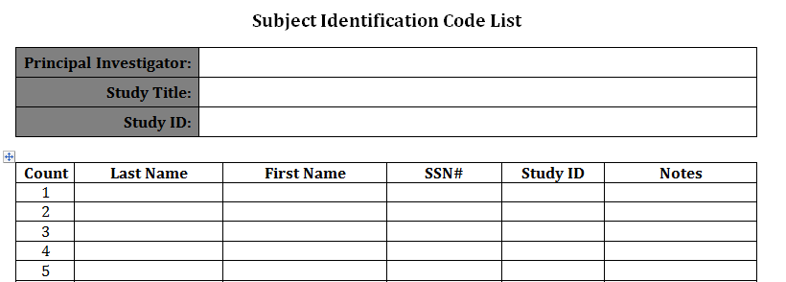
Subject Identification Code List
Confidential List of trial subject names
Allows the Investigator/Institution to reveal identity of
subject (ONLY)
NEVER share with outside entities (e.g. Sponsor, CRO)

Slide 37
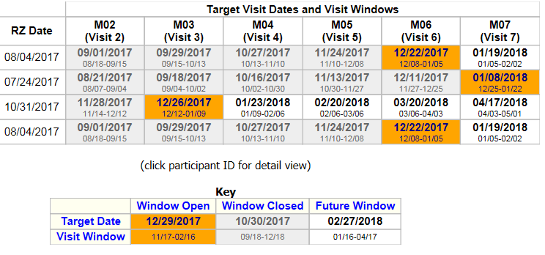
Subject Visit Tracking Log
Log of enrolled subject visits
Used to track scheduled visits as per protocol (e.g. within visit windows)
Reasons for Early Termination (ET)
Electronic Visit Log: visit compliance with protocol-specific appointments/or procedure visit
Example:
Notes:
REDCap form, sponsor-provided

Slide 38
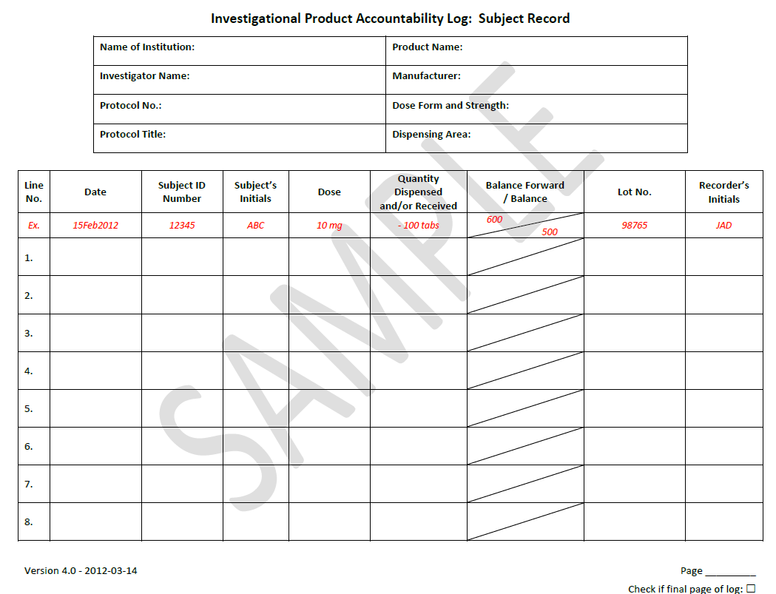
Investigational Product (IP) Accountability Records
Documentation of IP delivery to the site, inventory at the site, use by each subject, return to site, return to sponsor or destruction
Shipment Records
Receipt documentation
Stock (inventory) Record
Subject Dispense Record
Temperature logs
Investigational Drug Services (IDS) maintain
records (e.g. study product is blinded to the research
team)
Document location of records (e.g. Note-To-File in Reg Binder)

Slide 39
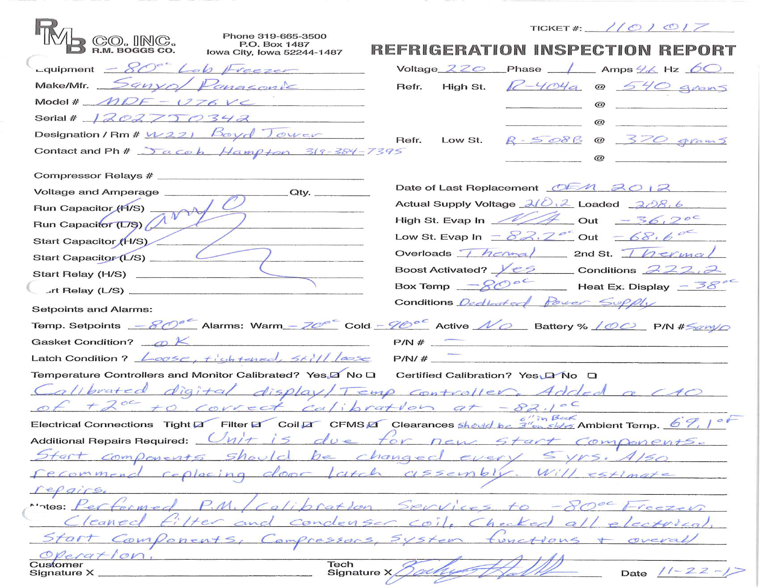
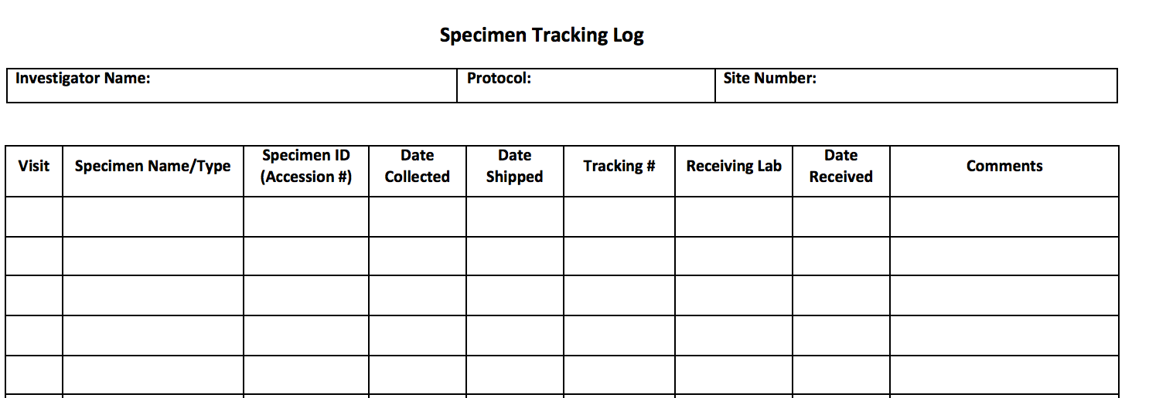
Clinical Laboratory Documentation
Lab reference ranges
Copy of lab certificates/accreditations (CAP, CLIA)
PI determination of clinical significance for all lab reports along with PI signature/date
i.e., clinically significant, nonsignificant, or abnormal
Lab Specimen Tracking Log
Specimen tracking log
Shipping documentation
Storage temperature logs
Freezer inspection reports

Slide 40
Clinical Lab Certificates
Examples: UIHC Pathology CLIA/CAP
https://www.medicine.uiowa.edu/pathology/research/pathology-clinical-trials-support-core

Slide 41
Adverse Events Documentation
Adverse Events (AEs) / Serious Adverse Events (SAEs)
SAE forms and memos
Correspondence, acknowledgement of reports of AEs
Documentation that event was reported to IRB, Sponsor, regulatory authorities
IND Safety Reports
AE/SAE Log
Unanticipated Problems (UPs)
Unanticipated Problems reports to IRB, Sponsor and regulatory authorities

Slide 42
Clinical Site Monitoring Visits
Monitoring Signature Log/Visit Record
Both Monitor and Research Team Member involved with the site visit must sign and date Visit Log:
Study Initiation Visit (SIV)
Interim Monitoring Visit (IMV)
Close-Out Visit
File original letter/email announcing each visit
File all visit correspondence
Follow Up Letter or report documenting findings and action items
Documentation that actions have been taken /issues have been resolved - signed off by monitor

Slide 43
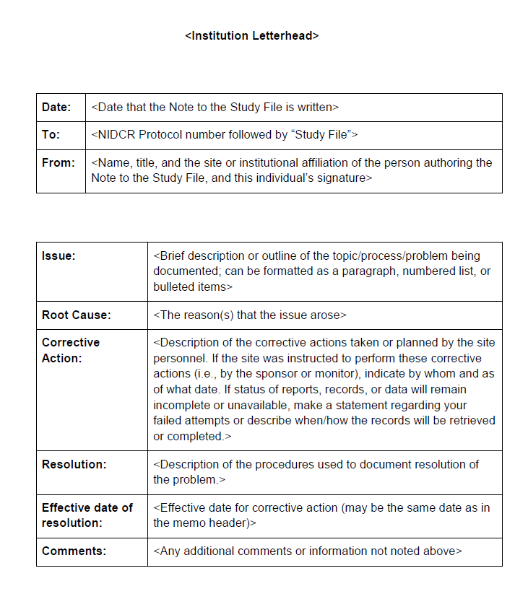
Notes-To-File (NTFs)
Should be used “thoughtfully”
When used to document an issue in the conduct of the study or a discrepancy (e.g., missing data item or a missing date on a consent form) should include:
Description of the issue/discrepancy
The root cause for the issue/discrepancy
Corrective and preventive actions that have been
taken to address the root cause
Discrepancy or Problem Action

Slide 44
Notes-To-File (NTFs)
Print on institution letterhead
Authored, signed, and dated by an individual responsible for its content:
Principal Investigator (PI) for issues/discrepancies/deviations related to PI responsibilities
e.g., human subject protection or data integrity at the site
An appropriately credentialed individual from the sponsor for issues/discrepancies/deviations related to actions taken by the sponsor/monitor
e.g., clarification of a protocol section
If applicable, send a scanned pdf to a Data Management Center (DMC)
File NTFs in the site Regulatory binder

Slide 45
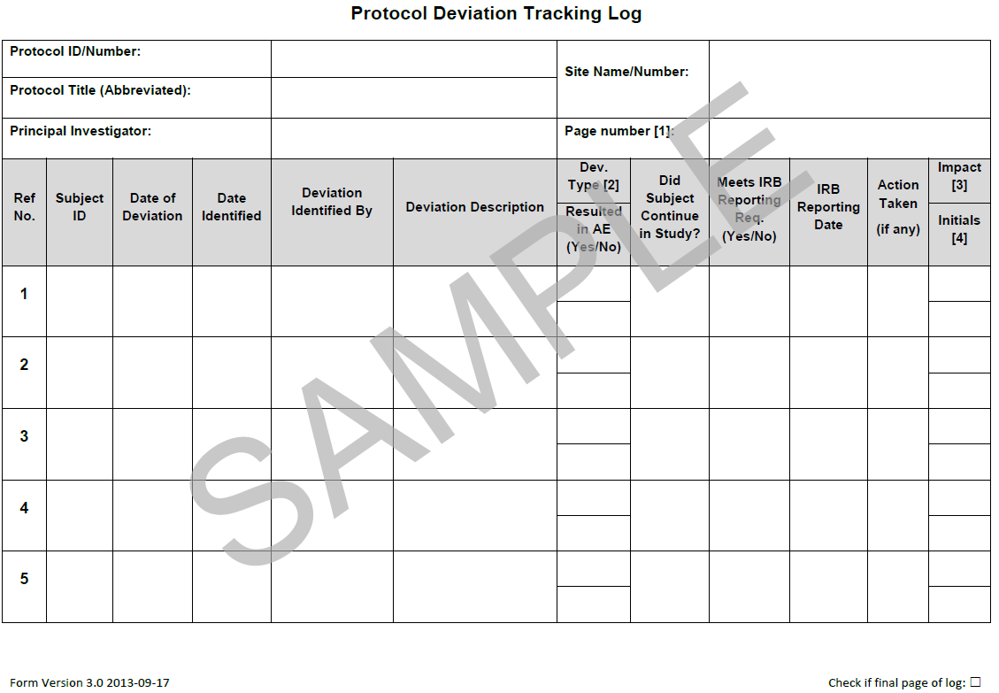
Deviation Log
Used to document all protocol deviations that occur on the study
Deviations – changes, divergence, or departure from the approved study design or procedures of the research protocol that have not been approved by the IRB and Sponsor
Report all deviations to IRB and Sponsor as per requirements

Slide 46
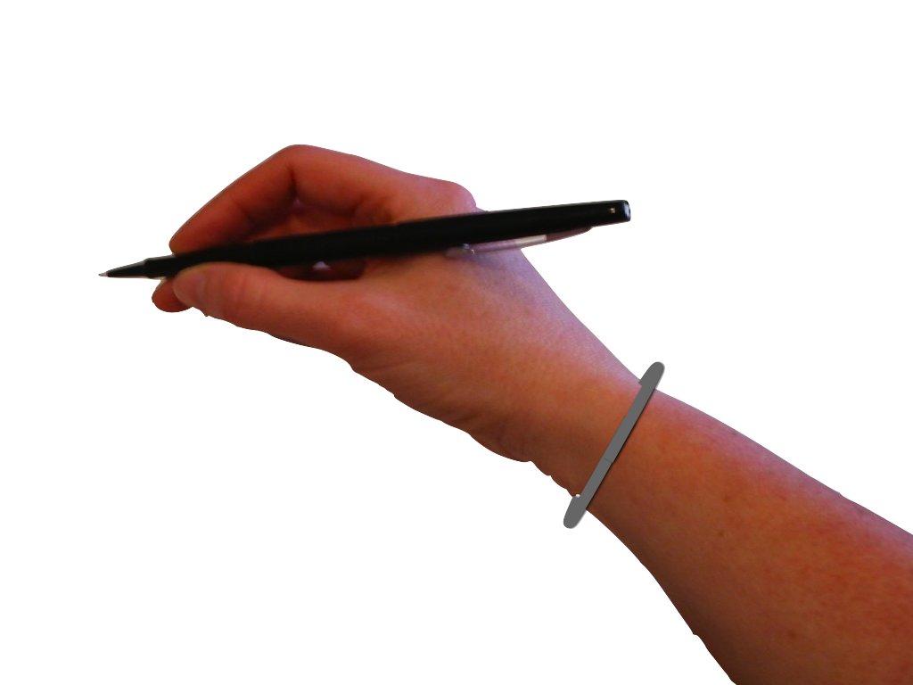
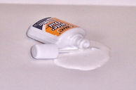
Good Documentation Practice
Document what is - and what is not – done
Provide reasons for any missed information
Use of indelible blue or black ink on paper forms.
Reduces fading over time or smudging
No pencils, felt-tipped markers or white-out
No back or future dating – use of current date when entries are made.
No “ditto” marks for repetitive data
Instrument printouts: Adhere printout to Original Source Document; add initials and date where the printout is attached.
Printouts sent for research data purposes need coded, redacted, or de-identified

Slide 47
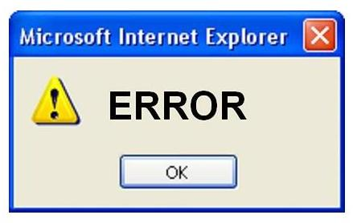
Correcting Information
Good Documentation Practice
Errors happen! Corrections are expected
Single line through incorrect information, do not to obscure original data
No writing over data (e.g. turning a 0 into a 9) - hides the original data
Enter the correct information
Initial and date when the corrections were made - CAS 05/17/2018
Entries on study documents and changes to those entries should be made by study team members with the authority to do so as delegated by the PI

Slide 48
“ALCOA-C”
Good Documentation Practice
A
Attributable: to who created the record; sign & date
Legible: readable, clear, comprehensible, identifiable
Contemporaneous: record activity as events occur
Original: original source document
Accurate: exact, truthful, correct, verifiable date
Complete: capture all required data, no blank spaces
21 CFR 58.130 (e)
**Changes to source documents should be traceable. ICH GCP (R2) 4.9.0 & 8.1
L
C
O
A
C
Notes:
If it wasn’t documented, it wasn’t done!
ALCOA has its roots in the Federal Regulations governing good laboratory practice for non-clinical laboratory studies, or 21 CFR 58.130 (e)
“ALCOA” remains the practice for FDA auditor and quality assurance professionals regarding clinical practice.

Slide 49
Electronic Documentation and Data
Electronic Medical Records (EMR) present security, and other legal challenges; know your institutional regulations at UIHC
Electronic Data Capture (EDC) systems are being utilized for databases, electronic case report forms (eCRF), clinical monitoring, and maintaining regulatory documents
Examples: Medidata Rave, Orcale, InForm, OmniComm, RedCAP
FDA guidance (May 2016) for source data should be ALCOA

Slide 50
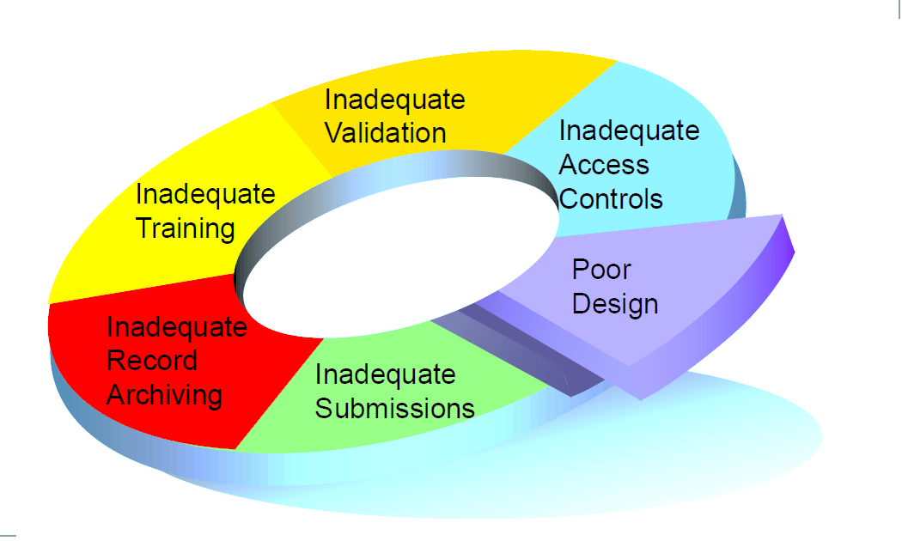
Electronic Data
21 CFR 11 FDA regulations for Electronic Records; Electronic Signatures
Validate Systems to ensure accuracy, reliability,
consistent performance, ability to discern invalid
or altered records
Access Controls: Internal security safeguards
limit access, passwords, authorized users,
automatic times log off
External Security: protect records
Audit Trails: track all changes; date/time
Document computer education, training and experience
Commonly cited issues:
Notes:
Never Share prior login and password to access, enter/ modify data in sponsor-provided system

Slide 51
Documentation Resources
Websites and Links for more information
https://nccih.nih.gov/grants/toolbox#startup
Register the Clinical Trial(s) http://www.clinicaltrials.gov
ICH E6 Guidance: http://www.ich.org/fileadmin/Public_Web_Site/ICH_Products/Guidelines/Efficacy/E6_R1/Step4/E6_R1__Guideline.pdf
Electronic Code of Federal Regulations http://ecfr.gpoaccess.gov/cgi/t/text/text-idx?c=ecfr&tpl=%2Findex.tpl
University of Iowa Resources – Human Subjects Office & HAWKIRB: https://hso.research.uiowa.edu
Final Rule: https://www.nih.gov/news-events/news-releases/hhs-take-steps-provide-more-information-about-clinical-trials-public
NIDCR’s Toolkit for Clinical Researchers: http://nidcr.nih.gov/research/toolkit
Office for Human Research Protections (OHRP): http://www.hhs.gov/ohrp/
https://www.nidcr.nih.gov/research/human-subjects-research/toolkit-and-education-materials
https://nccih.nih.gov/grants/toolbox/pdfs

Slide 52
Thank you!

