Slide 1
Academy for Research Professionals 2017 Fall Workshop ESSENTIAL DOCUMENTATION (Part 1) SAFETY of the SUBJECT (Part 2)
Tuesday September 12, 2017

Slide 2
Disclosures: No conflicts of interest.
The Presenter has no financial conflict of interest with any organization regarding the material discussed in this presentation.
Notes:
Before we take a LOOK…. I have no conflict of interests either financially or with the material I’m presenting.

Slide 3
DOCUMENTATION (Part 1)
Best Practices
Data Collection and Data Management
21 CFR Part 11
The Role of the Research Coordinator

Slide 4
Objectives
DOCUMENTATION (Part 1)
Documentation necessary to conduct quality clinical trials
Understanding Essential Documents and their relationship to regulatory guidelines and requirements
Regulatory Binder Document Management
Documentation & Record Keeping
Toolkit of Resources
Source Document Tips and Tools
Electronic Documentation and Requirements
Lifecycle of the Data Management

Slide 5
BACKGROUND
Elements of a Quality Clinical Study
Scientifically valid and ethically sound experimental design
Adequate protection of subjects right, safety, and welfare
Qualified personnel
Adequate monitoring
Current, complete and accurate data collection
Document management

Slide 6
BACKGROUND
Research
Federal
Industry
Private
Organization
Funding
Key
Component
Notes:
Funding is a key component for the conduct of any type of research activities.
Federal - funding through grants from agencies such as the National Institutes of Health (NIH). The oversee many agencies including the National Eye Institute or NEI
Industry – pharmaceutical research from sponsor (drug or device company) [examples Sanofi, Akorn, Allergan, ALCON, Bausch & Lomb, Bayer, GLAXCO, etc]. These clinical trials are usually run under the direction of the middle, non-biased clinical research organization (CRO) [EMMAES,
Private - benefactor foundations (Doris Duke, Howard Hughes Institute), organizations (Prevent Blindness,
Investigator Initiated

Slide 7
CLINICAL RESEARCH GUIDELINES
REGULATORY
HIPAA Privacy Rule 45 CFR Part 160; Subparts A and E of 164
Joint Office for Compliance & Billing
FDA Regulations 21 CFR 50.27
Institutional Review Board (IRB)
Documentation/Source Documents ICH E6 GCP
Protected Health Information Access (HIPAA) 45 CFR 160
Common Rule 38 CFR 16.111
Federal Code of Regulations (CFR)
Department of Health & Human Services (DHHS)
Monitors & Sponsor
VHA Handbook – Medical research in VHA facilities
Notes:
2) Regulatory mechanisms.
There are a number of policies governing privacy and confidentiality in research. Whereas these are not exhaustive, they are the major regulations to which investigators must adhere.
Common Rule 38 CFR 16.111 - When appropriate, there are adequate provisions to protect the privacy of subjects and to maintain the confidentiality of data.
FDA Regulations 21 CFR 50.27 - The ICF includes a statement describing the extent, if any, to which confidentiality of records identifying the subject will be maintained and that notes the possibility that the FDA may inspect the records.
HIPAA Privacy Rule 45 CFR Part 160 and Subparts A and E of part 164 - Research is not a covered function in itself. However, VA research (and clinical trials in and of themselves are covered) because it involves health care by a covered entity (VHA), and medical record or biologic samples labeled with health information are maintained by the covered entity (VHA) in the trial.
VHA Privacy Policy VHA Handbook 1605.1 and VHA Handbook 1605.2- Incorporate the HIPAA regulations into VHA-specific policy. It applies to all patient health information at VHA facilities, including that used for medical research or produced in the course of that research.

Slide 8
Regulations & Guidelines Declaration of Helsinki: Contents underpin the Principles of ICH GCP
REGULATORY
International ethical, scientific and
quality standards for clinical trials.
Recommended, not legally bound
requirements.
Assures trial subjects the rights,
integrity and confidentiality.
Identifies cooperation between 3 entities:
Sponsor, Principal Investigator and IRBs
FDA adopted ICH only as
guidance in 1997.
ICH = International Conference of Harmonization
E6 ICH Harmonized Tripartite Guideline
GCP = Good Clinical Practice
FDA = U.S. Food & Drug Administration
OHRP = Office for Human Research Protections
IRB = Institutional Review Board (External/or Internal)
Notes:
The International Conference on Harmonization of Technical Requirements for the Registration of Pharmaceuticals for Human Use, commonly referred to as the International Conference on Harmonization (ICH) is an attempt to streamline the process for developing and marketing new drugs internationally. The ICH is comprised of representatives from the pharmaceutical industry and the regulatory bodies of the United States, Japan and the European Union. In addition, observers include Canada, the European Free Trade Area, and the World Health Organization. The ICH has established several international standards of Good Clinical Practice (GCP) for the development of pharmaceutical products. The guideline that primarily affects investigators in the daily practice of clinical research is E6, "ICH Harmonized Tripartite
Guideline: Guideline for Good Clinical Practice." The E6 guideline has 8 parts: 1) glossary; 2) principles; 3) IRBs; 4) investigator; 5) sponsor; 6) protocol and amendments; 7) Investigator's Brochure; and 8) essential documents. The initial basis for drafting the E6 guidelines was the U.S. FDA regulations for the protection of human subjects (21 CFR 50 and 56).
GCP & ICH are recommendations, not legal requirements, that should be followed for clinical trials in which data are generated to submit to regulatory authorities internationally.
Good Clinical Practice (GCP) is an international ethical and scientific quality standard for clinical trials. GCP sets standards for design, conduct, performance, monitoring, auditing, recording, data analysis and reporting of clinical trials providing assurance that the data and reported results are credible and accurate. GCP also assures that the rights, integrity and confidentiality of trial subjects are protected.
GCP identifies three parties that cooperate in the conduct of a clinical trial: Sponsor, Principal Investigator (PI), and Institutional Review Board (IRB).
The Sponsor is that individual who submitted the IND (Investigational New Drug Application) or IDE (Investigational Drug Exemption) to the FDA or the individual responsible for the initiation and management of the trial when exempt from FDA IND/IDE regulations. The Sponsor may be an individual, company, institution or organization.
The PI is responsible for the overall conduct of the clinical trial at his or her study site. The PI is also responsible for the actions of his or her study team and any sub-investigators.
The IRB is the oversight committee charged with evaluating research studies for compliance with ethical standards as enumerated in the Common Rule. In the VA, the IRB must be the one of record for the VA facility where the study is being conducted.
The balance of this course will focus only on the roles and responsibilities of the PI. It will discuss five major areas: accountability, informed consent, safety reporting, documentation, and privacy/confidentiality.
Good Clinical Practice (GCP) is an international ethical and scientific quality standard for clinical trials. GCP applies to:
Research involving drug and biological products
Design, conduct, and documentation of a clinical trial
Roles and responsibilities of the Sponsor, Principal Investigator, and Institutional Review Board
ICH regulations is agreed by most countries involved in clinical drug development.

Slide 9
Regulations & Guidelines
REGULATORY
International Conference of Harmonization (ICH)
ICH has established several international standards of Good Clinical Practice (GCP) for the development of pharmaceutical products. The guideline that primarily affects investigators in the daily practice of clinical research is E6, "ICH Harmonized Tripartite”.
Guidelines for Good Clinical Practice (E6) has 8 parts: 1) glossary; 2) principles; 3) IRBs; 4) investigator; 5) sponsor; 6) protocol and amendments; 7) Investigator's Brochure; and 8) Essential Documents.
The foundation for the GCP E6 guidelines was the U.S. FDA regulations for the protection of human subjects (21 CFR 50 and 56).
Notes:
The International Conference on Harmonization of Technical Requirements for the Registration of Pharmaceuticals for Human Use, commonly referred to as the International Conference on Harmonization (ICH) is an attempt to streamline the process for developing and marketing new drugs internationally. The ICH is comprised of representatives from the pharmaceutical industry and the regulatory bodies of the United States, Japan and the European Union. In addition, observers include Canada, the European Free Trade Area, and the World Health Organization. The ICH has established several international standards of Good Clinical Practice (GCP) for the development of pharmaceutical products. The guideline that primarily affects investigators in the daily practice of clinical research is E6, "ICH Harmonized Tripartite
Guideline: Guideline for Good Clinical Practice." The E6 guideline has 8 parts: 1) glossary; 2) principles; 3) IRBs; 4) investigator; 5) sponsor; 6) protocol and amendments; 7) Investigator's Brochure; and 8) essential documents. The initial basis for drafting the E6 guidelines was the U.S. FDA regulations for the protection of human subjects (21 CFR 50 and 56).
GCP & ICH are recommendations, not legal requirements, that should be followed for clinical trials in which data are generated to submit to regulatory authorities internationally.
Good Clinical Practice (GCP) is an international ethical and scientific quality standard for clinical trials. GCP sets standards for design, conduct, performance, monitoring, auditing, recording, data analysis and reporting of clinical trials providing assurance that the data and reported results are credible and accurate. GCP also assures that the rights, integrity and confidentiality of trial subjects are protected.
GCP identifies three parties that cooperate in the conduct of a clinical trial: Sponsor, Principal Investigator (PI), and Institutional Review Board (IRB).
The Sponsor is that individual who submitted the IND (Investigational New Drug Application) or IDE (Investigational Drug Exemption) to the FDA or the individual responsible for the initiation and management of the trial when exempt from FDA IND/IDE regulations. The Sponsor may be an individual, company, institution or organization.
The PI is responsible for the overall conduct of the clinical trial at his or her study site. The PI is also responsible for the actions of his or her study team and any sub-investigators.
The IRB is the oversight committee charged with evaluating research studies for compliance with ethical standards as enumerated in the Common Rule. In the VA, the IRB must be the one of record for the VA facility where the study is being conducted.
The balance of this course will focus only on the roles and responsibilities of the PI. It will discuss five major areas: accountability, informed consent, safety reporting, documentation, and privacy/confidentiality.
Good Clinical Practice (GCP) is an international ethical and scientific quality standard for clinical trials. GCP applies to:
Research involving drug and biological products
Design, conduct, and documentation of a clinical trial
Roles and responsibilities of the Sponsor, Principal Investigator, and Institutional Review Board
ICH regulations is agreed by most countries involved in clinical drug development.

Slide 10
REGULATORY
U.S. Department of Health and Human Services – FDA U.S. Food & Drug Administration
Clinical Trials and Human Subject Protection
“Adherence to the principles of good clinical practices (GCPs), including adequate
human subject protection (HSP) is universally recognized as a critical requirement
to the conduct of research involving human subjects.
Many countries have adopted GCP principles as laws and/or regulations.
The Food and Drug Administration’s (FDA’s) regulations for the conduct of clinical trials,
which have been in effect since the 1970s, address both GCP and HSP.
These FDA regulations and guidance documents are accessible from this site.
International GCP guidance documents on which FDA has collaborated and that have
been adopted as official FDA guidance are also be found there. Finally, this site includes
links to other sites relevant to the conduct of clinical trials, both nationally and internationally.”
http://www.fda.gov/ScienceResearch/SpecialTopics/RunningClinicalTrials/default.htm

Slide 11
REGULATORY
Oversight for research subjects is under the federal guidelines of the Office for Human Research Protection (OHRP). This government agency provides leadership in the
protection of the rights, welfare, and wellbeing of subjects
involved in research conducted or supported under the
U.S. Department of Health & Human Services (HHS).
OHRP helps ensure this by providing clarification and guidance, developing educational programs and materials, maintaining regulatory oversight, and providing advice on ethical and regulatory issues in biomedical and social-behavioral research.
http://www.hhs.gov/ohrp/index.html
Notes:
Oversight for research subjects is under the federal guidelines of the Office for Human Research Protection (OHRP).
This agency provides leadership in the protection of the rights, welfare, and wellbeing of subjects involved in research conducted or supported by the U.S. Department of Health & Human Services (HHS).
OHRP helps ensure this by providing clarification and guidance, developing educational programs and materials, maintaining regulatory oversight, and providing advice on ethical and regulatory issues in biomedical and social-behavioral research.

Slide 12
REGULATORY
Both the Federal 45 CFR and International Committee of Harmonization (ICH) E6 GCP
Provides Guidance and Standards in Clinical Research:
Rights, safety, and well-being of subjects
Roles and Responsibilities of Investigators and Research Staff
Study conduct and protocol management
Safety reporting
Documentation and Record Keeping

Slide 13
REGULATORY
These resources and other tools are available through NIDCR’s Toolkit
for Clinical Researchers:
http://nidcr.nih.gov/research/toolkit
Objective | Resource
Protection of Human Subjects | 45 CFR 46
Staff Qualifications/Training | ICH E6, Sec 4.1. Sec 4.2
Research Resources | ICH E6, Sec 4.2
Protocol Adherence | ICH E6, Sec 4.5
Record Keeping | ICH E6, Sec 4.4.1, Sec 4.9, Sec 8
FAQs (OHRP Investigator Responsibilities) | http://answers.hhs.gov/ohrp/categories/1567

Slide 14
REGULATORY BINDER
Purpose
To provide an organizational framework for filing paper versions of essential study documents (or referencing location of an electronically stored file)
Compliance for Good Clinical Practice (GCP)
Core documentation GCP-required before a study is initiated.
GCP-required essential documents satisfy NIH grant documentation requirements.
To ensure all GCP-required essential documents are in place and in order for the clinical trial
Good Clinical Practice (E6) Section 8.1, 8.2, 8.3, 8.4

Slide 15
ICH E6 Consolidation Guide for GCP regulations: Essential Documents should be collected and filed in the Regulatory Binder for each clinical study. Sections for Collection of Documents: 1. Before the clinical phase of the study commences 2. During the clinical conduct of the study 3. After completion or termination of the study **Required for both observational and interventional clinical research studies
REGULATORY BINDER

Slide 16
Essential Documents - Regulatory Binder
Essential Documents must be organized and retained for the conduct of clinical studies.
These organized documents are referred to as the REGULATORY BINDERS
The binder must be kept at the Investigator’s clinical site
**TIP: Synonyms: Investigator Binder = Regulatory Binder = Investigational Site File (ISF) = Study Binder =
Master Trial File (MTF)

Slide 17
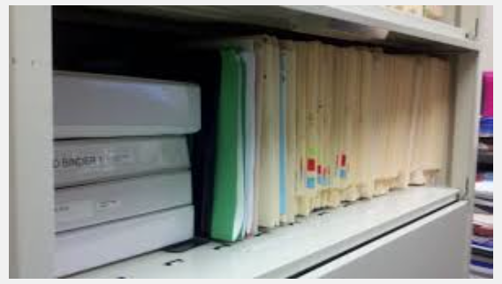
REGULATORY BINDER
Location of the Regulatory Binder
Locked office accessible to research study team.
Single or multiple binders stored in the same or different locations.
List other locations in binders, if other than primary site. Know binder locations!
Place a note to file in the section of the binder reference location of separate binder or location of Electronic document access
**TIP: The Regulatory Binder is the first document reviewed during audits or inspections.

Slide 18
REGULATORY BINDER
Best Practice Recommendations:
Store study documents/items in reverse chronological order, with the newest items within a section placed at the front of the section.
Multi-sites Studies: The Lead Site may choose to customize the checklist for the study and provide to all participating sites.
Good Clinical Practice (E6) Section 8.1, 8.2, 8.3, 8.4

Slide 19
Checklist of Essential Documents
REGULATORY BINDER
Study Protocol – signed, dated by all entities (PI, sponsor)
Study Protocol Amendments
Informed Consent
IRB Approval(s)
Delegate of Authority and Log of Responsibilities
Curriculum Vitae (CV’s) current
Financial Disclosures
Protocol Training Documentation
Training Documentation to conduct research, study-related duties or functions
Adverse Events and/or unanticipated events
Study Protocol Deviations
Note to File (NTF)
Standard Operating Procedures(SOPs); Manual of Procedures (MOPs) and or Appendixes
All communication s between entities (PI, research team, CRO, sponsors, governing boards)

Slide 20
Table of Contents List of Essential Documents
REGULATORY BINDER
Protocol
Supplemental Protocol instructions (Manuals)
Case Report Forms (Blank master copies)
Investigator Brochure (IB)
Consent Forms / Information for Patients
Subject Logs
Serious Adverse Event / Safety reports
IRB Submission Tracking Log / Approvals / Correspondence
Site-Sponsor Correspondence
Protocol Amendments
Notes-To-File / Correspondence
Telephone / Communications Log
Clinic Staff – Roles & Responsibilities / Signatures
Investigational Product Accountability / Logs
Regulatory Documents
Individual Patient Records / Files and Source Documents
Enrollment / Recruitment Logs

Slide 21
“ESSENTIAL” DOCUMENTATION
Documentation, Record Keeping, and Retention
Permits evaluation/audit of the conduct of a study
Permits evaluation/audit of data collected
Demonstrates GCP and compliance with applicable
regulatory requirements
Facilitates study management and oversight
Allows for monitoring and evaluation of practices

Slide 22
Protocol & Amendments
IRB-approved protocol
Signed principal investigator (PI) signature page
IRB-approved Case Report Forms (CRF’s)
IRB-approved advertisements, brochures
IRB-approved Participant Information Sheets
IRB-approved protocol amendments/PI signature page
Log of protocol changes

Slide 23
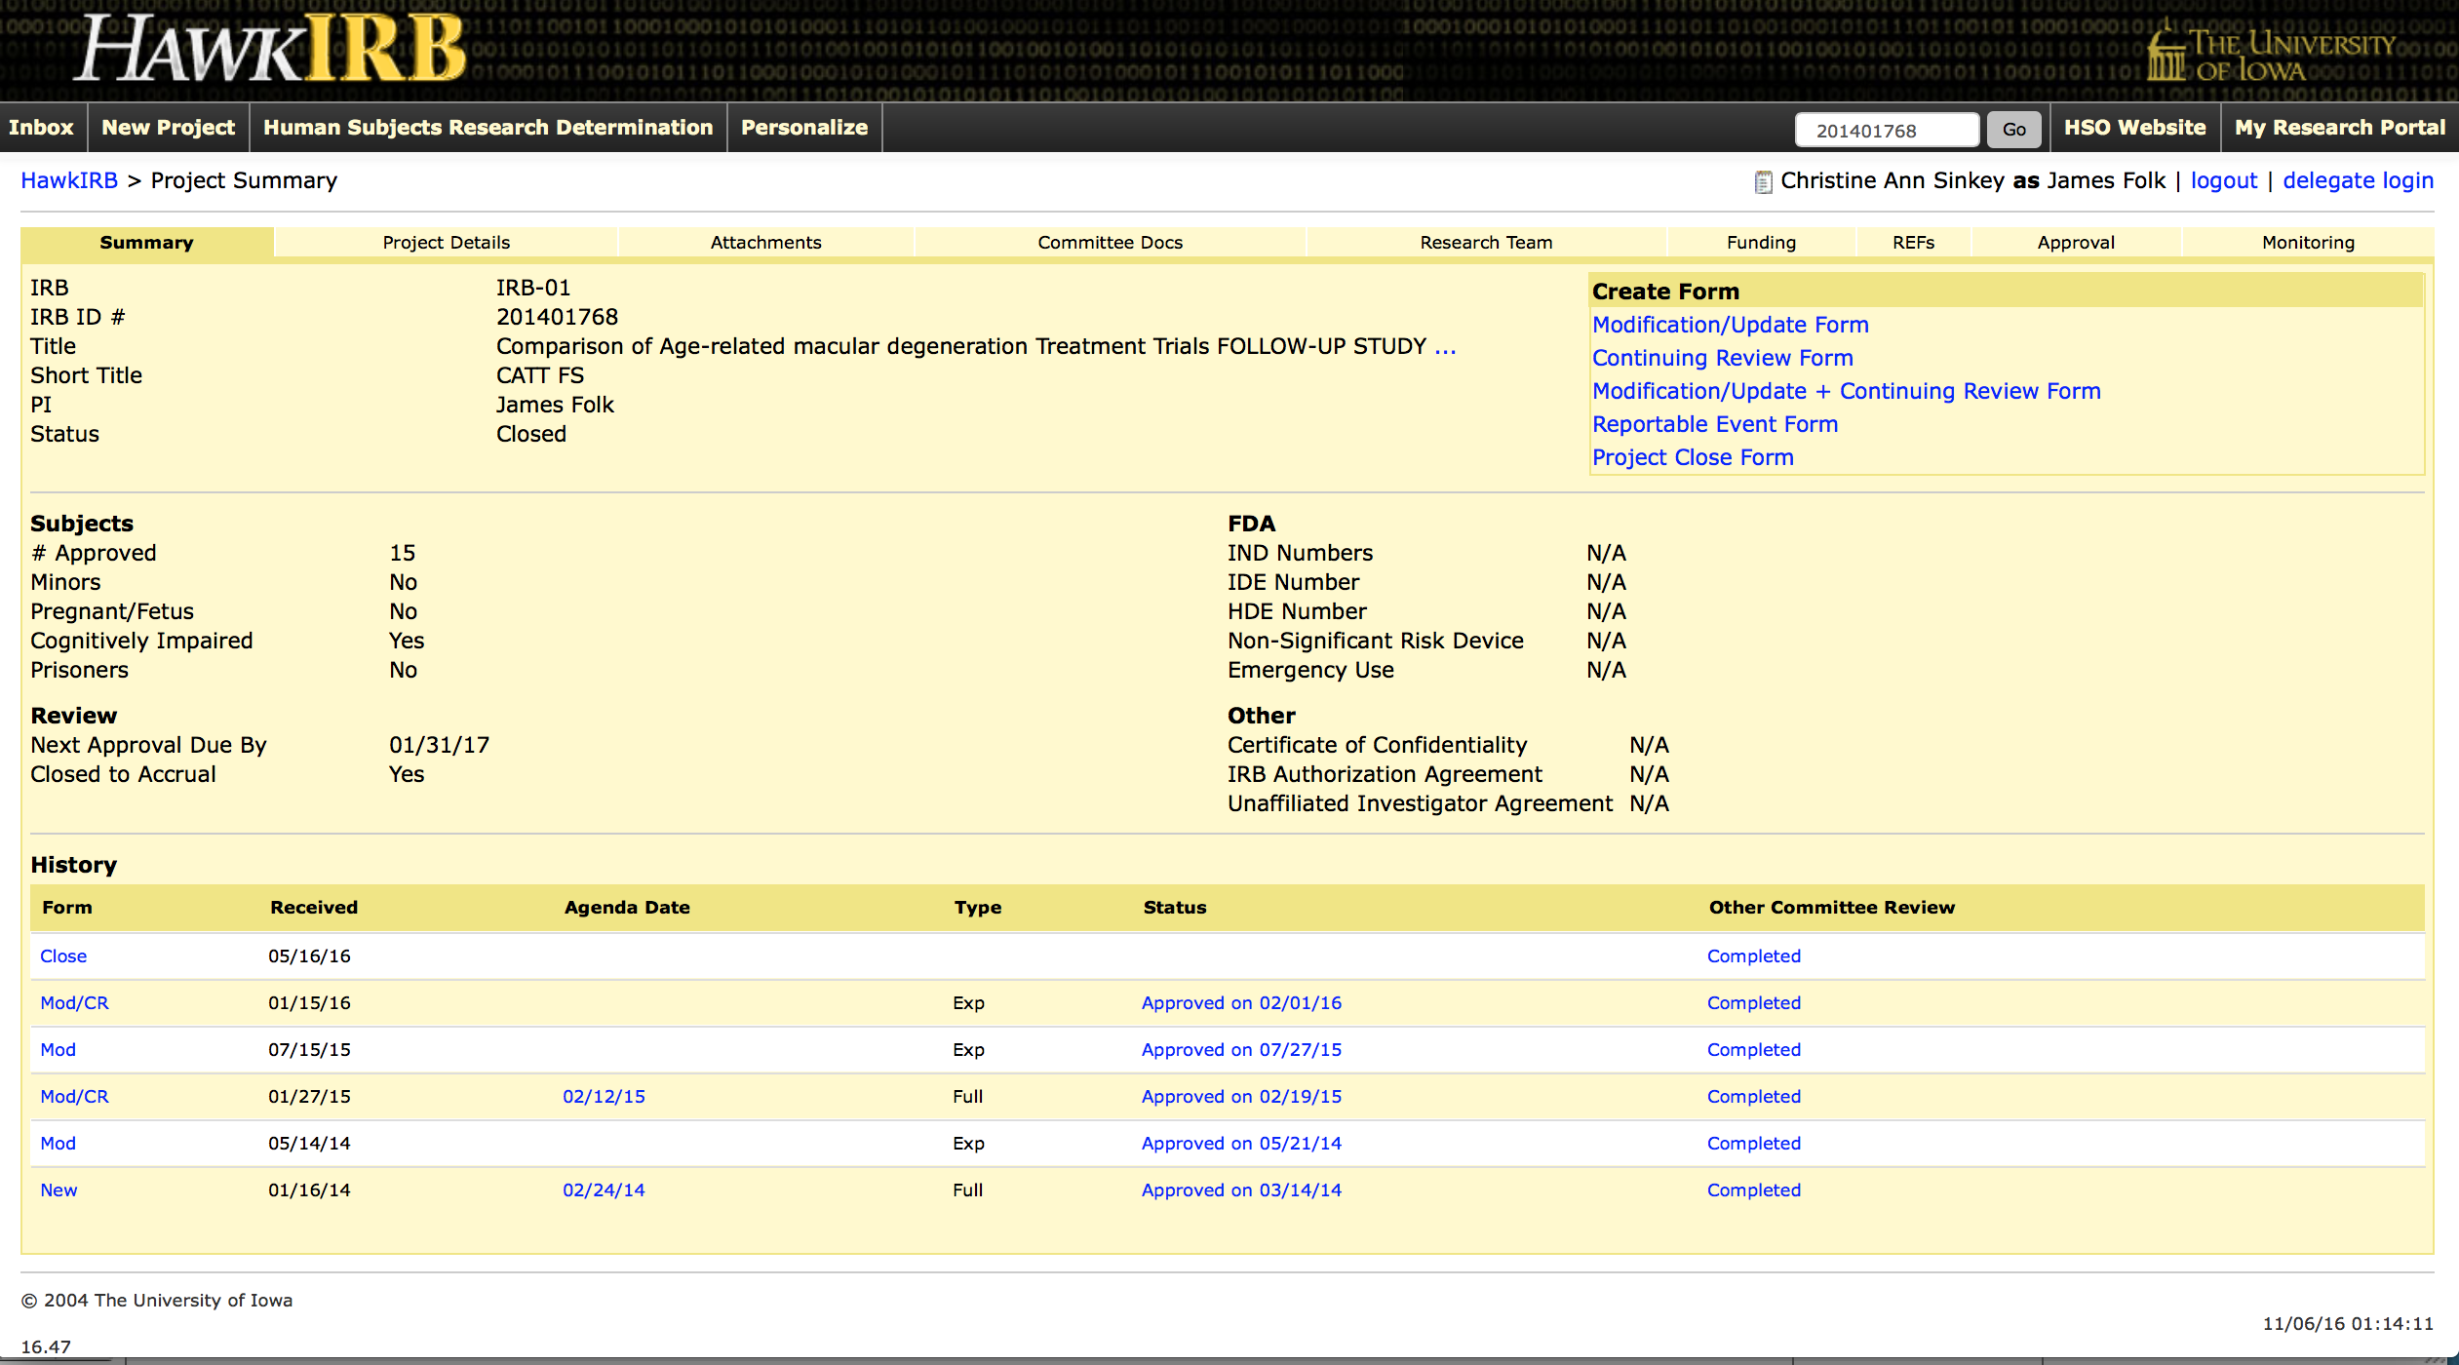
IRB Project Approvals

Slide 24
IRB Documentation & Approvals
IRB Federal Wide Assurance Number (FWA)
Link to OHRP Database (FWA & IRB Registration: http://ohrp.cit.nih.gov/search/IrbDtl.aspx
Updated IRB Rooster
IRB registration (optional)
IRB approval letters
Original IRB application/new project submission
IRB correspondence related to contingent approvals or stipulations
IRB annual reviews
Interim/annual progress reports to IRB
Project closure or termination

Slide 25
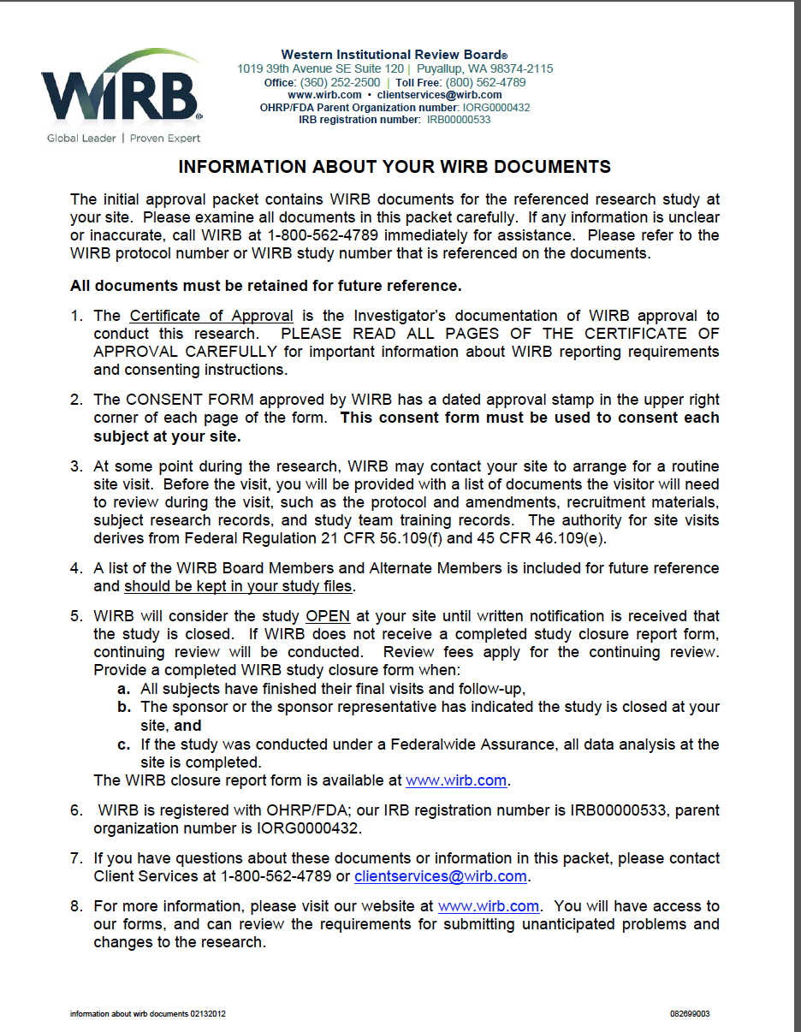
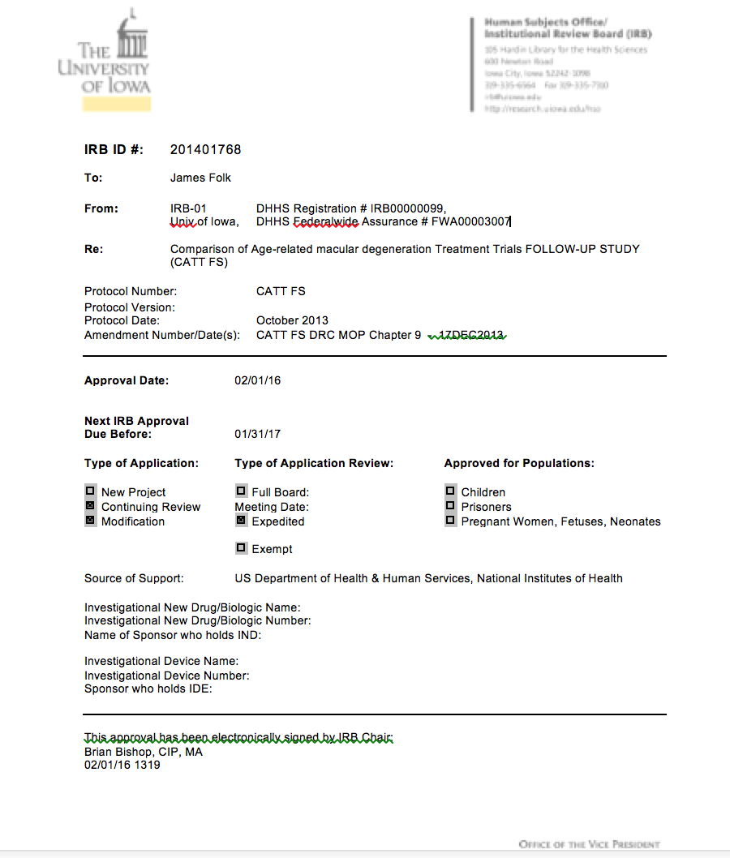
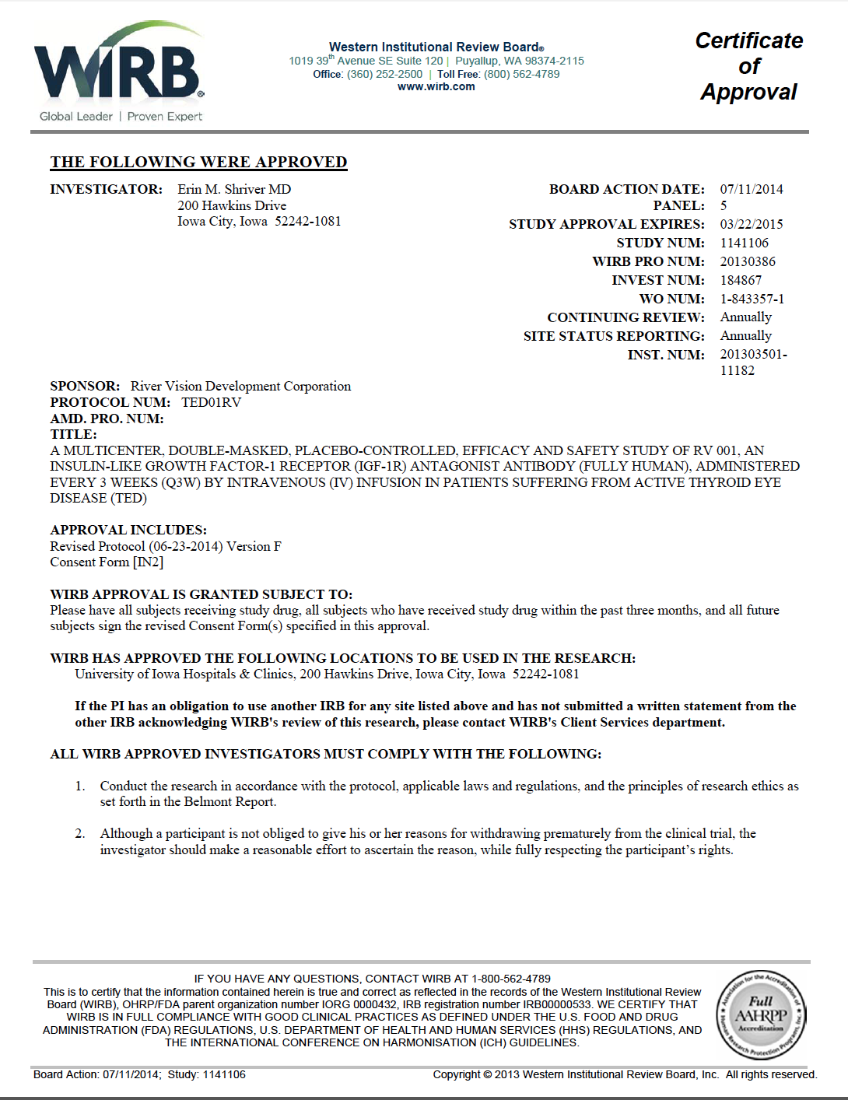
IRB Project Approvals - Examples

Slide 26
Informed Consent Documents
IRB-approved/stamped consent documents (clean copy)
IRB-approved/stamped assent documents
IRB-approved/stamped short form consents for non-English
languages include guidance for consent of non-English speaking subjects
Place most currently approved consent in plastic sleeve
Store in reverse chronological order with current approved version first
Log of Informed Consent versions
**TIP: Protocol version number and date should be on each consent
**TIP: An expiration date of the consent document on actual document, but cross-reference document is preferable to the IRB approval letter of the protocol may be required

Slide 27
Signed Consent Documents
All original signed IRB approved and stamped versions consent documents.
Or, if signed consent documents are kept in a separate binder or in the
subject’s medical record or dental record: A signed and dated memo to file
explaining where the consent documents are stored and the reason for
separate storage.
The signed consent document must be retained even if a subject withdraws
consent of fails the screening process.
All original signed protocol modifications requiring new version of the
Informed Consent Document must be maintained.
A consent log should be maintained with identifiable information. Only for
use at the site never to be shared with a clinical research organization or
sponsor.

Slide 28
Investigator Qualification
Current Updated investigator and sub-investigator Curriculum Vitae
(CVs) with address, signature and date on header; original signature
and date by investigator and sub-investigator
CVs address, name and licensure should reflect information on 1572
Current clinical professional licensure (dental, medical, nursing,
pharmacy, etc.) for PI and co-investigators, if licensed
Update CV and licensure documents as they expire or qualifications
change
**TIP: The CV & licensure dates should reflect mirror each other.

Slide 29
Clinical Investigator’s Brochure (IB)
Clinical investigator’s brochure (drug/product/or device)
Package insert; include labeling for approved medications
All amendments to the IB or package insert should be
included during the trial.
Device information sheet/manual
The IB document provides information on the mechanism of action, potential risks and adverse reactions and the ‘expected’ adverse reactions associated with the previous use of the drug/product/or device

Slide 30
FDA Documentation
FDA Form 1571 for Investigational New Drug application (IND): Date and sign all versions.
Required as part of the FDA submission packet as well as investigator initiated studies.
FDA Form 1572 Statement of Investigator (21 CFR Part 312) for IND studies involving an
investigational drug or sponsor requests: Date and sign all versions.
Signed investigator agreement (if applicable): device studies
Samples of labels attached to investigational product containers
Regulatory approval or authorization
FDA Correspondence Log (if applicable)
Go to FDA site for most current pdf of Forms to download:
http://www.fda.gov/AboutFDA/ReportsManualsForms/Forms/default.htm

Slide 31
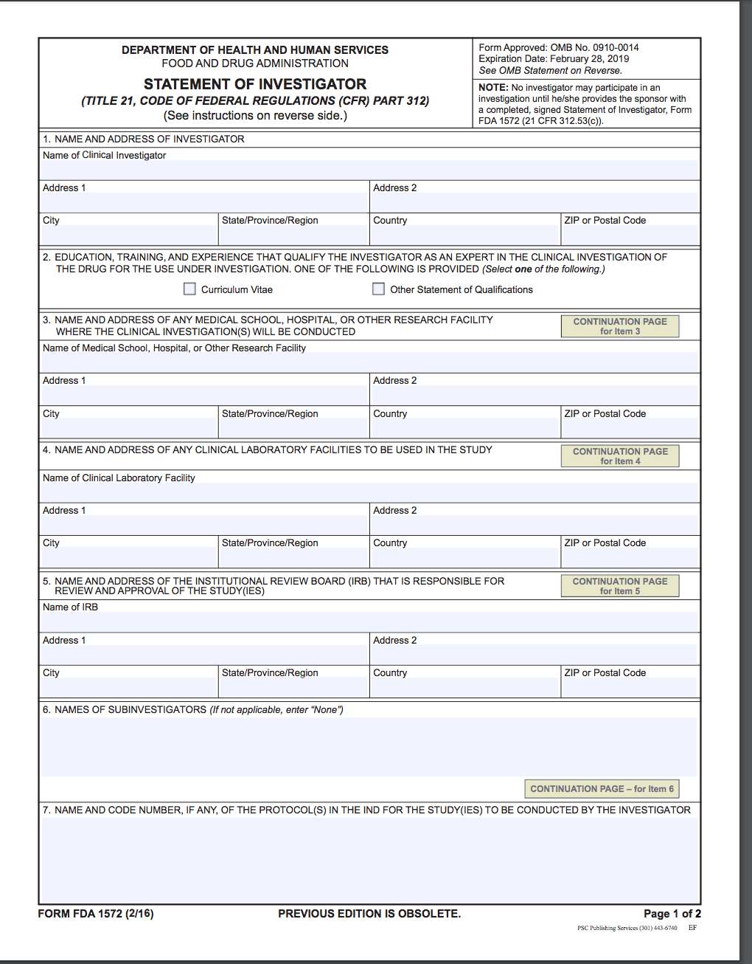
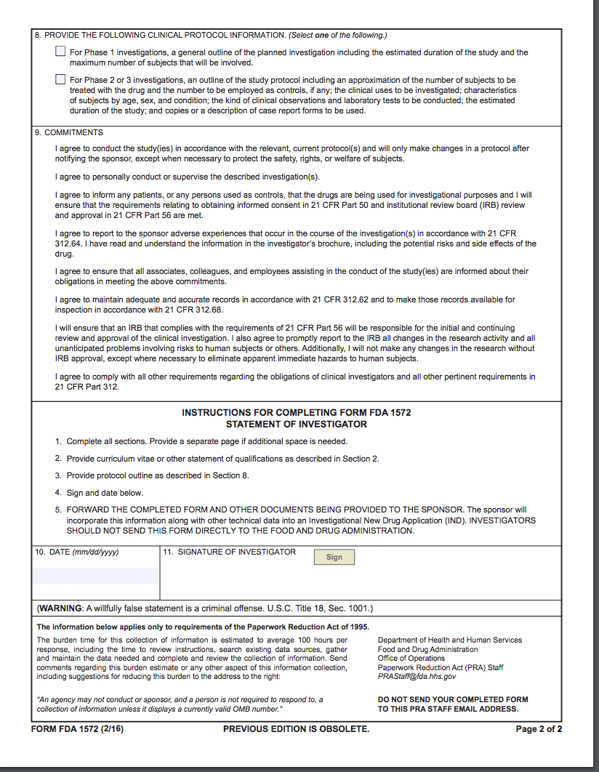
Example: Form FDA 1572:
Notes:
The FDA Form 1571 or ‘1571’ is the IND application cover page and it must accompany the initial IND submission and any amendments, IND safety reports, annual reports or general correspondence the sponsor submits to the FDA about the IND. The 1571 is a contractual agreement between the sponsor and the FDA. By signing the 1571, the SI agrees to the following:
S/he will not begin the clinical investigations until 30 days after the FDA’s receipt of the IND, unless the sponsor receives earlier notification from the FDA
S/he will not begin or continue the investigations covered by the IND if the FDA has placed the investigations on clinical hold
S/he will conduct the investigation in accordance with all other applicable regulatory requirements
An IRB that complies with 21 CFR 56 will be responsible for initial and continuing review and approval

Slide 32
Delegation of Authority Log (DoR)
Log with assigned study responsibilities or authority log with role
descriptions signed by the Principal Investigator (PI)
Delegated roles and descriptions to conduct the research study
Lists of all research team members on IRB application:
Research Team Members Start and Stop Dates
PRINTED name, initials, & original signatures
Study Role Description(s)

Slide 33
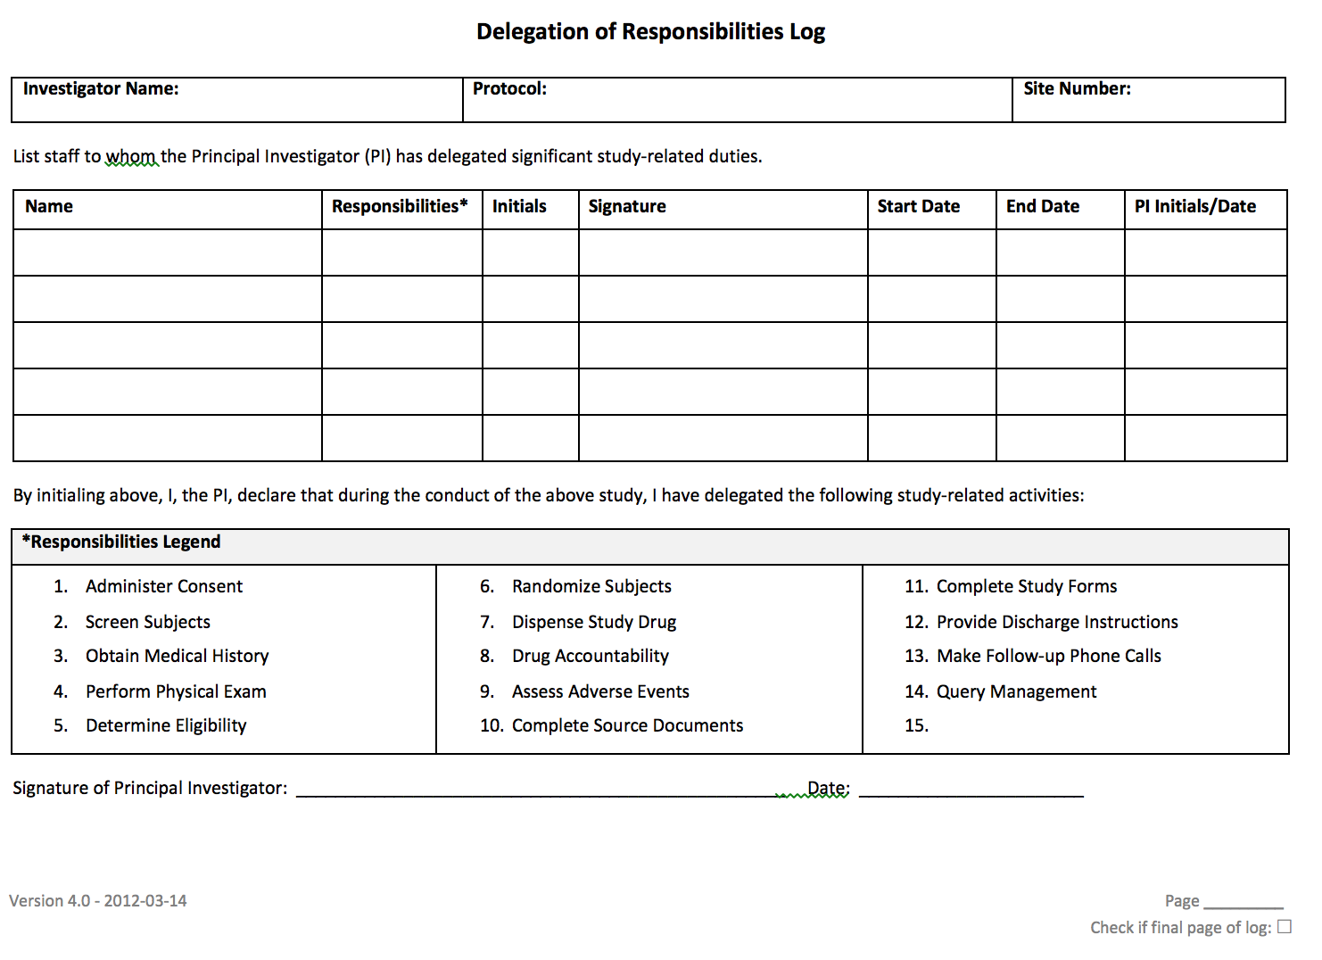
Example: Delegation of Authority (DoR)

Slide 34
Research Team Training
Documentation of current educational completion certificates for
Human Subject Protections and Good Clinical Practice (GCP)
training for all staff members (CITI)
Documentation of study-related training or procedure certification
Dangerous Goods training (if applicable)
Documentation of shipping biologics (IATA)
Procedure training log
**TIPS: Current certifications based on institutional, GCP, & ICH guidelines.

Slide 35
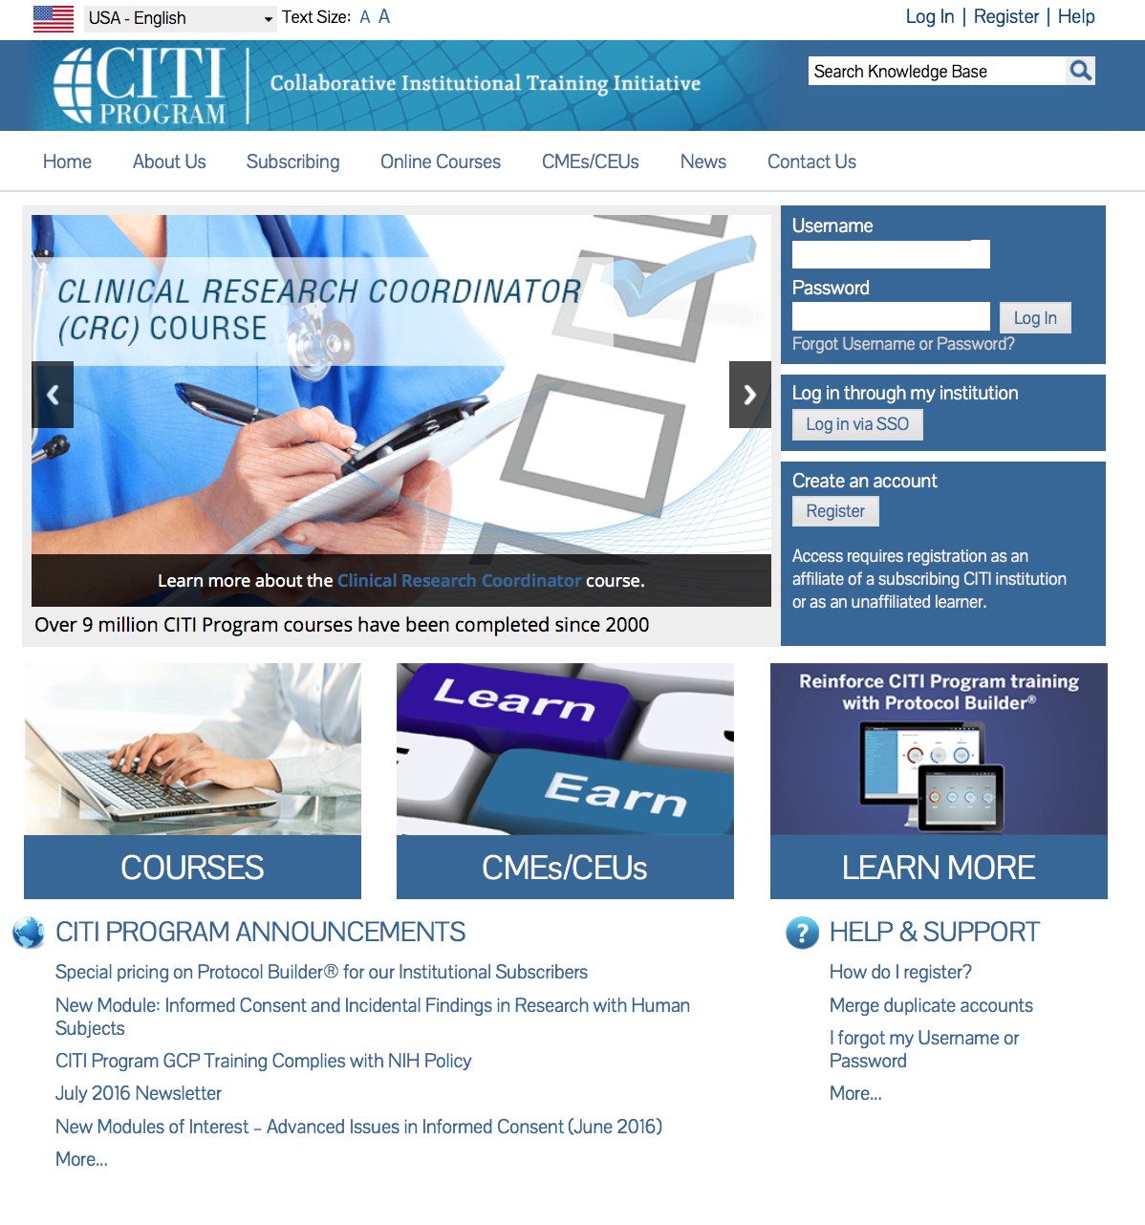
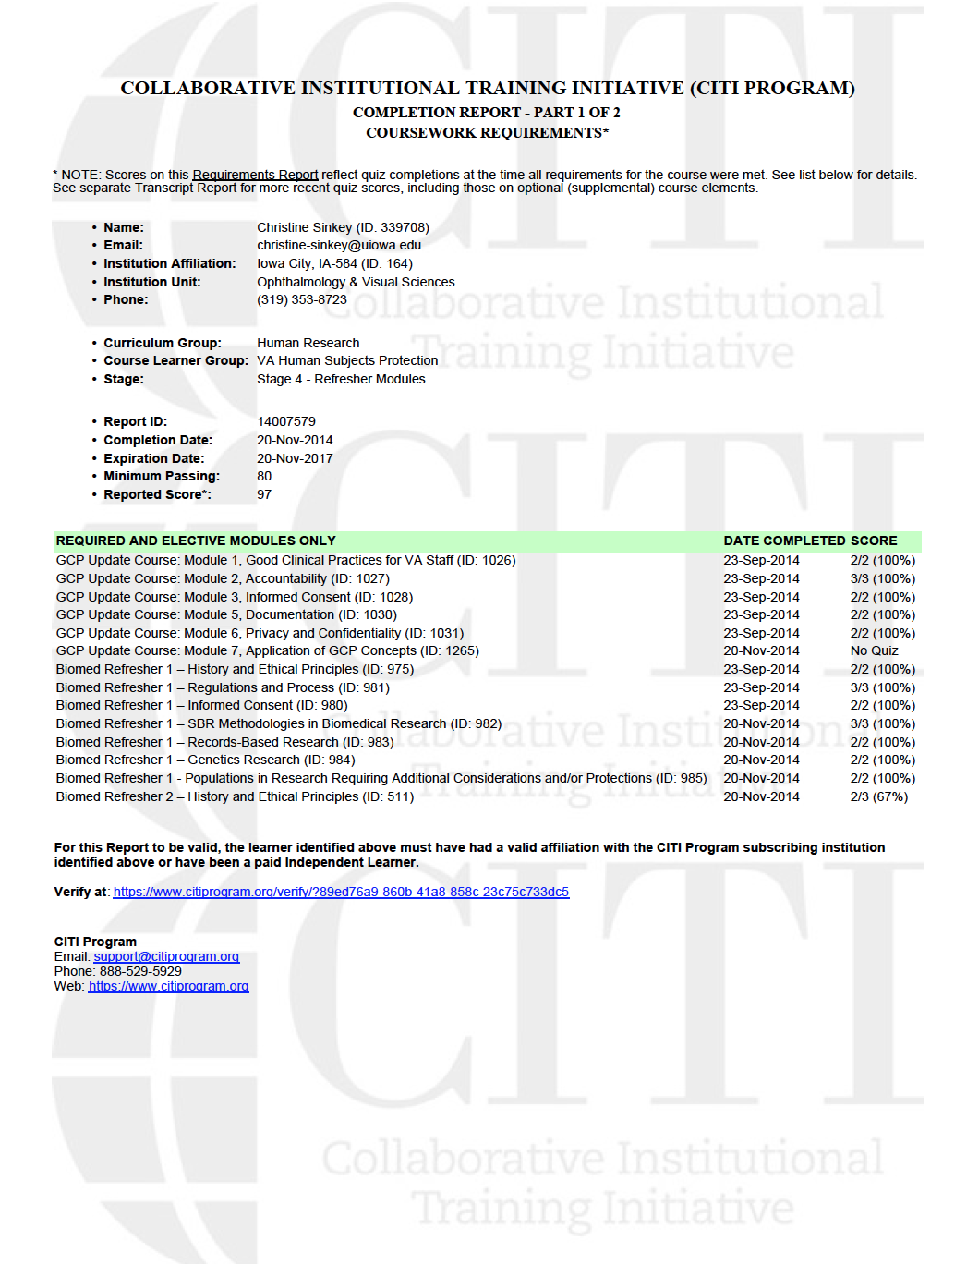
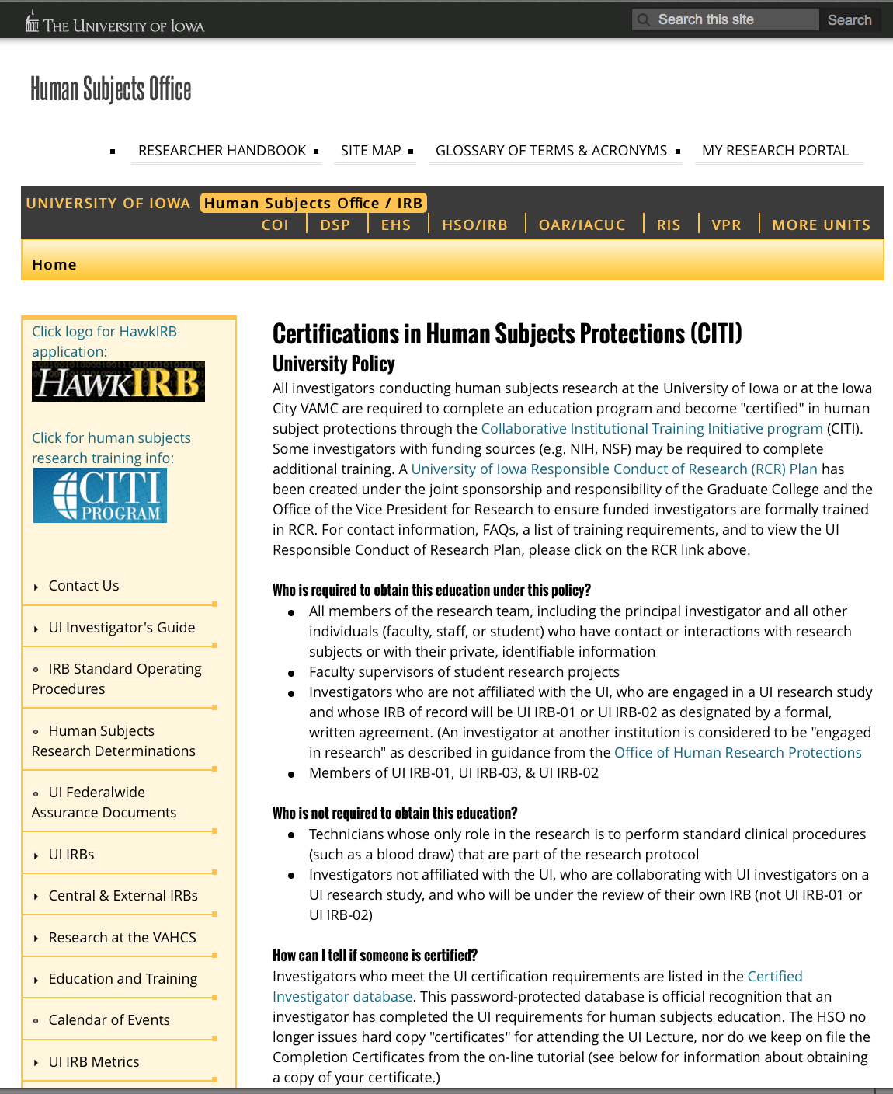
Research Educational Training HSP & GCP
https://www.citiprogram.org

Slide 36
Financial Disclosure Forms (FDF)
Signed Financial Disclosure Forms (FDF) for Principal Investigator, sub-investigator(s), and
applicable research team members listed on the 1572. Protocol title and number should
match the title and number listed.
If any of the five financial interest questions are checked “Yes” a statement addressing the
nature and amount of the interest, arrangement, or payment must be attached to the FDF.
The FDF form is required for any clinical study submitted in the marketing application that the
applicant or FDA relies on to establish that the product is effective and any study in which a
single investigator makes a significant contribution to the demonstration of safety.
FDA Form 3410: Confidential Financial Disclosure Report
FDA Form 3453: Certification: Financial Interests and Arrangements of the Investigators
FDA Form 3455: Disclosure: Financial Interests and Arrangements of the Investigators
Link for additional information: http://www.fda.gov/downloads/regulatoryinformation/guidances/ucm341008.pdf

Slide 37
Screening/Enrollment
Keep a log without identifying information that lists subjects who were
screened including reasons for screen failures.
Site screening plan. **Know what your IRB Application Screening Plan
Subjects may be tracked separately on logs, such as a coded list with key
If screening and enrollment and enrollment information is entered into an
electronic data capture (EDC) system. Please include a memo explaining
the process.
Enrollment log with assigned study codes; dates enrolled, terminated,
and completion.

Slide 38
Subject Visit Tracking Log
Log all enrolled subject visits
Reasons for Early Termination (ET)
Tracks/keeps scheduled visits as per protocol
Electronic schedule log for optimum compliance in studies
with specified appointment/procedure visit windows
Subject Identification Code List
Confidential list of subject names
Link between identity and study code to allow only the
Investigator to reveal identity of any subject

Slide 39
Study Product Records
Documentation of study product disposition
Investigational Product Accountability Log: Stock Record
Investigational Product Accountability Log: Subject Dispense Record
Investigational Drug Services (IDS) could maintain these records,
especially if the study product is masked to the research team.
Make Note To File in Regulatory Binder as to location of log documents
for monitor visits.
Product shipment communication, temperature logs and receipts.

Slide 40
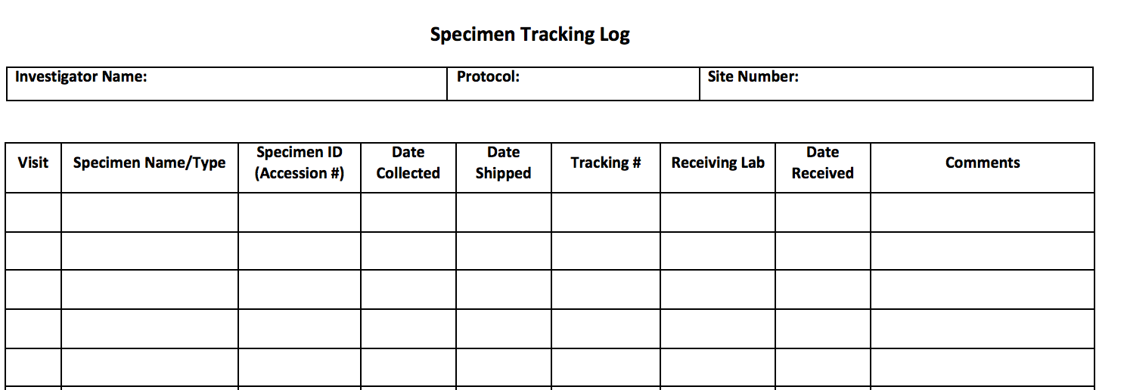
Local Clinical Lab Certificates/Reference Ranges
Clinical Laboratory Documentation
Laboratory reference ranges
Copy of laboratory certification and accreditations
PI review, sign and date all laboratory reports
Lab Specimen Tracking Log
Specimen sample log
Shipping documentation
Storage temperature logs

Slide 41
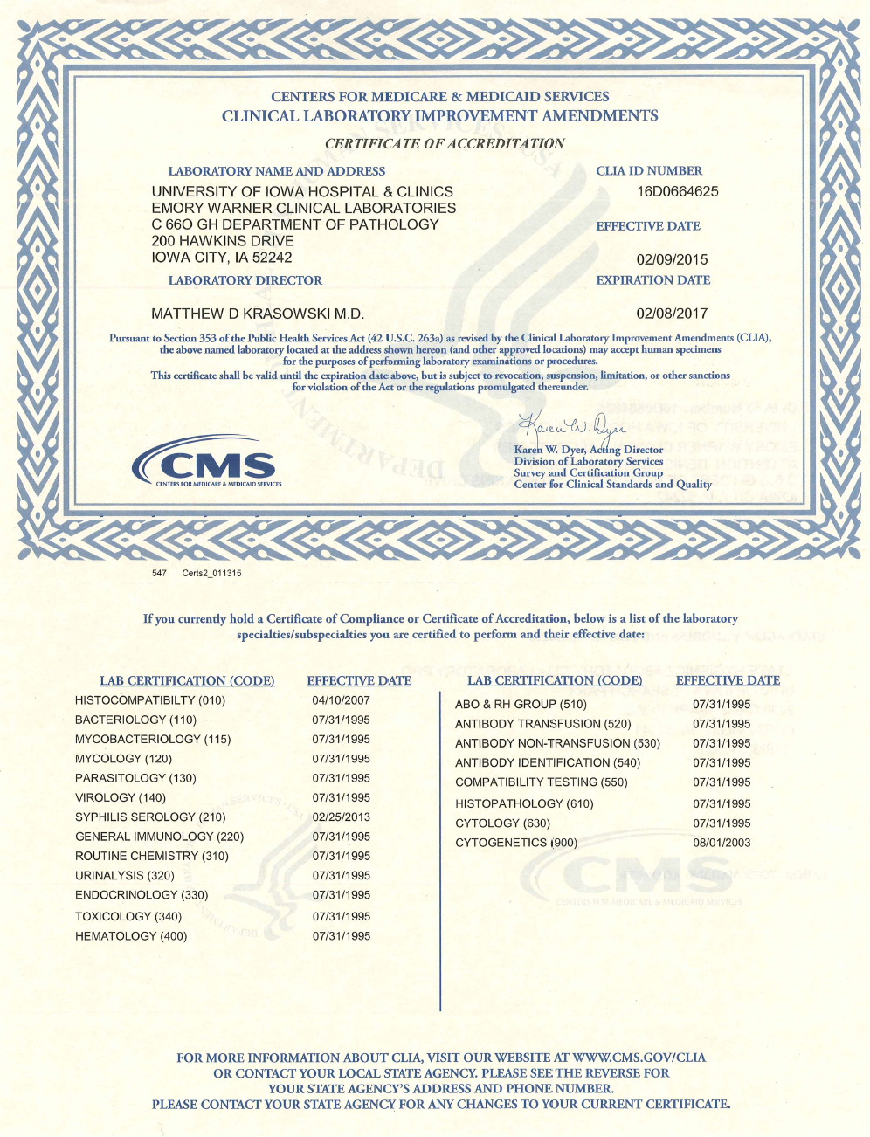
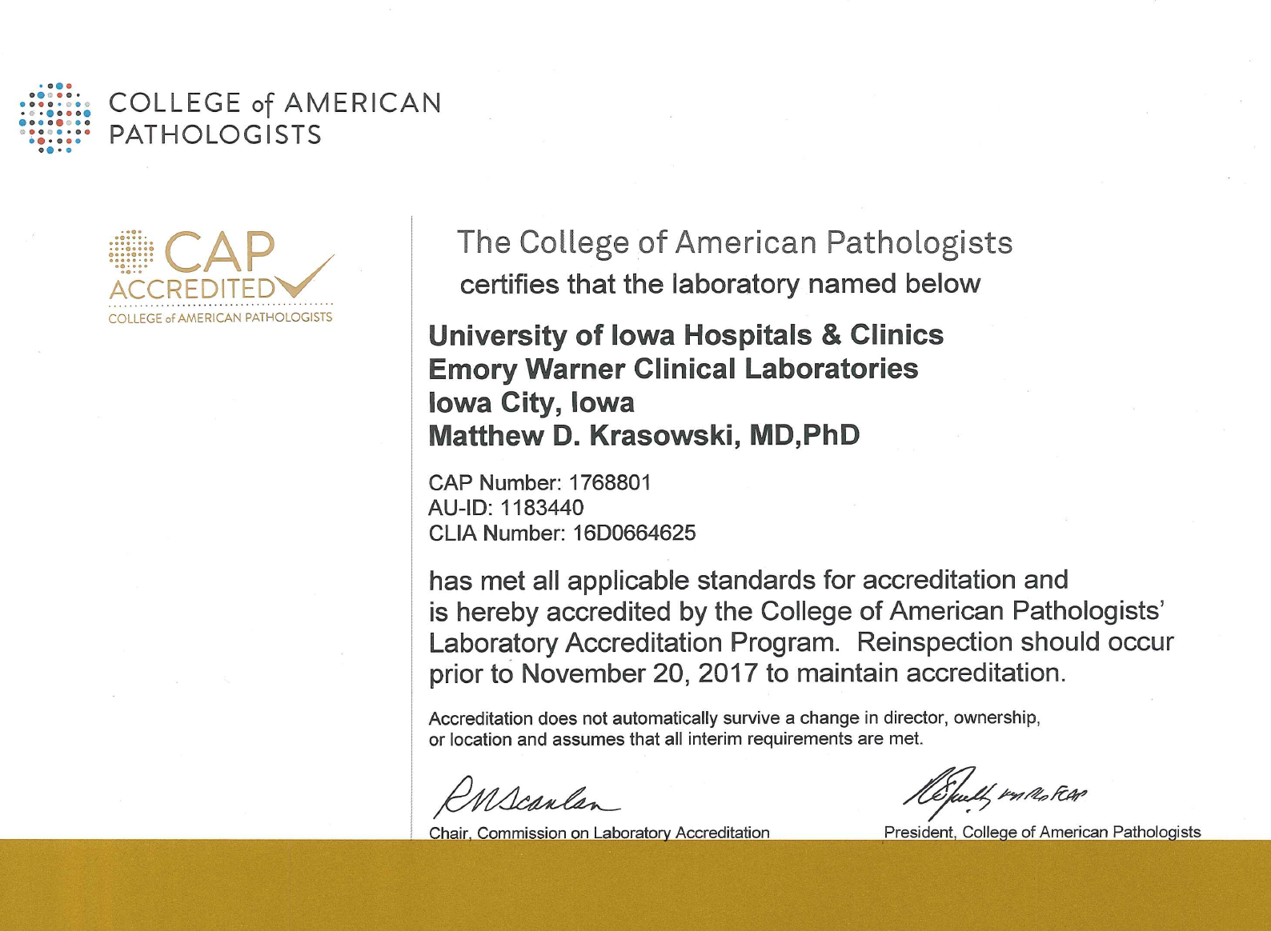
Clinical Lab Certificates
https://www.medicine.uiowa.edu/pathology/research/pathology-clinical-trials-support-core

Slide 42
Serious Adverse Events (SAEs)
Adverse Events Reporting
SAE forms or memos
Correspondence, copies and acknowledgement of
reports of internal AEs
External reports to IRB, Sponsor, regulatory authorities
IND Safety Reports
AE/SAE Log
Unanticipated Problems
Unanticipated Problems reports to IRB, Sponsor and
regulatory authorities

Slide 43
Clinical Site Monitoring Visits
Monitoring Signature Log/Visit Record signed and dated by both the
monitor and research team member involved with the site visit(s)
Study Initiation Visit (SIV)
Interim Monitoring Visit (IMV)
Close-Out Visit
File original letter documenting the visit announcement
File each visit’s correspondence
Post visit follow up reports/letters documenting the findings
Completed Action Items from monitor visit to ensure any outstanding
issues have been resolved

Slide 44
Study Communication
Letter of Understanding/Confidentiality Agreement
Data Sharing Agreement/Material Transfer Agreement
Signed agreements between parties (i.e., sponsor/investigators)
Important decisions regarding study conduct, such as notes to the Study File Notes to File (NTF)
All printed communication (i.e., emails) needs to be signed and dated by the individual printing and
storing the document. Can be saved to a compact disc (CD) for electronic storage and noted on
Note To File.
Electronic media must be permanent media, and must be appropriately secured and approved
(i.e., password protected). Memo Note To File describing the types of electronic media, start and
stop dates of email correspondence, and the signature and date of the individual creating the CD and
writing the memo.
Regulatory Document History Log
Document changes in electronic devices; Example: a study member receives a new computer or if a
newer version of software.

Slide 45
Guideline for Writing Notes to File
Notes to File (NTF)
Discrepancy or Problem:
Root cause of the identified problem
Identify the corrective action taken to prevent recurrence of the problem
Document that the corrective action has resolved the problem
The note should be forward-looking and not seek to explain an error discovered
Print on institution letterhead initiated and authored by an individual responsible for its content
Notes:
Written to identify a discrepancy or problem in the conduct of the clinical research study to note:

Slide 46
Guideline for Writing Notes to File
Notes to File (NTF)
Retention and Distribution:
NTF should be kept on site in the site regulatory file
Made available to the clinical site monitors reviewing the site’s documents and procedures.
If applicable, send a scanned pdf to a Data Management Center (DMC)
If the issue relates to PI responsibilities (e.g., human subject protection, data integrity at the site), the PI should write and sign the note to file
If the issue relates to actions taken by the sponsor or monitor (e.g., clarification of a protocol section), an appropriate credentialed individual from the sponsor should write and sign the note to file.

Slide 47
Research Documentation
Key Definitions: Documentation
Source Documents are original records and certified copies of original clinical findings and observations, or other activities in a clinical trial necessary for the reconstruction and evaluation of the trial. Section 1.51 ICH E6 GCP
Case Report Forms (CRF’s) A printed, optical, or electronic document
designed to record all of the protocol required information to be reported to the
sponsor for each trial subject (Section 1.11 ICH E6 GCP) to capture essential
source data about the subject for analysis to answer the hypothesis of a study.
**TIP: All Source must have a signature and date, original or electronic, by the person
creating the source

Slide 48
Research Documentation
Definitions Key to the Data Management Plan
Data Management: Is the responsibility of the research staff and a host of other IT professionals related to collecting, entering, securing, and preserving data as a valuable, and reproducible resources for the outcome of the study.
Data Integrity: Includes the development of policies and ethical practices for consistent procedures that properly manage the full data lifecycle needs for the outcome of the clinical trial. The principal investigator (PI) is the person responsible for data integrity, but must rely on the team of research professional in IT and the research coordinator to uphold the policies.
TIP: All Source must have a signature, original or electronic, by the person creating the source

Slide 49
Key Members for Source Data Lifecycle to Achieve Data Integrity
Research Documentation
It involves many different research members!
• Clinicians, Nurses, Ancillary Staff and Clinical Research Coordinators (Site)
• Clinical Research Associates or CRA Monitors (Industry)
• Data Safety Committee (DSC) monitors
• Data Offices (Industry)
• Database Managers
• Biostatisticians (Site or Industry)
• Nurses, Doctors who manage safety offices for drug manufacturers(Industry)
* *TIP: The Investigator is the custodian of the Data Chain at the site level

Slide 50
Research Documentation
What Does Data Integrity Look Like?
RELENTLESS
PASSION
Accuracy
Completeness
Timeliness
Carry out protocol precisely as written
Attention to detail
Follow GCP guidelines
Data entry & Corrections
Notes:
DATA INTEGRITY:
#1 A relentless attention to detail and an impeccable ability to: Follow GCP guidelines, and
Carry out the protocol precisely as written
#2 A passion for Accuracy, Completeness, Timeliness of data entry, and data corrections
No longer are the academic medical centers the sole or primary site for cutting edge clinical research. By 2005 more than 70% of US Clinical trials were being done by private sector physicians. These climbed from 4,000 in 1990 to a staggering 20,250 in 2010
The pharmaceutical industry has turned to commercial oriented network of physicians practicing in private offices in order to perform clinical research.
This has transformed private physicians into physician-investigators and their patient into patient-subjects.
This transition into the private office setting impacts the practice on the doctor=patient relationship and the research enterprise.
Wary of the potential conflict between the two roles that the physician serves the well-being of the patients and the investigator whose aim is to further activities which contribute to the development of generalizable knowledge.
Further complicated by the monetary compensation that is provided by the pharmaceutical companies and active retention of research subjects.

Slide 51
Documentation
Good Documentation Practice (GDP)
Standards by which accurate and complete study
Documents are created and maintained.
Study documents and data collection forms record the details of the study for that participant.
“Tells the story” of the participant in the study.
Complete and accurate study documentation supports the fundamental principle of protection of study participant’s safety, rights, and well-being.

Slide 52
Source Documentation
Good Documentation Practice
Original paper clinical visit note by a clinical licensed professional (i.e., nurse, physician, ARNP)
Electronic Medical Record (EMR) notes or reports scanned into the EMR from outside medical offices.
Test results printed from an institutional EMR
Pathology reports and/or procedure(s) results
Specific form created by the CRU for the study to record a mandatory process required by the protocol (i.e. PK sample statement log, patient drug diary, procedure orders)
**TIP: All Source Documents - original or electronic - must have a signature and date, by the person creating the source. When applicable the PI.

Slide 53
Capturing Study Information
Good Documentation Practice
Document what is - and what is not – done.
Include reasons for any missed information.
Use of indelible blue or black ink on paper forms.
Reduces fading over time or smudging
No pencils, felt-tipped markers or white-out
No back or future dating – use of current date when entries are made.

Slide 54
Capturing Study Information
Good Documentation Practice
Discourage use of “ditto” marks for repetitive data.
For any instrument printouts, adhere printout to chart with clear adhesive tape and include initials and date where the printout is attached.
Any printouts sent for data purposes need to be coded and de-identified of subject’s health information. Maintain original source document.

Slide 55
Study Documentation
Good Documentation Practice
Documentation should follow the course of the participant in the study:
Consent Process → Study Visits → Completion/or Discontinuation
Examples of Source Documents can include:
Tracking database
Electronic medical records, clinic notes and research charts
Lab, imaging and radiography reports
Consent documents and process documentation
Visit checklists
Participant questionnaires, participant diaries
Medication lists, pharmacy records

Slide 56
Attributes of GDP: “ALCOA”
Good Documentation Practice
Attributable - it should be clear who has documented the data.
Legible - readable and signatures identifiable.
Contemporaneous - the information should be documented in the correct time frame along with the flow of events.
Original – original or exact copy (photocopy preferred over 2nd original); the first record made by the appropriate person. Originals maintained at satellite locations during the study with copy to PI. Originals filed with PI at conclusion of study for records retention.
Accurate - accurate, consistent and real representation of facts.
21 CFR 58.130 (e)
Notes:
If it wasn’t document, it wasn’t done!
ALCOA has its roots in the Federal Regulations governing good laboratory practice for non-clinical laboratory studies, or 21 CFR 58.130 (e)
“ALCOA” remains the practice for FDA auditor and quality assurance professionals regarding clinical practice.

Slide 57
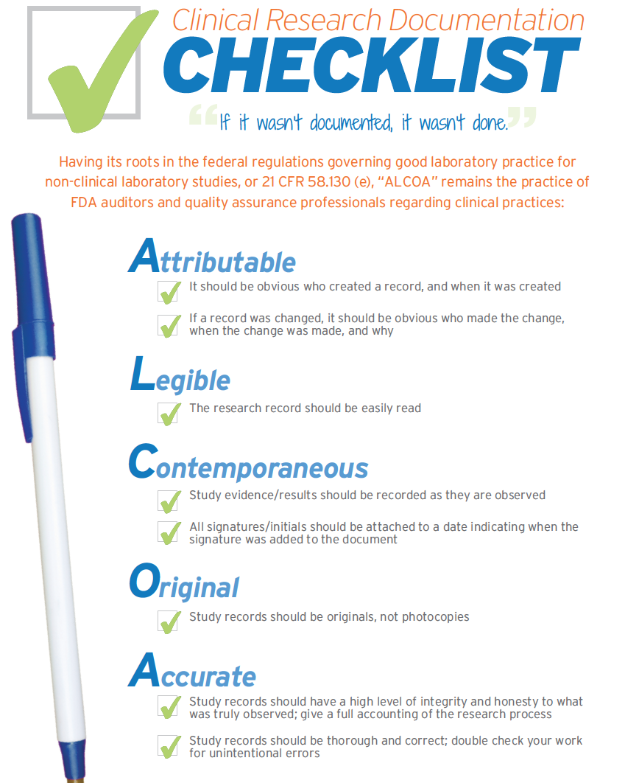
http://www.imarcresearch.com/blog/alcoa-the-best-way-to-document-your-work

Slide 58
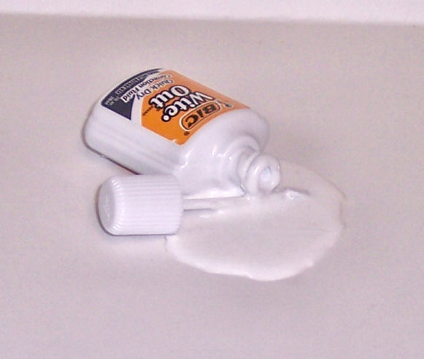
Correcting Study Information
Good Documentation Practice
Corrections are expected!
Single line through incorrect information, making sure not to obscure the original data
No white out or writing over data (e.g. turning a 0 into a 9) because it hides the original data
Enter the correct information
Initial and date when the corrections were made
Entries on study documents and changes to those entries should be made by study team members with the authority to do so as delegated by the PI.

Slide 59
Source Documentation
If it is not documented it did not happen!
ALCOA =
Attributable-Legible-Contemporaneous-Original-Accurate
No white out if paper
Single Line through incorrect data, must be legible
Date and initial changes any additions by appropriate research staff person
Electronic Medical Records present security, and other legal challenges; know your institutional regulations at UIHC
TIPS: Always follow research documentation guidelines per SOP!

Slide 60
Optimize Documents
Good Documentation Practice
- Minimize impact by collecting only Essential Data
- Relevant and critical to safety and effectiveness endpoints
- Meet all guidance recommendations, where applicable
- Capture via checklist, limit to numbers, and or to a few
descriptive words
- “Less can be more” – avoid duplicate copies
Errors happen!

Slide 61
What is ClinicalTrials.gov?
ClinicalTrials.gov is a clinical trial registry and results data bank operated by the National Institutes of Health (NIH). Section 801 of the FDA Amendments Act (Food and Drug Administration FDAAA 801) requires the registration and submission of the results of applicable clinical trials – which include those involving FDA INDs.
The Federal Registration deadline is no later than 21 days after enrollment of the first participant.
If there is a plan to publish the data, the International Committee of Medical Journal Editors requires registration prior to the enrollment of the first subject.
After submission to CT.gov, the review process can take up to 30 days.
Once accepted, the record including the CT.gov registration number or the National Clinical Trial (NCT number) will be available on their website within 2-5 business days.
Currently the UI-IRB, investigator-initiated studies must document the PI as the “Responsible Party". If the UI is the IRB of record, you will need to provide the NCT number in HawkIRB Section VII.B.1.b.

Slide 62
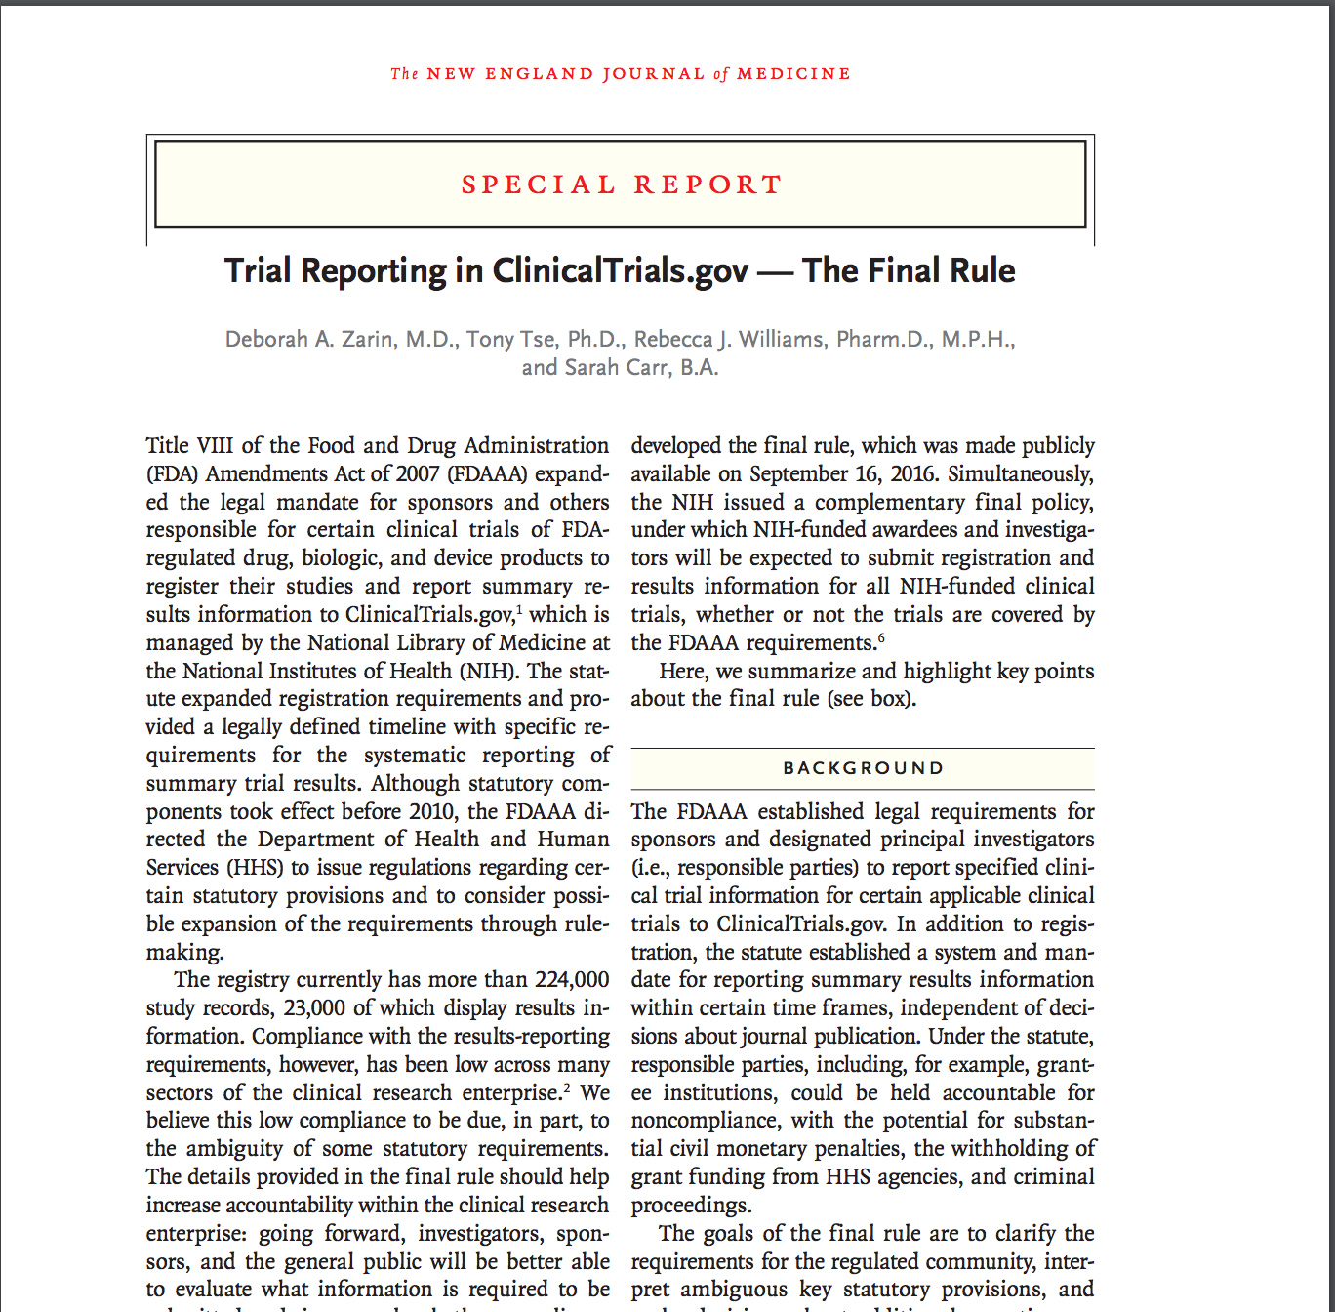
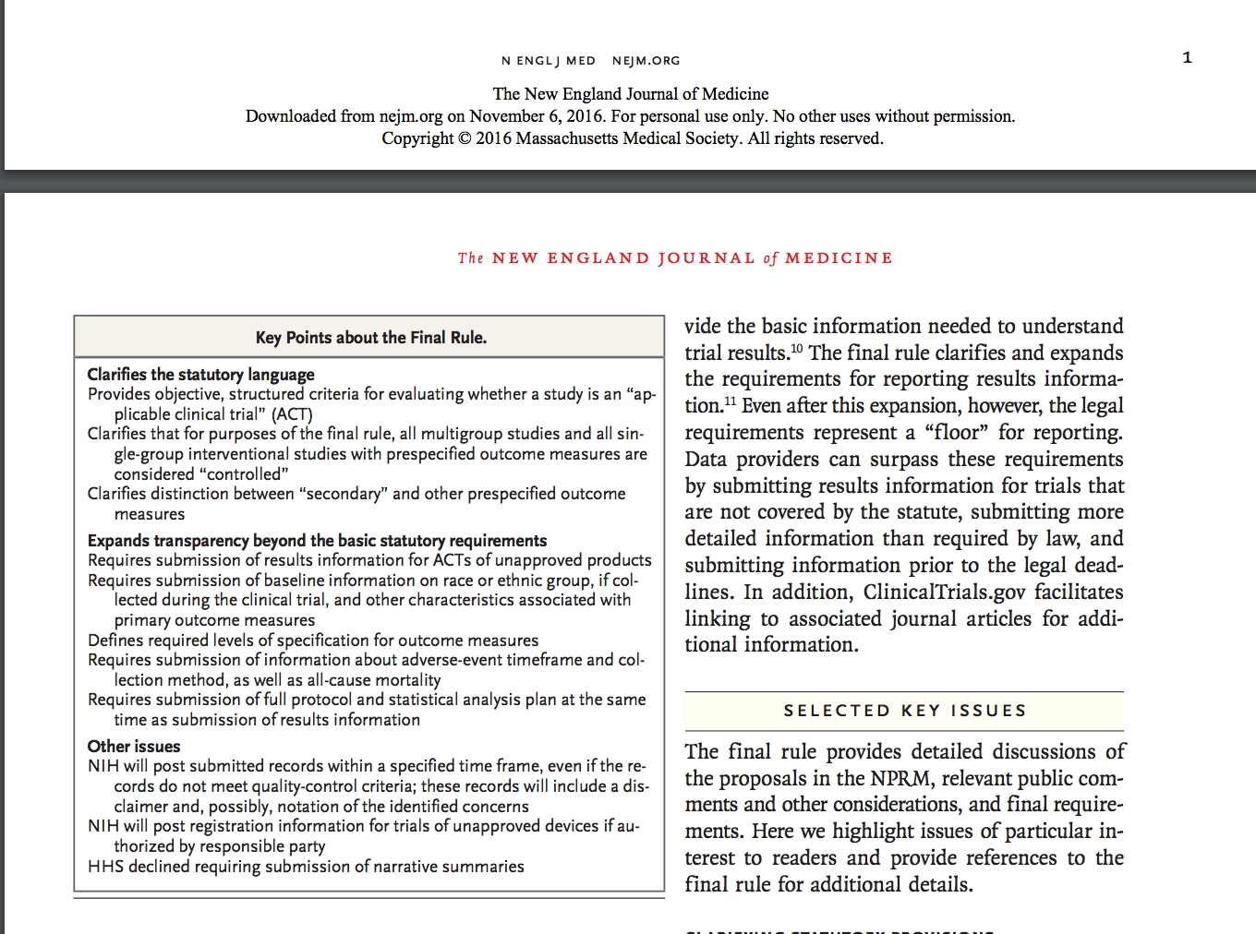
Final Rule for FDAAA 801
https://www.nih.gov/news-events/news-releases/hhs-take-steps-provide-more-information-about-clinical-trials-public

Slide 63
Final Rule for FDAAA 801
NIH Policy on Clinical Trial Report
https://www.nih.gov/news-events/news-releases/hhs-take-steps-provide-more-information-about-clinical-trials-public

Slide 64
Changes will effect: 1) Informed Consent Requirements - Concise summary of ‘key information’ - Updated pre-negotiated language with central IRBs, NCI,CIRB, and commercial - Future use of biospecimen disclosure - Commercial use disclosure - Whole genome sequencing disclosure (WGS) 2) Continuing Review Reduction 3) New FWA and OHRP Reach - IRBs no longer need to submit IRB members to OHRP - OHRP has direct regulatory jurisdiction over external IRBs **FDA is Not a Common Rule Agency
Common Rule Proposed Changes

Slide 65
Tool Box of Documentation Resources
Websites and Links for more information:
https://nccih.nih.gov/grants/toolbox#startup
Register the Clinical Trial(s) http://www.clinicaltrials.gov
ICH E6 Guidance: http://www.ich.org/fileadmin/Public_Web_Site/ICH_Products/Guidelines/Efficacy/E6_R1/Step4/E6_R1__Guideline.pdf
Electronic Code of Federal Regulations http://ecfr.gpoaccess.gov/cgi/t/text/text-idx?c=ecfr&tpl=%2Findex.tpl
University of Iowa Resources – Human Subjects Office & HAWKIRB: https://hso.research.uiowa.edu
Final Rule: https://www.nih.gov/news-events/news-releases/hhs-take-steps-provide-more-information-about-clinical-trials-public
NIDCR’s Toolkit for Clinical Researchers: http://nidcr.nih.gov/research/toolkit
Office for Human Research Protections (OHRP): http://www.hhs.gov/ohrp/

Slide 66
PART 2
WARNING:
The following content may cause drowsiness

Slide 67
Objectives
Safety of the Subjects (Part 2)
Key definitions
Identifying, documenting and reporting Adverse Events
Investigator Responsibilities
How are research participants protected?
Safety related roles in clinical research
Notes:
This is a pretty broad topic area and this has been discussed in the context of the other presentations you’ve already heard. But I would like to focus on some key definitions, specifically Adverse Events – identifying, documenting and reporting AEs.
I’ll also talk about investigator responsibilities in the context of the federal regulations, institutional policies, and guidelines that we work within and I hope to help answer the question, “How are research participants protected?”
Need to document everything you do or don’t do, you have to report to various people and committees and you have to be prepared to explain why you did or did not do something.

Slide 68
Safety of the Subjects (Part 2)
Background
45 CFR 46 & ICH E6 GCP Provides Guidance and Standards
Rights, safety, and well-being of subjects
Roles and Responsibilities of Investigators and Research Staff
Study conduct and protocol management
Safety reporting
Documentation and Record Keeping

Slide 69
Regulatory Guidelines for Safety Reporting
Safety Reporting
Monitoring of adverse events (AEs) is critical to the patient’s safety (i.e. human subjects protection) and data integrity.
Enhance the safety of patients in clinical trials by improving the quality of safety reports submitted to the FDA – Food and Drug Administration under the DHHS
Final Rule lays of clear definitions and standards so that critical safety information about new drugs will be accurately reported to the agency, minimizing uninformative reports and enhancing reporting of meaningful, interpretable information in humans

Slide 70
Safety Reporting
Adverse Events
It is important that multiple clinical terms have been used to convey as Adverse Event (AE) including:
Toxicity
Side effect
Acute or late effect
Complication
All directing to a change possibly caused by treatment
All of the terms above imply that an intervention caused the event which is not the definition of an AE

Slide 71
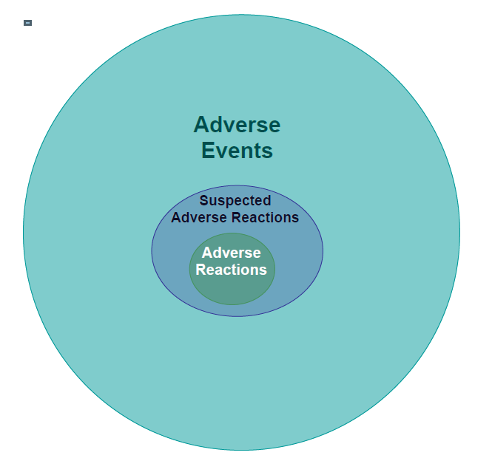
Terms
The Universe of Adverse Events
The diagram depicts the relationship between
adverse events,
suspected adverse reactions,
and adverse reactions.

Slide 72
Terms
Adverse Event (AE)
Suspected Adverse Reaction (SAR)
Adverse Reaction
Unexpected
Serious
Life-Threatening

Slide 73
Definitions FDA revised requirements 21 CFR 312.32 and 312.64(b)
Safety Reporting
1. Adverse Event (AE) means:
“any untoward medical occurrence associated with the use of a drug
in humans, whether or not considered drug related.’ (FDA 21 CFR 312.32(a))
Also referred to as an “adverse experience” can be any unfavorable and unintended sign in a human
subject (e.g. an abnormal laboratory finding ), symptoms, or disease temporally associated with the use of
the drug or with a subject’s participation in the research and does not imply any judgment about causality.
An Adverse Event can arise with any use of a drug (e.g. off-label use, use in combination with another
drug), with any route of administration, formulation, or dose, including an overdose.
Notes:
FDA regulations define an adverse event as any untoward medical occurrence associated with the use of a drug in humans, whether or not considered drug related.
HHS regulations, 45 CFR 46, does not define the term Adverse Event but OHRP guidelines recognize this and reference GCP guidelines. This definition provides a little more detail but regardless of the definition used, the takeaway is pretty much anything unfavorable or unpleasant that occurs in a research subject.
AEs are a reality of human subjects research, but it’s important to remember that not all adverse events are reportable.
Just because an AE occurs, does not mean it meets the reporting requirements of the Sponsor, FDA, IRB or other committee reporting requirements. Adverse Events happen every day, outside of research. We all suffer Adverse Events. However, while they may not always be reportable they are often recordable and that is where it is important to know your study’s protocol but I’ll come back to this later.

Slide 74
Safety Reporting Definitions
2. Suspected Adverse Reaction (SAR) means:
“any adverse event for which there is a reasonable possibility that
the drug caused the event.” (FDA 21 CFR 312.32(a))
For the purposes if Investigational New Drug (IND) safety reporting, ‘reasonable possibility‘ means there is evidence to
suggest a causal relationship between the drug and adverse event. A Suspected Adverse Reaction implies a lesser
degree of certainty about causality than adverse reaction, which means an adverse event caused by a drug.
Suspected Adverse Reactions are the subset of all adverse events for which there is a ‘reasonable possibility’ that the
drug caused the event. The requirement to report a SAR, the sponsor needs to evaluate the available evidence and make
the judgment about the likelihood that the drug actually caused the adverse event.
The FDA ‘reasonable possibility’ causality standard is consistent with the International Conference on Harmonization
(ICH) E2A guidance with respect to who is responsible for making the judgment. The ICH E2A guidance recommends
judgment is based on either the investigator’s or the sponsor’s opinion.
Notes:
FDA regulations define an adverse event as any untoward medical occurrence associated with the use of a drug in humans, whether or not considered drug related.
HHS regulations, 45 CFR 46, does not define the term Adverse Event but OHRP guidelines recognize this and reference GCP guidelines. This definition provides a little more detail but regardless of the definition used, the takeaway is pretty much anything unfavorable or unpleasant that occurs in a research subject.
AEs are a reality of human subjects research, but it’s important to remember that not all adverse events are reportable.
Just because an AE occurs, does not mean it meets the reporting requirements of the Sponsor, FDA, IRB or other committee reporting requirements. Adverse Events happen every day, outside of research. We all suffer Adverse Events. However, while they may not always be reportable they are often recordable and that is where it is important to know your study’s protocol but I’ll come back to this later.

Slide 75
Safety Reporting Definitions
3. Adverse Reaction (AR) means:
“any adverse event caused by a drug” (FDA 21 CFR 312.32(a))
Adverse Reactions are a subset of all adverse events
for which there is a reason to conclude that the
drug caused the event.
Notes:
FDA regulations define an adverse event as any untoward medical occurrence associated with the use of a drug in humans, whether or not considered drug related.
HHS regulations, 45 CFR 46, does not define the term Adverse Event but OHRP guidelines recognize this and reference GCP guidelines. This definition provides a little more detail but regardless of the definition used, the takeaway is pretty much anything unfavorable or unpleasant that occurs in a research subject.
AEs are a reality of human subjects research, but it’s important to remember that not all adverse events are reportable.
Just because an AE occurs, does not mean it meets the reporting requirements of the Sponsor, FDA, IRB or other committee reporting requirements. Adverse Events happen every day, outside of research. We all suffer Adverse Events. However, while they may not always be reportable they are often recordable and that is where it is important to know your study’s protocol but I’ll come back to this later.

Slide 76
Safety Reporting Definitions
4. Unexpected means:
“an adverse event or suspected adverse reaction considered ‘unexpected’ if it is
not listed in the investigator brochure or is not listed at the specificity or severity
that has been observed or, if an Investigator brochure is not required or available,
is not consistent with the risk information described in the general investigational
plan, protocol or elsewhere in the current application.” (FDA 21 CFR 312.32(a))
For the purposes if Investigational New Drug (IND) safety reporting, ‘reasonable possibility‘ means there is evidence to
suggest a causal relationship between the drug and adverse event. A Suspected Adverse Reaction implies a lesser
degree of certainty about causality than adverse reaction, which means an adverse event caused by a drug.
Suspected Adverse Reactions are the subset of all adverse events for which there is a ‘reasonable possibility’ that the
drug caused the event. The requirement to report a SAR, the sponsor needs to evaluate the available evidence and make
the judgment about the likelihood that the drug actually caused the adverse event. The FDA ‘reasonable possibility’
causality standard is consistent with the International Conference on Harmonization (ICH) E2A guidance with respect to
who is responsible for making the judgment. The ICH E2A guidance recommends judgment is based on either the investigator’s or the sponsor’s opinion.
Notes:
FDA regulations define an adverse event as any untoward medical occurrence associated with the use of a drug in humans, whether or not considered drug related.
HHS regulations, 45 CFR 46, does not define the term Adverse Event but OHRP guidelines recognize this and reference GCP guidelines. This definition provides a little more detail but regardless of the definition used, the takeaway is pretty much anything unfavorable or unpleasant that occurs in a research subject.
AEs are a reality of human subjects research, but it’s important to remember that not all adverse events are reportable.
Just because an AE occurs, does not mean it meets the reporting requirements of the Sponsor, FDA, IRB or other committee reporting requirements. Adverse Events happen every day, outside of research. We all suffer Adverse Events. However, while they may not always be reportable they are often recordable and that is where it is important to know your study’s protocol but I’ll come back to this later.

Slide 77
Safety Reporting Definitions
5. Serious means:
“any adverse event or suspected adverse reaction is ‘Serious’ if, in
the view of either the investigator or sponsor, it results in any of the
following outcomes:
* Death or
* A life-threatening adverse event, or
* Inpatient hospitalization or prolongation of existing hospitalization, or
* Persistent or significant incapacity, or
* Substantial disruption of the ability to conduct normal life functions, or
* Congenital anomaly/birth defect.
Important medical events that may not result in death, be life-threatening, or require hospitalization may be considered
serious when, based upon appropriate medical judgment, they may jeopardize the patient or subjects and may require
medical or surgical intervention to prevent one of the outcomes listed in the definition. (FDA 21 CFR 312.32(a))
Notes:
FDA regulations define an adverse event as any untoward medical occurrence associated with the use of a drug in humans, whether or not considered drug related.
HHS regulations, 45 CFR 46, does not define the term Adverse Event but OHRP guidelines recognize this and reference GCP guidelines. This definition provides a little more detail but regardless of the definition used, the takeaway is pretty much anything unfavorable or unpleasant that occurs in a research subject.
AEs are a reality of human subjects research, but it’s important to remember that not all adverse events are reportable.
Just because an AE occurs, does not mean it meets the reporting requirements of the Sponsor, FDA, IRB or other committee reporting requirements. Adverse Events happen every day, outside of research. We all suffer Adverse Events. However, while they may not always be reportable they are often recordable and that is where it is important to know your study’s protocol but I’ll come back to this later.

Slide 78
Safety Reporting Definitions
6. Life-Threatening means:
“any adverse event or suspected adverse reaction is ‘Life-Threatening’ if, in
the view of either the investigator or sponsor, its occurrence places the patient
or subjects at immediate risk of death. It does not include an adverse event or
suspected adverse reaction that has it occurred in more severe form, might
have caused death” (FDA 21 CFR 312.32(a))
As with the definition of serious, the determination of whether an adverse event is life-threatening can
be based on the opinion of either the investigator or sponsor. Thus, if either believes that it meets the
definition of life-threatening, it is considered life-threatening. For reporting purposes.
Notes:
FDA regulations define an adverse event as any untoward medical occurrence associated with the use of a drug in humans, whether or not considered drug related.
HHS regulations, 45 CFR 46, does not define the term Adverse Event but OHRP guidelines recognize this and reference GCP guidelines. This definition provides a little more detail but regardless of the definition used, the takeaway is pretty much anything unfavorable or unpleasant that occurs in a research subject.
AEs are a reality of human subjects research, but it’s important to remember that not all adverse events are reportable.
Just because an AE occurs, does not mean it meets the reporting requirements of the Sponsor, FDA, IRB or other committee reporting requirements. Adverse Events happen every day, outside of research. We all suffer Adverse Events. However, while they may not always be reportable they are often recordable and that is where it is important to know your study’s protocol but I’ll come back to this later.

Slide 79
Protocol Adherence
Document investigators’ agreement to follow the protocol
Adhere to the IRB-approved protocol/protocol amendments
Only deviate from the protocol to avoid immediate hazards to subjects
Document and report all protocol deviations to the IRB
Review ALL study documents – manual of procedures (MOP), standard operating procedures (SOP), Investigator Brochure (IB) - to understand the project’s definitions for Adverse Event reporting, time to report to agencies, sponsor, and IRB.

Slide 80
Adverse Event Assessment
The Adverse Event is identified and reported to the Principal Investigator (PI) based on protocol adherence.
Assessment is done by the PI or designated research team member to determine:
Severity of event
Attribution (cause) of the event
The Assessment + Expectedness of the event helps determine the timeliness for reporting to the IRB, sponsor or other regulatory over sight groups.

Slide 81
Adverse Event Assessment
Severity Assessment Tools:
Tools are intended to be an agreed upon terminology
for designation, reporting and grading of AEs that occur.
Examples:
The Common Terminology Criteria for Adverse Events (CTCAE) is used by oncology groups to determine severity of an AE
The Cancer Therapy Evaluation program (CTEP) of NCI developed the original Common Toxicity Criteria (CTC) in the 1980’s to aid in the recognition and severity grading.
Medical Dictionary for Regulatory Activities (MedDRA) System Organ Class (SOC) is a table format listing SOCs alphabetically.
http://ctep.cancer.gov/protocolDevelopment/electronic_applications/ctc.htm

Slide 82
Adverse Event Assessment
Attribution or Relatedness
Establish the Severity of the Event.
The next step is to find the cause, or ATTRIBUTION, of the event.
Is the event related to the study drugs, disease or an
underlying preexisting condition??
It is important to identify what the AE is related to and NOT merely what it is not related to.
Information assists regulatory oversight groups to assess safety and protect human subjects.

Slide 83
Adverse Event Assessment
Determining ATTRIBUTION
The investigator determines the attribution/cause with the input from the research team using the following questions:
What do we know about the drug/therapy/device or classification?
What is the temporal relationship of the AE to the study therapy?
Does the AE improve or disappear when drug/ therapy is stopped?
If the drug/therapy is restarted, does the AE reappear? At the same severity? At the same time point?
Is the AE a result of an existing disease signs and symptoms?
Is the AE a worsening of baseline symptoms?
Is the AE a result of an underlying concurrent medical condition(s) or concurrent medication(s) ?

Slide 84
Adverse Event Assessment
Approaches to Determining Attribution
Attributions: Approach #1
Two Options:
Related: Reasonable casual relationship between the
the AE and _____________
Not Related: No reasonable casual relationship between the AE and _____________
Attributions: Approach #2
Five Options:
Definite--clearly related to ____________
Probable--likely related to ____________
Possible--may be related to___________
Unlikely--doubtfully related to _________
Unrelated--clearly not related to________

Slide 85
Adverse Event Documentation
Know your protocol for AE reporting requirements
Collection of AE information begins at the initiation of the study intervention (drug/procedure)
AE information should be collected from the start of a placebo lead-in period or other observational period intended to establish a baseline status for the patient
Good documentation at baseline of medical history
Evaluate at study start all your Inclusion/Exclusion criteria
AEs should be followed to resolution or stabilization.
Follow up also is required for AEs that cause interruption or discontinuation of the study drug, or those that are present at the end of study treatment .

Slide 86
Adverse Event Documentation
Notify subjects of follow up needed per protocol (early termination visit).
Request subjects sign a Release of Information (ROI) to provide referral and event documentation from outside hospitals/or clinics. Pursue records for ongoing AEs
Actively monitor, ensure care for, and document AEs
Follow to resolution or stabilization
Report AEs to the IRB/Safety Committee and comply with any specific guidance

Slide 87
Adverse Event Documentation
AE Progress Note
All AEs should be documented in the patients’ medical record including any workup or treatment needed.
A good progress note documenting the AE will contain both good clinical practice documentation and good clinical research practice documentation.
Date the AE began (Note: Important to note time of AE, especially with infusion or drug administration reactions.)
Treatment for AE (e.g. no treatment needed, further testing to diagnose event, hospitalization, dose reduction, holding of study intervention).
Event description in enough detail that a CTCAE term or MedDRA grade can be assigned as part of data management activities
Attribution of the AE (Note: Sort out if there is more than one therapy or drug given)

Slide 88
Adverse Event Documentation
AE Progress Note
Before documenting AEs, the research team must understand how AEs should be collected.
Prevent bias collection of AEs. Patients should not be questioned regarding specific events that might be anticipated while on the study.
AEs should be spontaneously reported or elicited from a subject using open ended questions, during the examination and evaluation
Date AE resolved.
If ongoing AE worsens or improves in its severity or its relationship to the study drug changes, documentation should be continuously collected as stated above.

Slide 89
Regulatory Reporting
Safety Reports to Regulatory Oversight Groups
Types of Regulatory Reporting Mechanisms:
1. Routine
- Reporting occurs at the time of continuing review
- At minimum a brief statement that there have
been no unanticipated problems and an AE have occurred at the
expected frequency and level of severity as documented in the
research protocol, the informed consent, and investigator’s
brochure (IB).
- Some IRBs require a summary of all AEs report that occurred on
the protocol since the previous review. May report in table format.
- Know your IRB’s or external IRB of record reporting policy.
2. Expedited

Slide 90
Regulatory Reporting
Safety Reports to Regulatory Oversight Groups
FDA
FDA will be informed by the Sponsor in a summary fashion of AEs in the annual report required by all INDs
The local IRB will ask if a regulatory agency had any communication ‘Yes’. A copy of the report will be requested for the IRB.
Institutional Biosafety Committee (IBC) & Office of Biotechnology Activities (OBA)
Protocols using recombinant DNA will require reports to IBC/OBA.
OBA will be informed in the annual report required for all recombinant DNA studies
**Know your IBC’s policy on routine AE reporting

Slide 91
Regulatory Reporting
Safety Reports to Regulatory Oversight Groups
Sponsor
The AE CRF – if electronic will be informed of a routine AE.
Per FDA regulations, the investigator must record (i.e., enter onto a CRF) non-serious adverse events and report to the Sponsor according to the timetable for reporting specified in the protocol.
Contact when knowledgeable of an AE and that submission will be coming.
Contact study Medical Director for resource.

Slide 92
Regulatory Reporting
Safety Reports to Regulatory Oversight Groups
Expedited Adverse Events
Subset of adverse events that are reported to regulatory oversight groups in an expedited manner
Alias references:
Serious Adverse Event
Serious Adverse Experience
Expedited Adverse Event
Adverse Drug Reaction

Slide 93
Regulatory Reporting
Safety Reports to Regulatory Oversight Groups
Expedited Adverse Events
Serious Adverse Event (SAE) (21 CFR 312, ICH GCP, OHRP Guidance)
Any adverse event occurring at any dose that results in any of the following outcomes:
Death
Life-threatening adverse drug experience
Inpatient hospitalization or prolongation of existing hospitalization
Persistent or significantly incapacity of substantial disruption of the ability to conduct normal life functions
Congenital anomaly/birth defect
OR

Slide 94
Regulatory Reporting
Safety Reports to Regulatory Oversight Groups
Expedited Adverse Events
Serious Adverse Event (SAE) (21 CFR 312, ICH GCP, OHRP Guidance)
Important medical events (IME) that may not result:
In death
be life-threatening
Or require hospitalization
May be considered a serious adverse drug experience when they may:
Jeopardize the patient/subject
AND
May require medical or surgical intervention to prevent one of the outcomes above

Slide 95
Regulatory Reporting
Expedited Adverse Events Report Forms
“Key Information”
Reporter information
Subject demographics
Study agent (date(s) given, dose, route of administration)
Event
Attribution
Narrative summary
Investigator signature
be life-threatening
Or require hospitalization

Slide 96
Regulatory Reporting
Expedited Adverse Events Report Forms
“The Narrative Summary”
Most important section of AE report form
Describe event as if the recipient of the form does not know anything about the subject or their history
Provides background information necessary to assess the event and support the Investigator’s attribution
Description of the Event:
Information that describes the event(s)
Information that puts the events in perspective-Relevant Subject History
Underlying medical conditions; prior surgeries/procedures; family history; recent events that may be a contributing factor
Concomitant medications – sponsor specific e.g., subject medical history, other medical conditions

Slide 97
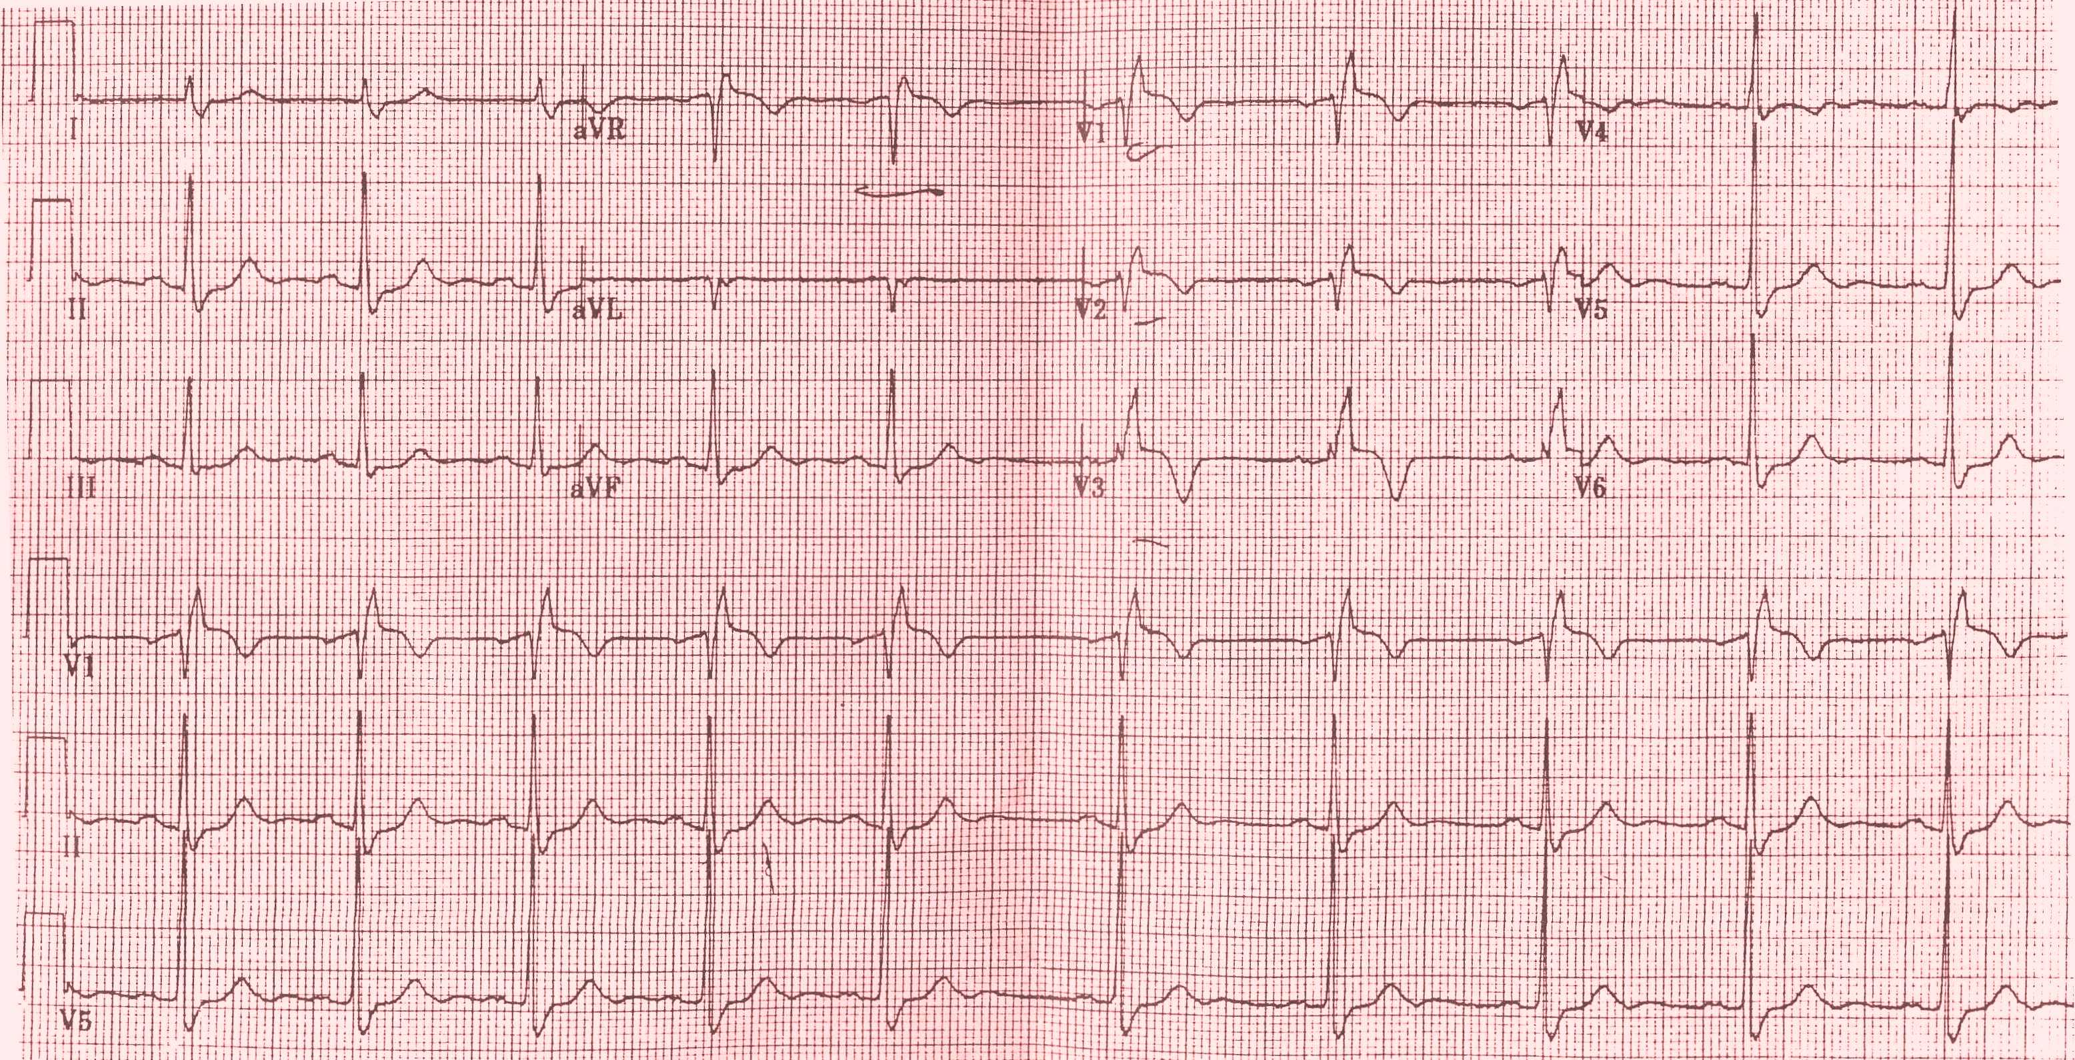
Regulatory Reporting
Expedited Adverse Events Report Forms
“The Narrative Summary”
Supporting Documentation:
Related source documentation should accompany the report.
Remove patient identifiers on documents
When needed to explain the experience
When needed to support the differential diagnosis
Sponsor specific – not always necessary

Slide 98
Regulatory Reporting
Expedited Adverse Events Report Forms
“What To Do If Only Limited Information Available”
Contact treating physician/institution and document all conversations in medical record
Submit what you have:
Most recent clinical evaluation, baseline history and physical
Provide plan for obtaining information
Provide a summary of the event and treatment to date
When additional information becomes available – amend the report or provide dated sequelae follow up information

Slide 99
Regulatory Reporting
Expedited AE Follow-Up Reporting
Follow-up is required when:
there’s a change in the cause/or relatedness of the experience
new information on a death becomes available
requested by the regulatory/oversight group
Follow-up report is NOT required when:
the AE resolves
resolved date will be noted on the adverse event case report form CRF

Slide 100
Regulatory Reporting
Expedited AE Reporting REMINDERS
Expedited Events are a subset of adverse events
All information captured on an expedited event form MUST be present in the source documents AND be found on the adverse event case report form (CRF)
Some events that initially appear to meet expedited reporting requirements may be excluded from the expedited reporting as per the protocol.
***The protocol trumps all other reporting requirements.***
All expedited report forms and any response information from the regulatory/oversight group is to be placed in the Regulatory Binder.

Slide 101
Regulatory Reporting
Unanticipated Problem (UP)
OHRP and FDA require that ‘Unanticipated Problems’ be reported to the IRB.
OHRP
45 CFR 46.103(b)(5) Written procedures for ensuring prompt reporting to IRB, appropriate institution officials of any unanticipated problems involving risks to subjects or others
FDA
21 CFR 56.108(b) Follow written procedures for ensuring prompt reporting to IRB, appropriate institution officials, and FDA of (1) any unanticipated problems involving risks to human subjects or others;
21 CFR 312.66 The investigator shall also assure that he/she will promptly report to the IRB all unanticipated problems involving risks to human subjects or others

Slide 102
Regulatory Reporting
Unanticipated Problem (UP) Definition
An incident, experience, or outcome that meets all of the following criteria:
Nature, severity, or frequency is unexpected for the subject population or research activities as described in the current IRB approved protocol, supporting documents, and the IC document(s)
Related or possibly related to participation in the research
Suggests the research may place the subject or others at a
greater risk of harm than previously recognized
Physical, psychological, economic, or social harm

Slide 103
Regulatory Reporting
FDA Adverse Events that are Unanticipated Problems
FDA Report (7-days) reporting of unexpected fatal or life-threatening SARs
Change to protocol and IC documents is an Unanticipated Problem
IND Safety Report (15-days)
Serious and unexpected suspected adverse reaction
Findings from other studies
Findings from animal or in vitro testing
Increased rate of occurrence of serious suspected adverse reactions

Slide 104
Regulatory Reporting
Protocol Deviation/Violation = Unanticipated Problems
In addition to adverse events, there are protocol deviations/violations that may also meet the criteria to be an unanticipated problem and reportable to the IRB. Examples include:
Malfunctioning infusion pump results in drug being given over 15 minutes versus 1 hour as specified in protocol but subject doesn’t have any AEs
Ineligible subject who receives protocol intervention without any AEs Subject received more drug (10-times) than per protocol but suffers no adverse events

Slide 105
Regulatory Reporting
Unanticipated Problem that is not an AE
or Protocol Deviation/Violation
There are always unanticipated problems that occur that are neither an AE pr protocol deviation/violation. Examples include:
Individually identifiable sensitive information stored on laptop computer without encryption, and the laptop computer is stolen.
Product contamination with no AEs experienced by subjects.
Staff member becomes ill due to odor from IV bag of investigational product but patient with no AEs.
Subject becomes incarcerated during the course of the research.

Slide 106
Regulatory Reporting
OHRP Guidance: Content of UP Report
Appropriate identifying information for the research protocol, such as the title, investigator’s name, and the IRB project number.
Detailed description of the AE, incident, experience, or outcome.
Explanation of the basis of determining that the adverse event, incident, experience, or outcome represents an unanticipated problem.
Description of any changes to the protocol or other corrective actions that have been taken or are proposed in response to the unanticipated problem.

Slide 107
Regulatory Reporting
Correction Action Plan for Unanticipated Problem
Revised protocol:
Modify inclusion or exclusion criteria to mitigate the newly identified risks
Implement additional procedures for monitoring subjects
Suspend enrollment of new subjects
Terminate the research
Informed consent
Revise the IC document
Provide additional information about newly recognized risks to previously enrolled subjects
Inform enrolled subjects
Increase monitoring activities
Encrypt laptops, no identifiable information on laptops
Provide training and /or re-training.
Submit ORS and work with appropriate institutional officials.

Slide 108
Regulatory Reporting
FDA/OBA are looking for an attribution as it relates to an investigational drug/product
IRB is looking for attribution as is relates to the research.
Sponsors may use either one or a combination
This means that an event that is to be reported to a Sponsor may not necessarily be reported to the IRB or FDA.

Slide 109
Regulatory Reporting
SAMPLE: SERIOUS ADVERSE EVENTS LOG
(SAEs occurring at this site)
Investigator: ______________________________________ Project: ________________________________________
Study Site: ______________________________________ Sponsor: ________________________________________
Date SAE Occurred | Date Learned of Event | Patient Number | Event | SAE Form Completed (Y/N) | Date Reported to Sponsor* | Date Reported to IRB** | IRB Acknowledged (Y/N)
*If required by the Sponsor (see protocol for Sponsor requirements) **If required by the IRB (see IRB requirements on SAE reporting, i.e., definitions & timeframes

Slide 110
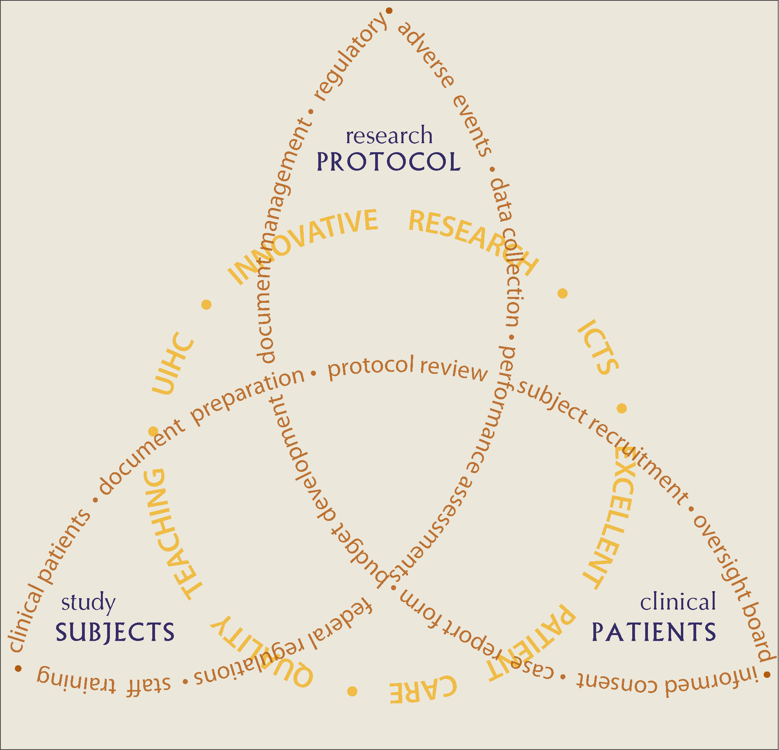
CONCLUSION
It is our responsibility to understand our multiple research roles that most importantly,
impact the right, safety,
and welfare of our:
Clinical patients
Research protocol
Study subjects
Notes:
It is your responsibility to understand your roles with the
Clinical patients
Research protocol
Study subjects

Slide 112
Thank you!
Research studies are designed to answer important questions about disease by testing their safety and effectiveness in patients. Before new medicines, devices or diagnostic tests can be approved for public use, they are all tested in these types of clinical trials.
Notes:
INSERT OWN CONTACT INFORMATION

